Slide 1
‘Patients first’
Garrett Emmerson, Chief Executive Officer
29 June 2017

Slide 2
Our Care Quality Journey since 2015
 | Safe | Caring | Effective | Responsive | Well Led
Outstanding
Good
Requires Improvement
Inadequate
2017
2015
2017
2017
2017
2015
2015
2017
2015
2015

Slide 3
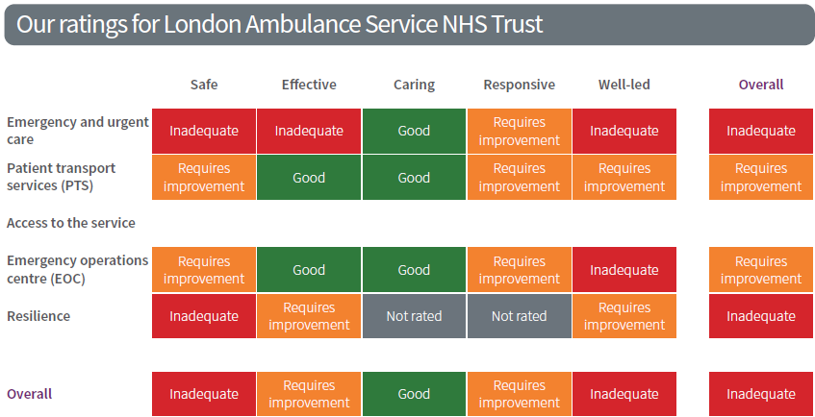
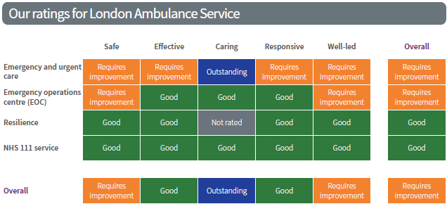
Ratings: London Ambulance Service
Notes:
<Copy and paste this slide for multi site trusts>

Slide 4
What have we done?
Since February 2017
Our plans going forward
Across the five domains…

Slide 5
1. Safety Domain
Since February, we have:
Mandatory and Statutory Training (MAST)
Reviewed our training data making sure it accurately reflects compliance and ensures all staff are properly trained
Produced monthly training dashboard for all managers to highlight actions needed
Enabled access to over 500 e-learning packages for staff to make compliance easier
Developed and agreed a comprehensive action plan to address all identified issues from the CQC inspection

Slide 6
1. Safety Domain
Introduced daily incident & complaint reviews to identify issues earlier and act on them
Set local stretch target of 40 days instead of 60 day national target to complete serious incident investigations – accelerate learning and reduce risk to patients
Reduced 60 day breaches from 25 to 4
Introduced a programme of 16 risk based “deep dive” inspections to identify improvements and learning (for example: hospital handovers)
Begun the process of recruiting 4 full-time posts to provide dedicated capacity to oversee patient safety and support quality agenda ‘from Trust Board to Frontline’
Since February, we have:
Mandatory and Statutory Training (MAST)
Incident reporting and learning

Slide 7
1. Safety Domain
Increased the Infection Prevention and Control (IPC) team by 4 posts, including: 2 Business Partners, 1 Administrator and 1 part-time Micro-Biologist
Appointed 29 Infection Control Champions and trained them to support compliance across the sectors
Rolled out Vehicle “make ready” services to a further 6 sites, taking the total to 11 new hubs (out of 14 planned) to increase standards of hygiene on vehicles
Since February, we have:
Mandatory and Statutory Training (MAST)
Incident reporting and learning
Infection Prevention and Control

Slide 8
1. Safety Domain
Begun rolling out “make ready” hubs – reducing time crews spend at beginning of shifts on vehicle checks
8 new HART vehicles delivered and currently being made ready to ensure more vehicles on the roads to provide more timely response to patients
Improved vehicle preparation and equipment on vehicles, unlocking an extra 5,765 patient facing vehicle hours through a reduction in time off the road – reducing delays for patients
Since February, we have:
Mandatory and Statutory Training (MAST)
Incident reporting and learning
Infection Prevention and Control
Vehicle quality and availability

Slide 9
1. Safety Domain
Recruited a further 151 new frontline staff
Strengthened our Paramedic Pathway by:
Currently training 76 apprentice paramedics (due to graduate in July)
Committed to a further 72 staff to go through the LAS Academy to degree qualified paramedic
On-going engagement through school and college, job fairs with over 500 expressions of interest in working for LAS this year
Since February, we have:
Mandatory and Statutory Training (MAST)
Incident reporting and learning
Infection Prevention and Control
Vehicle quality and availability
Frontline staffing

Slide 10
Going forward on safety, we are committed to:
Further improving mandatory and statutory training rates across the Trust, protected time for training, supported by reliable and accurate reporting mechanisms – providing assurance that all staff have the skills to do their job
Ensuring staff are aware of the requirements to report all incidents, to enable continuous learning and improvements for patients
Continue to strengthen medicines management by introducing secure drug rooms to improve security across sectors – making sure medicines are always available for our patients when they are needed
Providing staff with handheld devices to enable real-time audits of essential equipment on vehicles to ensure ready availability when treating patients
Continuing to work with NHS partners to reduce delays in hospital handovers to reduce demand and speedier access to care for patients.

Slide 11
2. Effective Domain
Improved performance and are currently responding to 71.9% of (A8) emergency calls within target timescales
Trajectories in place to hit 75% by October 2017
Taken forward innovative pilot projects, including:
Ambulance ‘tethering’ project in North Central Sector
Fast Response Unit (FRU) end of shift pilot in South West Sector
Since February, we have:
Performance targets

Slide 12
2. Effective Domain
Since February, we have:
Performance targets
Mental Health
Mental Health Nurses in place, continuing to deliver bespoke training to staff across the Trust, with 230 trained to date to increase understanding of Mental Health Act and how to support patients
Increased the number of Mental Health Nurses in the Emergency Operations Centre by 3 to 6 to increase the support to frontline staff in managing patients with mental health concerns

Slide 13
Going forward for effective, we are committed to:
Reducing our Job Cycle Time (JCT) by 7 minutes by end of March 2018
Implementing a new system to improve number of rest breaks given from July 2017
Working jointly with the Commissioners and STPs to deliver the 2% reduction in demand
Planning and preparing for the changes to national standards for the ambulance service to further improve the response to our sickest patients
Improving our approach to managing the health and wellbeing of our staff across all areas of the Trust, which is fair consistent

Slide 14
3. Caring Domain
We are pleased that our staff have been recognised as being outstanding for the care they provide for our patients.
Since February, we have:
Further improving patient focus
Improved care given to patients in cardiac arrests with reductions in associated serious incidents from seven to zero currently
Worked to increase our focus on patients ‘from Trust Board to Frontline’ by, for example, re-introducing Patient Stories at the Board
Introduced a new sector specific feedback mechanism for patients to increase responses and identify improvements
Committed to working more closely with the Patients’ Forum to improve our feedback from complaints

Slide 15
3. Caring Domain
Launched the ‘RU OK?’ programme to encourage staff to seek support and care for each other
Provided specific support to staff involved in recent major incidents
Launched the third year of Mind’s mental health programme to support the emergency services consistently
Procured a new occupational health service to support the health and well-being of all of our staff
We are pleased that our staff have been recognised as being outstanding for the care they provide for our patients.
Since February, we have:
Further improving patient focus
Supporting our staff

Slide 16
Going forward for caring, we are committed to:
Continuing to build a culture of putting ‘Patients First’ by increasing the involvement of patients in the development of our services
Continuing to develop our ‘See and Treat’ and ‘Hear and Treat’ services to further improve the response and timeliness of treatment for our patients
Sharing our expertise in delivering outstanding care in the development of future Integrated Care Services
Playing a pro-active role in the further development of integrated urgent care across the capital, as the only pan London NHS Trust

Slide 17
4. Responsive Domain
Held a solutions workshop with over 50 people from the Trust to refresh the Workforce Race Equality Standard (WRES) Action Plan 2017/18
Held listening events with the Chairman with over 50 staff to understand the BME experience
Proactively engaged in a ‘blue light’ collaboration project on inclusivity
Had our LGBT Forum Chair win NHS Inclusive Leader of the Year Award
Been cited in NHE journal March 2017 for best practice in relation to bullying and harassment
Since February, we have:
Equality and Inclusion

Slide 18
4. Responsive Domain
Completed a review of CAD and begun implementing actions
Completed initial Business Impact Assessments for all Directorates within the Trust
Established a steering group to drive forward Business Continuity across the Trust
Undertaken, in light of recent events, a review of security and further strengthened arrangements at Waterloo and Bow
Since February, we have:
Equality and Inclusion
Business Continuity

Slide 19
Going forward for responsive, we are committed to:
Ensuring that our workforce is truly representative of the community we serve
Increasing our recruitment across all London boroughs
Ensuring a consistent pan London Alternative Care Pathway platform exists
Using patient experience data to inform core skills training and service developments
Developing pan London pathways for specific patient groups; fallers, patients with mental health needs, urgent care referrals and end of life care

Slide 20
5. Well Led Domain
Since February, we have:
Appointed to key Executive posts and re-aligned executive portfolios
Completed an independent review into Well-Led
Introduced monthly sector performance meetings
Revised the clinical governance framework and aligned reports to CQC Key Lines Of Enquiry
Signed off the Trust 2017 Business Plan with four overarching goals
Begun the process of refreshing the five year strategy
Commissioned NHS Elect to design and deliver Leadership and Management Training courses across the Trust

Slide 21
LAS Gap Analysis : Moving to outstanding
Existing KLOE
What is the CQC definition of ‘good’ ?
What do inspection reports from Nov 2016 (111) and Feb 2017 suggest are LAS gaps at corporate and core service level ?
New / significantly changed KLOE
What is the CQC definition of ‘good’ ?
What actions currently to address the gaps in business plan and immediate CQC Action Plan
How are LAS currently placed to meet the requirements?
What actions do we need to take to address any gaps at all levels in the Trust ?
Align to CQC Action Plan, Business Plan

Slide 22
Alignment to strategic vision:
PATIENT
Vision
Objectives: Deliver High Quality, Timely and Effective Care
Core Strategies: Quality, Clinical, Nursing
Supporting Strategies: IM&T, CQC programme, Workforce, CQUIN, ( aligned to Business Plan)

Slide 23
‘Business as Usual’ Organisational Structures and Support

Slide 24
Going forward for Well-Led, we are committed to:
Developing a robust performance and risk management framework
Ensuring a comprehensive workforce plan is in place
Ensure robust asset management planning for fleet, equipment and estates
Improving and strengthening our strategic planning capabilities
Improving our Stakeholder and Staff engagement
Developing a new long term vision for LAS - at the heart of Integrated Urgent Care
Developing a 5 year strategy to deliver that vision

