Slide 1
The view from here looking backwards, looking forwards
A personal reflection
Fionna Moore, MBE, QAM, FRCS, FRCSEd, FRCEM, FIMC

Slide 2
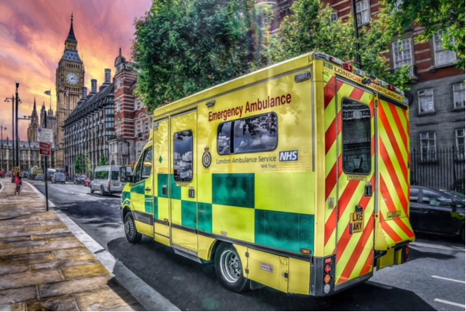
Disclosures and Conflicts of Interest
These are entirely my own opinions, gathered from over 25 years of experience in EMS and 40 years in Emergency Medicine
Inevitably, my views are London, South East of England and UK centric

Slide 3
What have I learnt?
My journey
The highs and lows
The learning and the benefit of hindsight
Some of the amazing events
The NHS and ambulance services
The memorable bits!
The challenges and the future

Slide 4
My Background – Emergency Medicine
Medicine was always my career choice (apart from a brief flirtation with flying fast jets – aged 11)
Qualified 1974 in London
Surgery (plastic surgery in particular) was my initial career option
Saw the light in 1982, when Emergency Medicine training was in its infancy
First Consultant post at University College and Middlesex Hospitals in 1985
Subsequently worked in Oxford before returning to London in 1996. Currently Hon Consultant at Imperial College Healthcare Trust

Slide 5
My Background – EMS
Chair London A&E Consultants Group from 1985
Chair Paramedic Steering Committee from 1987
London Ambulance Service Medical Director 1997 - 2015
Doctors are wonderful people – in their place
(Not in my ambulance!)
CEO 2015 - 2017
Medical Director South East Coast Ambulance Service 2017-2023
Interim CEO April – September 2019 (some people never learn)
Currently Senior Medical Advisor Air Ambulance Charity Kent Surrey Sussex

Slide 6
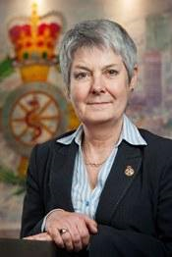
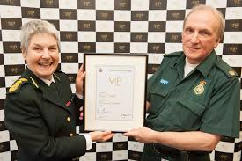
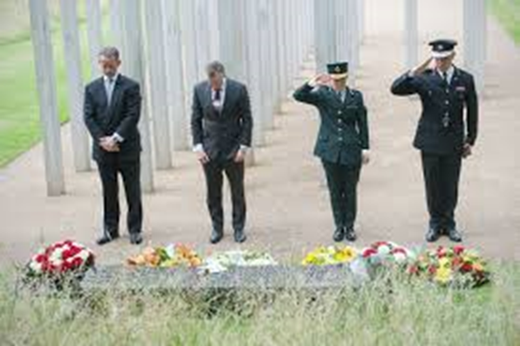
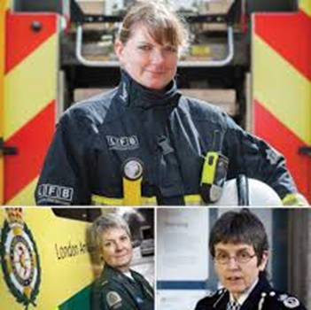
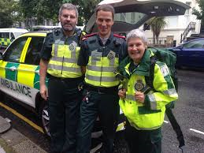
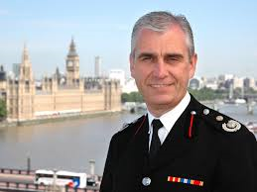
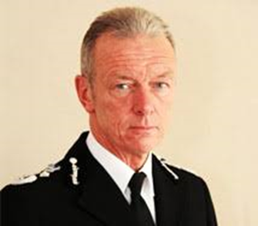
The privileges

Slide 7
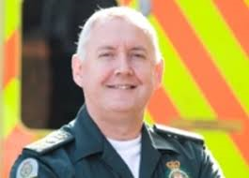
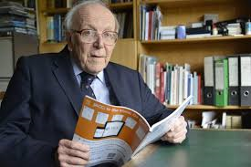
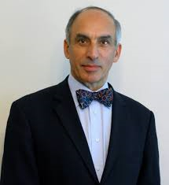
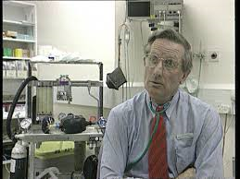
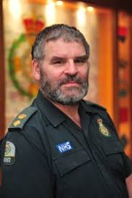
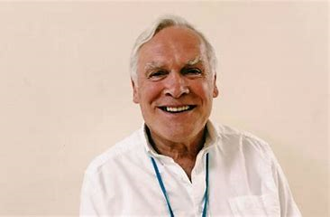
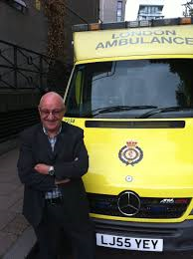
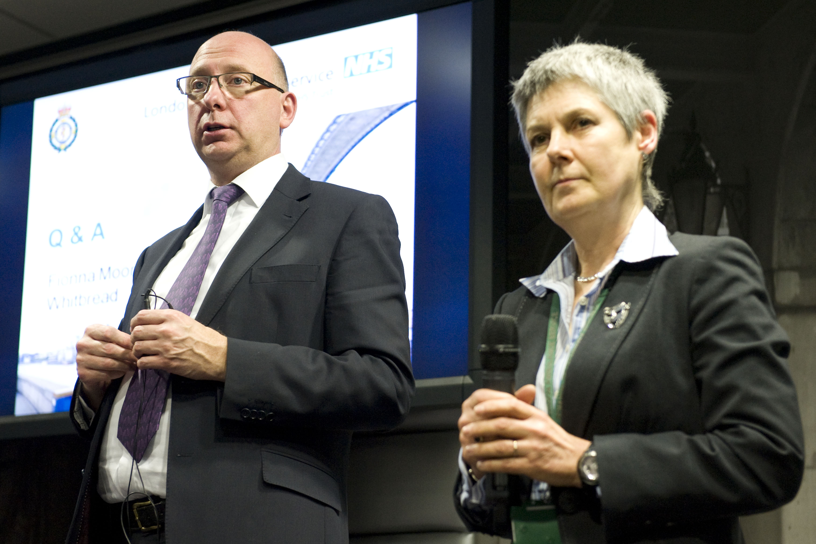
The game changers
Dr Bryan Galbally

Slide 8
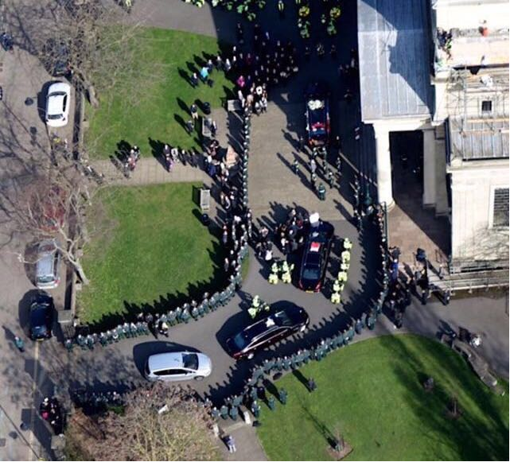
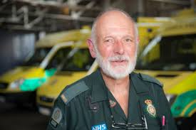
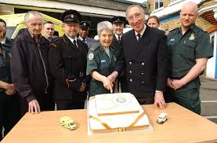
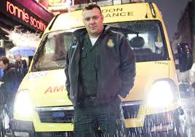
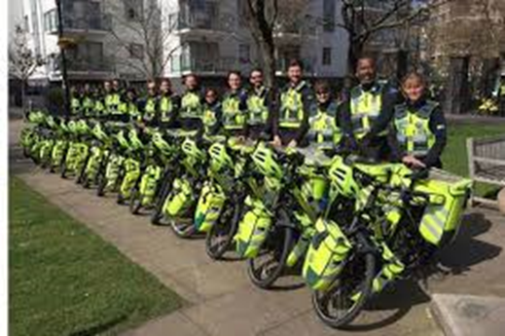
Special moments

Slide 9
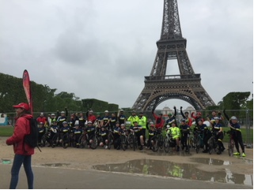
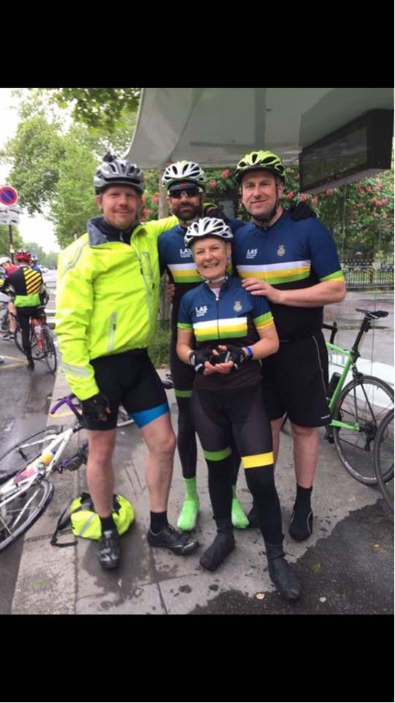
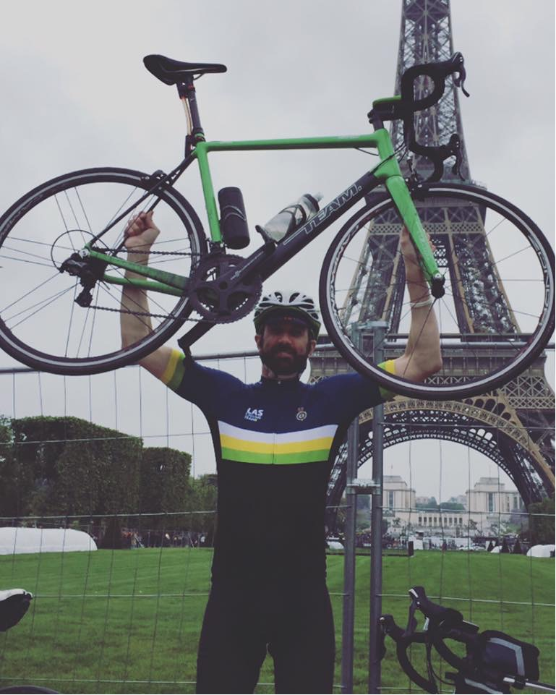
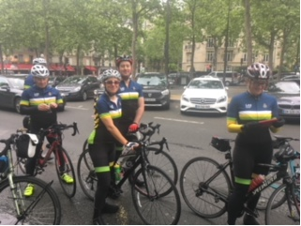
Cycling London 2 Paris

Slide 10
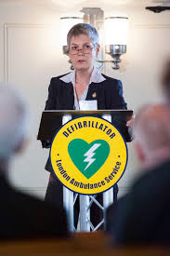
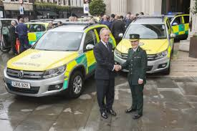
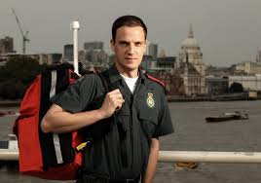
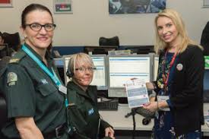
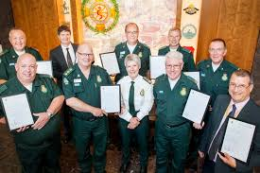
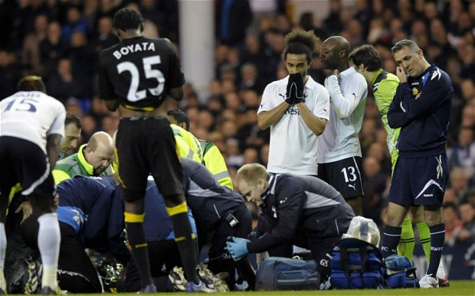
Successes

Slide 11
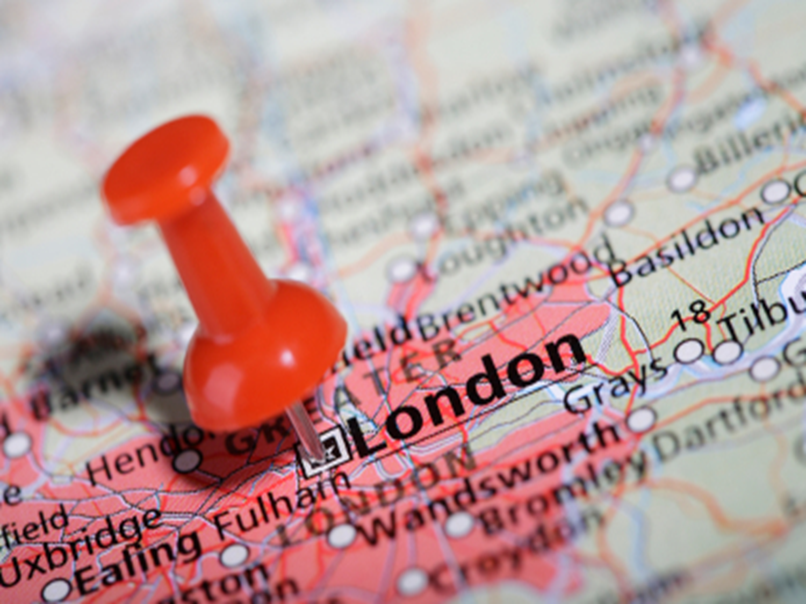
July 2005

Slide 13
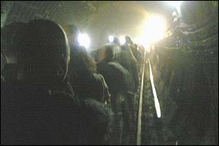
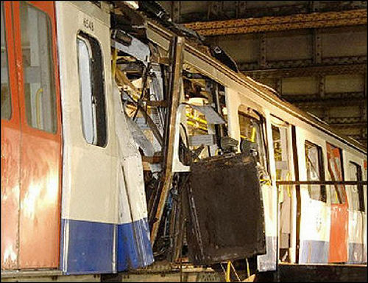
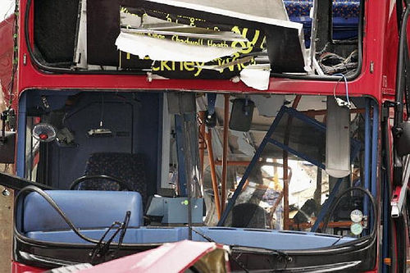
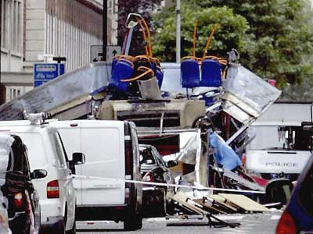
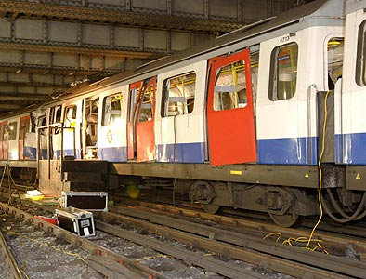
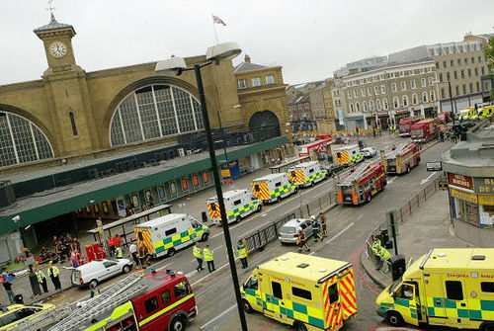
7th July 2005
When the bombs exploded there were :
- over 500 trains on the underground system
- over 200,000 passengers on London Underground
- around 2,500 staff on duty at stations
These were all evacuated in 1 hour
Notes:
13

Slide 14
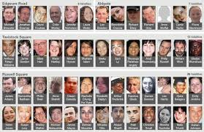
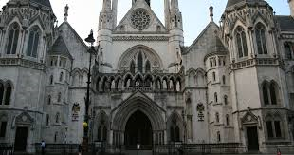
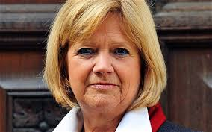
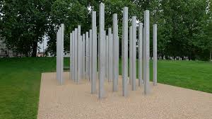
The learning and the Inquests 2011

Slide 15
CAD 2010 (Command Point)
Became CAD 2011
Failed within hours
Finally up and running 6 weeks before the Olympics!
Lesson
If you buy an off the shelf system, limit the changes!

Slide 16
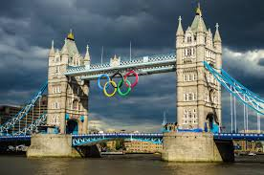
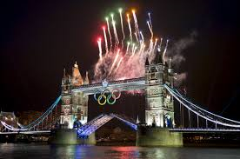
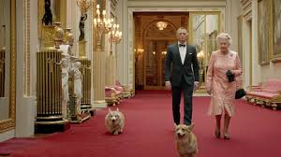
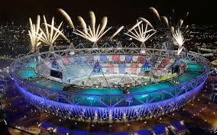
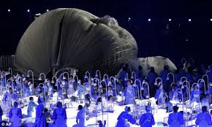
London 2012 – The Olympics!

Slide 17
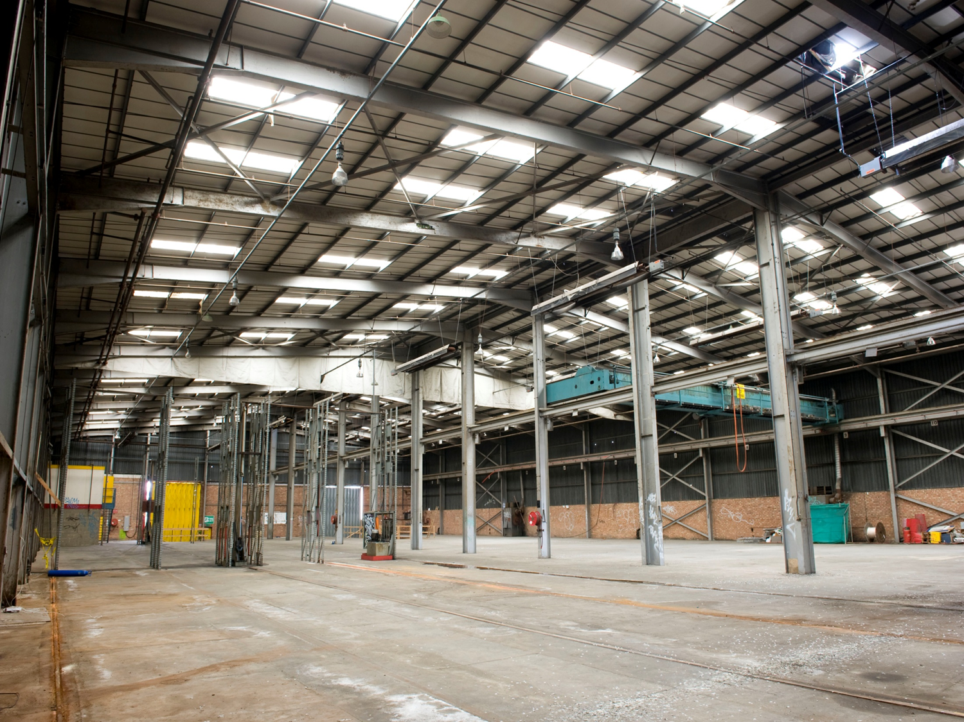
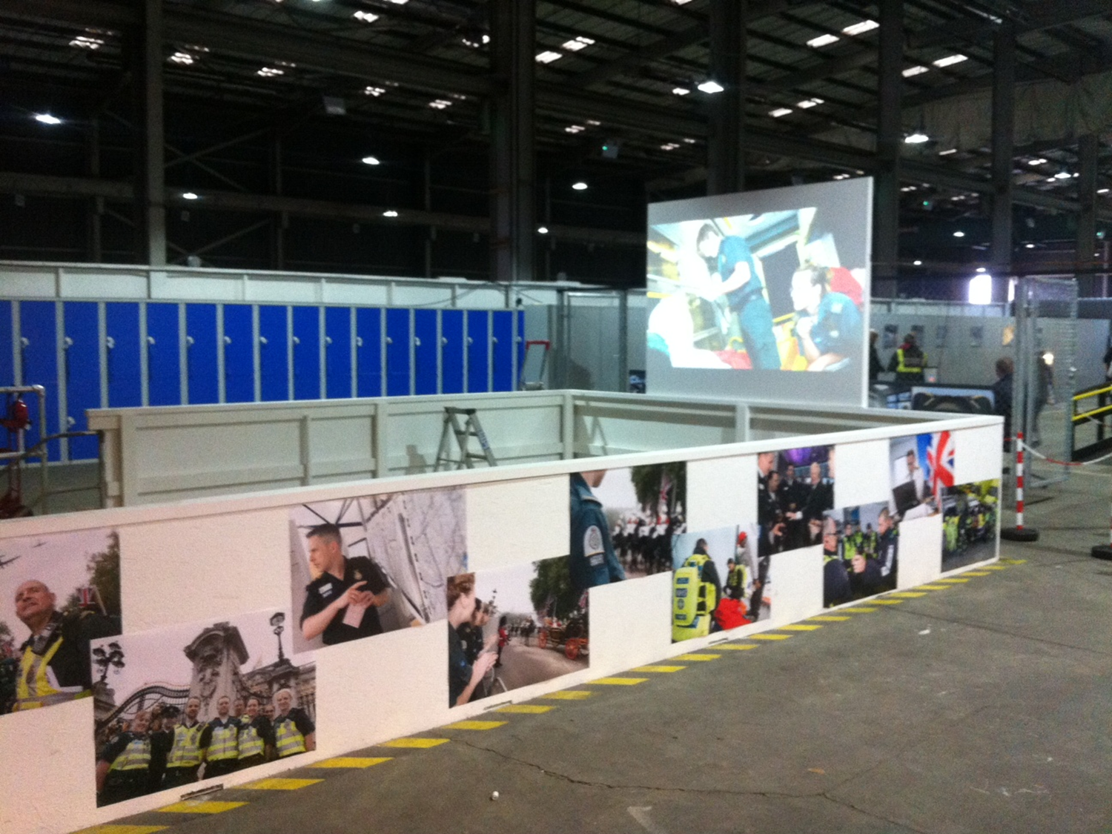
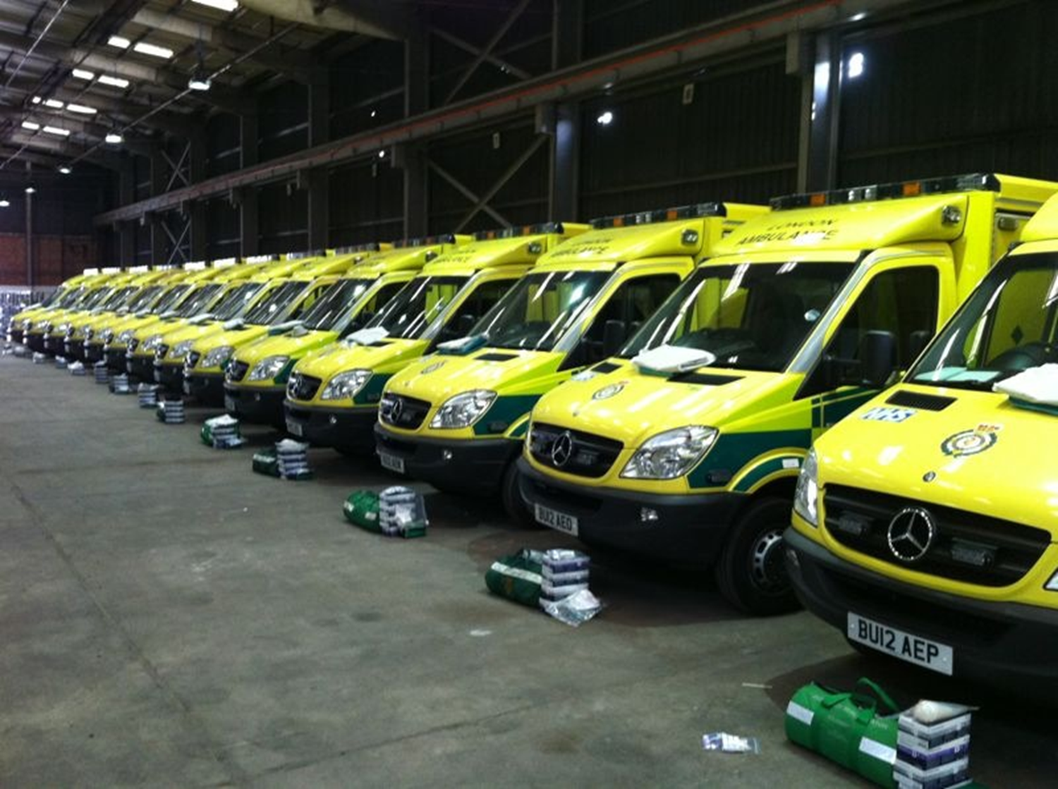
Olympic Deployment Centre

Slide 18
Pre-planned aid

Slide 19
Despite the Olympics people still called 999

Slide 20
The legacy

Slide 21
London Trauma System 2012

Slide 22
Difficult days: strikes in 2014 / 2015
How do you run a 999 ambulance service without staff?
80% front line staff either did not attend or worked to rule
All but 20% Control Room staff attended

Slide 23
Difficult days: strikes in 2014/ 2015

Slide 24
The NHS is 75 years old
The UK’s most treasured resource.
Envy of the world
Free at the point of delivery
Employer of 1.5 million staff
Eradicated polio and diphtheria
Pioneered many new treatments (heart & liver transplants, mechanical thrombectomy for stroke)
Great track record in research and innovation

Slide 25
The NHS is 75 years old
However:
The NHS is overspent by almost £6 billion
Shortage of nurses (33%)
Number of potential recruits to nursing falling
Failure to recruit planned number of student midwives
Numbers applying to enter General Practice falling
Massive issue around pensions and contributions
National shortage of Paramedics (4,000)

Slide 26
The NHS is 75 years old
And :
We have disillusioned and disaffected staff
25% report bullying and harassment
Ambulance staff went on strike over pay and conditions (2014, 2022)
Junior doctors went on strike over their contract (2016) & are currently on strike. They have been joined by Consultants
A&E four hour performance worst since records began (<80%)
Waiting lists lengthening (>7.8 million)

Slide 27
And let’s not forget…….
The impact of Covid 19
On the vulnerable
On children
On health services
On the race for vaccines

Slide 28
A vision for the Ambulance Service ‘2020 and beyond’ (AACE, 2015)

Slide 29
Current challenges for Ambulance Services
Call handling (October 2023)
Response times (October 2023)
Target – pick up within 5 seconds
National mean 9 seconds
LAS 9 seconds (90th centile 20)
SECAmb 22 seconds (90th centile 83)
C1 national mean 8 minutes (7)
C2 national mean 41.40 minutes (18)
C2 90th centile 90 minutes (40)
C3 mean 2 hrs 31 minutes
C3 90th centile 6 hrs 6 minutes (2hr)

Slide 31
NHS 111
Introduced 2013 to replace NHS Direct
Currently handles over 22,700 million calls / yr
Algorithm based (NHS Pathways). Average call taking time 340 seconds
Allows calls to be redirected to the most appropriate service
12.6% ambulance C2; 8.6% ambulance C3
Often criticised by ambulance service staff – but conveyance rates equivalent to 999 calls
Allows flexibility and response to public health emergencies
Used as a default service by Primary Care

Slide 32
What have we learned?
The need for addressing culture change
Better incident reporting – demonstrates a blame free culture
Clear strategy and direction of travel
Medicines Management – keeping drugs safe and secure
Stay within the legal guidelines
Management of Controlled Drugs
Temperature control
Medical gases
Security of vehicles and premises

Slide 33
Next is Now?
This is about the people
How do we recruit and retain the best staff
How do we educate them for 80% of the work
How do we protect them from the stress of 20%
How do we maximise the professionalism – all of the time
It’s also about maximising the benefits of technology

Slide 34
Next is Now?
The Future; Control Rooms, Integrated Clinical Hubs & developing the Paramedic profession
Maximise the benefits of technology; video streaming & AI
Establish rotations through Primary Care, ED, Minor Injuries Units Integrated Clinical Hubs
This is a multidisciplinary sport; let’s welcome nurses, pharmacists, midwives
But ensure continuing development the Paramedic profession
Look to appointing Clinical Directors to support Medical and Nursing colleagues

Slide 35
We shouldn’t forget to celebrate success and highlight good practice
https://

Slide 36
And now?

Slide 37
Thank you

