Slide 1
Patient Forum Pack
May 2018
This report refers to April 2018 Data unless otherwise stated
This data is subject to change

Slide 2
EXECUTIVE SUMMARY
Ambulance Response Programme Overview
Since February 2015, three other ambulance services - South West, Yorkshire and West Midlands - have been involved in trials led by NHS England of the new standards. They focused on four main areas:
Identifying the most seriously ill patients as early as possible through processes known as Pre-Triage Sieve and Nature of Call.
Giving control room staff more time (up to 240 seconds) to assess incidents through a process known as Dispatch on Disposition.
Developing new clinical code sets and response categories using the best available clinical evidence.
Developing new targets, indicators and measures.
The trials have also been independently reviewed by the University of Sheffield.
Category | Percentage of calls per Category | National Standard | How long does the ambulance service have to make a decision? | What stops the clock?
Category 1 | 8% | 7 minutes mean response time 15 minutes 90th centile response time | The earliest of: The problem being identified An ambulance response being dispatched 30 seconds from the call being connected | The first emergency vehicle that arrives on scene stops the clock.(There is an additional Category 1 transport standard to ensure that these patients also receive early ambulance transportation)
Category 2 | 48% | 18 minutes mean response time 40 minutes 90th centile response time | The earliest of: The problem being identified An ambulance response being dispatched 240 seconds from the call being connected | If a patient is transported by an emergency vehicle, only the arrival of the transporting vehicle stops the clock. If the patient does not need transport, the first emergency vehicle arriving at the scene of the incident stops the clock.
Category 3 | 34% | 120 minutes 90th centile response time | The earliest of: The problem being identified An ambulance response being dispatched 240 seconds from the call being connected | If a patient is transported by an emergency vehicle, only the arrival of the transporting vehicle stops the clock. If the patient does not need transport, the first emergency vehicle arriving at the scene of the incident stops the clock.
Category 4 | 10% | 180 minutes 90th centile response time | The earliest of: The problem being identified An ambulance response being dispatched 240 seconds from the call being connected | Category 4T: If a patient is transported by an emergency vehicle, only the arrival of the transporting vehicle stops the clock.
The new standards are intended to:
Prioritise the sickest patients quickly to ensure they receive the fastest response
Ensure national response targets to apply to every patient for the first time – so ending ‘hidden waits’ for patients in lower categories
Ensure more equitable response for patients across the call categories
Improve care for stroke and heart attack patients through sending the right resource first time.
Due to the nature and impact of these changes, the previous performance measures are not comparable.
However, NHS England have published National Standard for a number of the key measures which are included here.

Slide 3
EXECUTIVE SUMMARY
Ambulance Response Programme – Summary
 | C1 Mean | C1 90th Centile | C2 Mean | C2 90th Centile | C3 90th Centile | C4 90th Centile
 | (00:07:00) | (00:15:00) | (00:18:00) | (00:40:00) | (02:00:00) | (03:00:00)
Previous month (Mar 18) _ | 00:07:24 | 00:11:58 | 00:23:21 | 00:49:21 | 02:51:25 | 02:36:36
Last month (Apr 18) _ | 00:06:51 | 00:11:15 | 00:16:55 | 00:33:17 | 01:49:37 | 02:05:05
Current YTD (2018/19) _ | 00:06:51 | 00:11:15 | 00:16:55 | 00:33:17 | 01:49:37 | 02:05:05
* from 1st April 2018 – 30 April 2018
Demand
Performance
90,525 Incidents were provided with a face-to-face response.
Category 2 incidents reached 50,041 incidents. This accounts for 55% of face-to-face responses.
8,193 incidents were categorised as Category 1 and provided with a face-to-face response.
April shows all 6 key performance measures achieving responses within the various National Standards.
The C1 Mean was 6 minutes 51 seconds. This is well within the 7 minutes national standard.
The C3 90th centile demonstrated a major improvement in performance. This was from just under 3 hours in March to 1 hour 49 seconds in April.

Slide 4
EXECUTIVE SUMMARY
Ambulance Response Programme Overview – Category Demand
Fig 2.1
Fig 2.2
Fig 2.3
Fig 2.4

Slide 5
EXECUTIVE SUMMARY Ambulance Response Programme - Key Metric Variance April 2018
Category | Measure | LAS Monthly Performance (Apr 18) | National Standard | Variance
Category 1 | Mean Response Time_ | 00:06:51 | 7 minutes | 00:00:09
 | 90th centile_ | 00:11:15 | 15 minutes | 00:03:45
Category 2 | Mean Response Time_ | 00:16:55 | 18 minutes | 00:01:05
 | 90th centile_ | 00:33:17 | 40 minutes | 00:06:43
Category 3 | 90th centile_ | 01:49:37 | 120 minutes | 00:10:23
Category 4 | 90th centile_ | 02:05:05 | 180 minutes | 00:54:55

Slide 6
EXECUTIVE SUMMARY
Ambulance Response Programme – National Picture April 2018
Fig 4.1 Illustrates the Category 1 Mean Response Performance for Ambulance Trusts across England during April 2018.
Additional information also displayed :
The National Standard (00:07:00)
The average for England (00:07:38)
The ranking position for each Trust
LAS achieved 6 minutes and 51 seconds for the mean response time for Category 1 patients. This is within the 7 minute national standard.
LAS ranked fourth when compared to 9 other Ambulance Trusts across England.
LAS also performed within the England average by 46 seconds.
Fig. 4.2 Displays the six key ARP performance measures for each Ambulance Trust across England during April 2018.
LAS ranked 2nd in the Category 1 90th centile performance measure, compared to the other Trusts.
For the Category 2 mean, LAS remained stable ranked at 5th compared to the other Trusts.
 | Mean | 90th Centile |  | Mean | 90th Centile |  | 90th Centile |  | 90th Centile
April 2018 | Category 1 | Category 1 |  | Category 2 | Category 2 |  | Category 3 |  | Category 4
National Standard | 00:07:00 | 00:15:00 |  | 00:18:00 | 00:40:00 |  | 02:00:00 |  | 03:00:00
England | 00:07:38 | 00:13:26 |  | 00:20:15 | 00:41:42 |  | 01:55:52 |  | 02:43:12
East Midlands | 00:08:36 | 00:15:39 |  | 00:31:57 | 01:08:06 |  | 02:41:18 |  | 02:01:50
East of England | 00:08:06 | 00:14:44 |  | 00:22:43 | 00:47:23 |  | 02:17:03 |  | 02:47:28
London | 00:06:51 | 00:11:15 |  | 00:16:54 | 00:33:16 |  | 01:49:47 |  | 02:05:08
North East | 00:05:53 | 00:10:05 |  | 00:17:09 | 00:34:56 |  | 02:01:38 |  | 01:52:32
North West | 00:07:51 | 00:13:24 |  | 00:23:38 | 00:51:59 |  | 02:21:50 |  | 02:56:37
South Central | 00:06:35 | 00:11:50 |  | 00:14:13 | 00:27:46 |  | 01:40:08 |  | 02:33:04
South East Coast | 00:07:24 | 00:13:45 |  | 00:16:08 | 00:30:17 |  | 02:32:34 |  | 04:10:57
South Western | 00:08:32 | 00:15:50 |  | 00:23:25 | 00:48:24 |  | 01:58:50 |  | 04:15:42
West Midlands | 00:06:50 | 00:12:04 |  | 00:11:23 | 00:20:24 |  | 00:55:17 |  | 01:32:40
Yorkshire | 00:08:02 | 00:13:44 |  | 00:21:39 | 00:45:53 |  | 02:05:16 |  | 02:44:53
Isle of Wight | 00:07:44 | 00:16:37 |  | 00:12:21 | 00:30:52 |  | 01:17:58 |  | 03:01:40
Fig 4.2

Slide 7
EXECUTIVE SUMMARY
Ambulance Response Programme
These tables show 6 key performance measures for March and April 2018 profiled by STP.
April performance shows the improved performance compared to March. This improvement could be attributed to the warmer weather experiences and the school holidays over the Easter period. This also follows a similar pattern from previous years
All STP areas remained within the national standard for almost all key measures.
The C3 90th centile performance in the North Central STP, although just above the national standard, shows the highest improvement of over 1 hour 25 minutes.
C4 90th centile in the South West STP was the only measure to increase. (by just over 2 minutes) Despite this increase this measure remains within the national standard of 3 hours.
April 2018 | C1 Mean | C1 90th Centile | C2 Mean | C2 90th Centile | C3 90th Centile | C4 90th Centile
STP Position | (00:07:00) | (00:15:00) | (00:18:00) | (00:40:00) | (02:00:00) | (03:00:00)
North Central | 00:06:47 | 00:10:46 | 00:17:54 | 00:35:27 | 02:05:50 | 02:02:31
North East | 00:07:00 | 00:11:18 | 00:17:05 | 00:33:05 | 01:57:16 | 02:13:36
North West | 00:06:44 | 00:11:16 | 00:17:10 | 00:34:14 | 01:56:23 | 01:58:06
South East | 00:06:54 | 00:11:27 | 00:15:31 | 00:30:13 | 01:32:42 | 02:01:11
South West | 00:06:50 | 00:11:27 | 00:16:56 | 00:33:12 | 01:39:23 | 02:03:17
March 2018 | C1 Mean | C1 90th Centile | C2 Mean | C2 90th Centile | C3 90th Centile | C4 90th Centile
STP Position | (00:07:00) | (00:15:00) | (00:18:00) | (00:40:00) | (02:00:00) | (03:00:00)
North Central | 00:07:36 | 00:12:16 | 00:25:53 | 00:55:47 | 03:31:08 | 02:42:54
North East | 00:07:31 | 00:12:21 | 00:25:31 | 00:54:05 | 03:04:53 | 03:09:28
North West | 00:07:09 | 00:11:44 | 00:22:40 | 00:47:51 | 03:02:15 | 02:47:14
South East | 00:07:15 | 00:11:48 | 00:20:45 | 00:43:51 | 02:19:51 | 02:16:36
South West | 00:07:37 | 00:12:03 | 00:21:46 | 00:45:06 | 02:33:49 | 02:01:03

Slide 8
Hospital Handover Summary
Hospital Conveyance Lost Hours April 2018

Slide 9
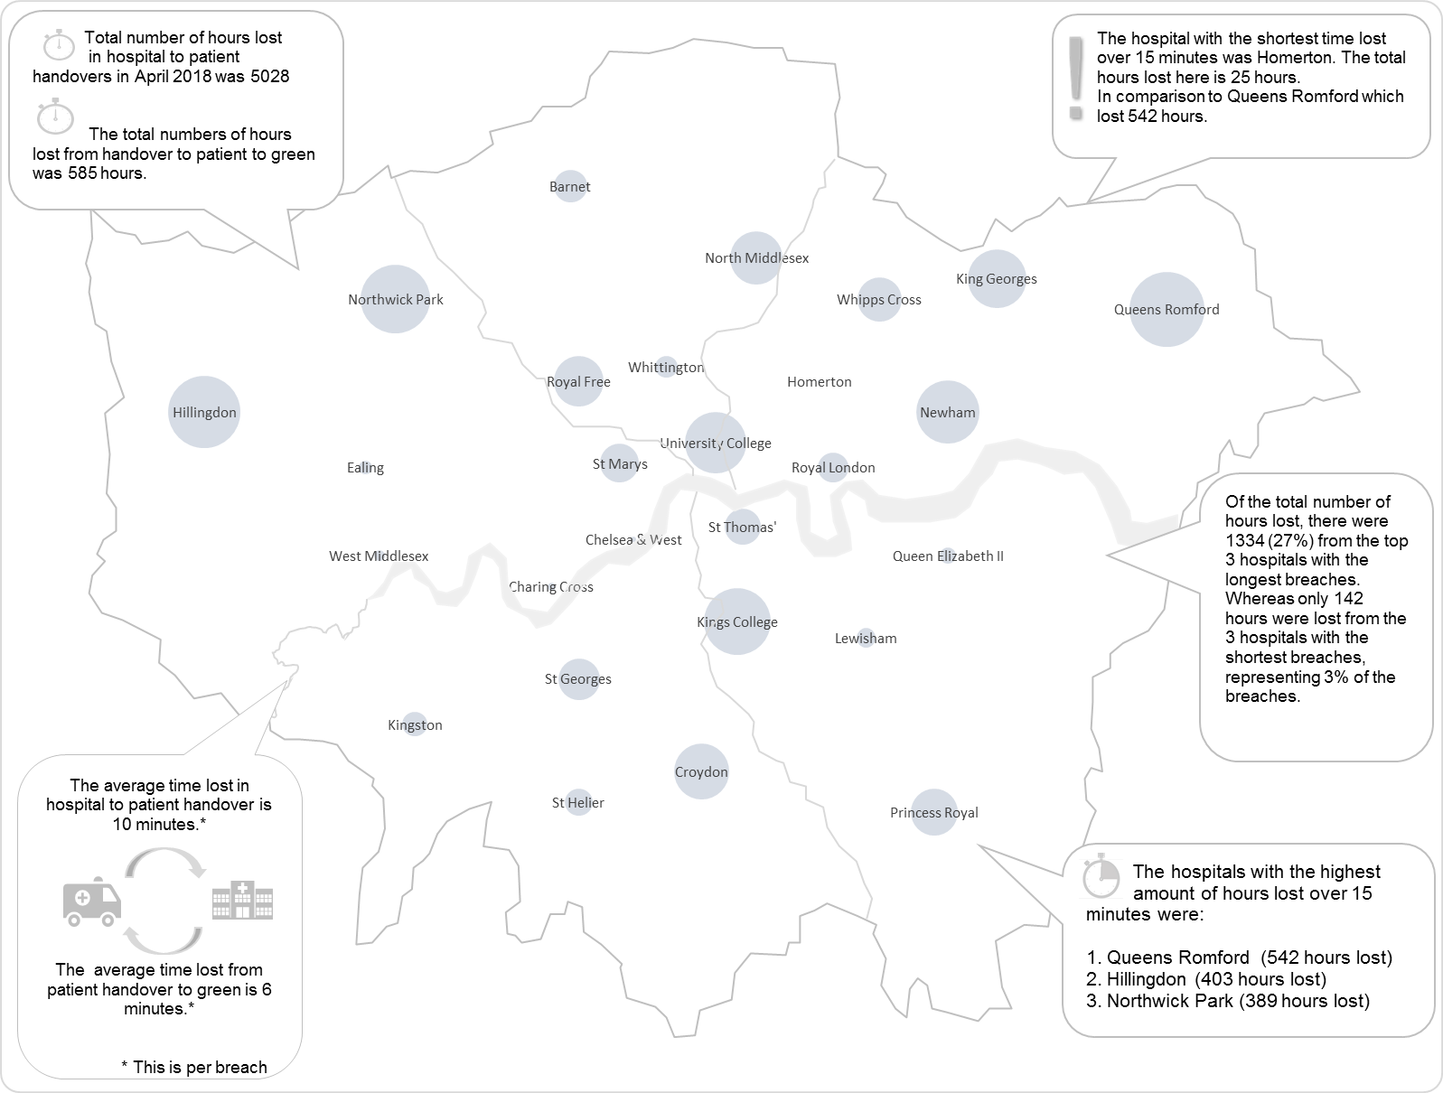
Hospital Handover Summary
Hospital Conveyance by Location April 2018
This map shows the location of each ED hospital across London.
The size of the bubble relates to the comparative hours lost* at that hospital.
The larger the bubble, the more hours lost at hospital.
For example, during the reporting week, the highest hours lost were at Queens Romford.
The fewest hours were lost at Homerton, as the bubble can barely be seen
* Total time accrued after 15 minutes, for arrival at hospital to patient handover.
 | Highest number of hours lost.
 | Lowest number of hours lost.

