Slide 1
Can 111 improve demand management for patients needing urgent & emergency care? Patient Forum – 12th June 2017 Katy Millard, Deputy Director Operations – IUC / 111 Anne Jones, 111 Centre Operations Manager

Slide 2
Urgent and Emergency Care Review
The NHS is now in the 3rd year (Implementation Phase) of the Urgent and Emergency Care (UEC) Review
This phase is focussed on implementing new models of care and ways of working
A key outcome is to ‘functionally integrate’ services between NHS 111 and GP OOHs to provide 24/7/365 Access, Assessment, Advice and Treatment Services
The vision is “talk before you walk”, where the pubic will either dial 111 or make contact with 111 ‘online’ or phone 999
The UEC Networks across London are helping to implement the review recommendations
44 Sustainability Transformation Plans across England have detailed deliverables realisable by 20/21, including Integrated Urgent Care
The new stronger offer to the public is higher levels of routing to clinicians with a single call; with a joined up care plan; via a clinical hub; accessible by professionals and the public
UEC Review – A reminder of the 5 key system changes
Provide better support for people to self-care
Help people with urgent care needs to get the right advice in the right place, first time
Provide highly responsive urgent care services outside of hospital so people no longer choose to queue in A&E
Ensure that those people with more serious or life threatening emergency needs receive treatment in centres with the right facilities and expertise in order to maximise chances of survival and a good recovery
Ensure that the urgent and emergency care system becomes more than just the sum of parts through the creation of urgent care

Slide 3
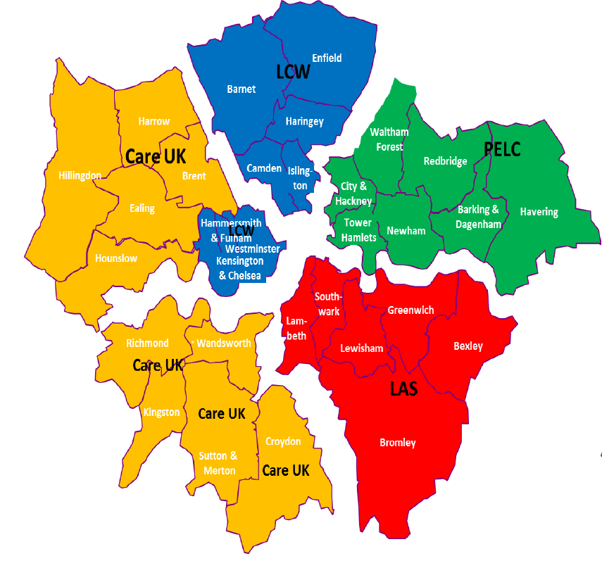
NHS 111 and IUC
NCL
NWL
NEL & ELC (ELHCP)
Vocare
SEL
Vocare
SWL
Vocare

Slide 4
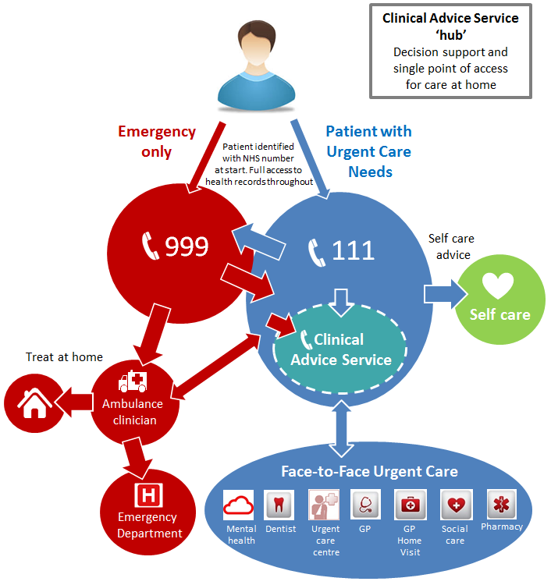
Functionally Integrated Urgent Care
The commissioning standards for Integrated Urgent Care were published in September 2015
The standards outline intent that NHS 111 will be the primary route to urgent care services and will enable commissioners to deliver functionally integrated 24/7 urgent care services acting as the ‘front door’ of the NHS and providing the public with access to both treatment and clinical advice. This will include NHS 111 providers and GP Out of Hours services, community services , ambulance services, emergency departments and social care.
Commissioners across England are procuring new services based on an integrated model across 111 and OOHs; either functionally or fully integrated
A single contract with a lead provider, signifying a Lead/ Subcontract arrangement
Bidders may bid in a partnership or collaboration
Anticipated contract values range from £8 to £12million per annum (111 and OOH or 111)
A multi-disciplinary clinical hub is a key feature of the new system, expectation that providers will collaborate to provide integrated services both in terms of technological interoperability and direct referral and bookings in and out of hours.

Slide 5
Delivery of Integrated Urgent Care (IUC)
New Clinical Hub Workforce:
Specialist Non-Pathway Nurse
GPs
Link to London Dental Hub
Pharmacist
Care Navigators
Link to Mental Health Professionals
Link to specialist MS Nurses
Introduction of Specialised Pathways for:
Over 85s
Under 5s
MS Patients
Housebound Patients for fast access to GP Home visits – in and out of Hours
Care Homes and Ambulance Crews (HCPs)
Functionality:
In hour GP Appointment Booking
Complex / End of Life Care Plan Callers Direct to Clinician
Callers with worsening conditions
Ambulance Crews and Care Homes
Ambulance dispatch process
Dos Functionality to send electronic referrals through none pathways workflow
Ability to flex workforce in real-time
Direct booking into hubs/Primary Care Centres
Care Plans follow the patient including to Ambulance Crews if IUC Dispatches
Pan London agreed work flows
One Clinical Queue

Slide 6
National Priority 30% Clinical Assessment
Currently 45.29% of NHS 111 calls are transferred to a clinical advisor for enhanced assessment (on track for the target of 51% by 31st March 2018)
STP Area | **111 Provider | Total 111 calls answered | NHS 111 MDS |  | Calls transferred to clinicians in London (not included in MDS 5.16 data) |  |  |  |  |  | TOTAL % of calls transferred to or answered by clinicians**
 |  |  | Calls transferred to a clinician | Calls transferred to a clinician % | MB Total Dental Hub Referrals % | Warm Transferred to Mental Health Crisis Line % | Pharmacy - Total Received % | IUC Clinician Hub% | HCP GP Hub * Access % | Total
ONWL | Care UK | 5540 | 1227 | 21.9% | 6.44% | 0.28% | 1.27% | 0.00% | 1.52% | 9.51% | *31.4%
SEL | LAS | 6368 | 1627 | 26.3% | 7.89% | 0.25% | 1.16% | 3.04% | 3.80% | 16.15% | 42.45%
INWL/ NCL | LCW | 6997 | 1945 | 26.4% | 5.96% | 0.07% | 1.49% | 3.23% | 40.38% | 51.13% | 77.53%
NEL | PELC | 8270 | 1712 | 20.3% | 12.08% | 0.09% | 1.16% | 3.37% | 6.48% | 23.18% | 43.48%
SWL | Vocare | 6333 | 1475 | 23.3% | 5.73% | 0.10% | 0.33% | 2.61% | 3.60% | 12.37% | *35.67%
Total/Average |  | 33508 | 8031 | 22.60% | 7.62% | 0.16% | 1.08% | 2.45% | 10.34% | 21.65% | 45.29%
Current MDS
5.16 = 23.3%
Updated MDS 5.22 = 37.2%
The data above (from w/e 28th May) demonstrates the additional clinical pathways captured beyond the national 111 MDS reporting which shows that all 111 providers are exceeding the 30% target (such as the OOH dental Nurse Triage, Pharmacy Hub, complex care plan callers via the Patient Relationship Manager, HCPs accessing GP 24/7). The new London target for providers to meet, using the updated MDS, is now 38.7% every week
*Note ~2% of the 5.22 total comes from HCPs calling *567 to access a GP 24/7 as part of the London 111 Winter Improvement Programme. If the pilots are not extended beyond 31st July 2017 both Care UK & Vocare may fall below the 30% target. **Limitations – Currently the PRM only captures data split by provider, so the table does not give a view on how each contract area is performing.

Slide 7
Analysis on calls from Care Homes
Since the start of the IUC pilots at the end of January 2017, we have seen an impact on calls from care homes moving away from 999 to 111.
 | 999 Calls From Care Homes |  | 111 Calls From Care Homes (*6) | % 111 calls of total calls made by care homes
Month | 2016 | 2017
January | 3150 | 3617 | 470 | 11.5%
February | 3005 | 2699 | 1472 | 35.3%
March | 3114 | 2946 | 1868 | 38.8%
April | 2987 | 2789 | 2227 | 44.4%
The % of all calls made by Care Homes is increasingly being made to 111, rather than 999

Slide 8
Impact on the over 85s
For the over 85s we are stating to see lower acuity outcome figures when 111 providers have utilised the skills of a GP in the hub 24/7 targeting complex /over 85 years as part of the GP caseload. Overall more cases are closed for this cohort of callers.
Data is also indicating that new IUC providers with new IUC patient pathways contribute to lower ED referral rates and higher numbers of callers not being recommended another service i.e. case being closed, compared to the NHS 111 service standard model . The 3 models are highlighted below:
Some of the cases will be directed straight to a clinician, having been identified by the London PRM as having a digital care record - SPN, Care plan or End of Life Plan.
Over 85s Data | Provider Type | % ambulance referrals | % ED referrals | % referred to primary care | % referred to another service | % case was closed – self management
Care UK | 111 | 23.7% | 2.5% | 60.4% | 1.2% | 12.2%
LAS | 111 | 13.4% | 1.5% | 57.6% | 7.3% | 20.2%
LCW | IUC | 13.4% | 1.8% | 33.9% | 2.6% | 48.2%
PELC | IUC Vanguard | 19.5% | 1.9% | 54.3% | 2.7% | 21.5%
Vocare | 111 / IUC* | 16.9% | 1.4% | 59.8% | 7.5% | 14.3%
London totals – over 85s |  | 16.1% | 1.8% | 50.4% | 1.5% | 30.4%
London totals – all ages |  | 10.5% | 11.8% | 56.1% | 2.1% | 19.5%
1
LCW IUC model
2
PELC’s vanguard pathway
3
Early impact of Vocare’s new pathway for over 85s getting direct access to a GP
8

Slide 9
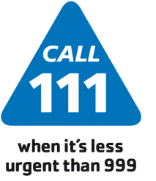
IUC Winter Pilots: Impact on LAS Referrals
Since November 2014, enhanced clinical assessment of Green Ambulance dispositions has delivered substantial benefits to London 111 providers and the wider UEC system.
111 Clinician confirms the Green Ambulance disposition (~34% of cases) or changes to an alternative outcome (~ 67%)
What is Green Ambulance re-triage?
NHS Pathways assessment
Low acuity “Green” ambulance disposition reached
Call “warm transferred” (all London 111 providers) to a 111 clinician or queued for 111 clinician call back (LAS 111 only)
Total of
129,422
fewer Green Ambulance referrals from London 111 providers to LAS 999 since Nov 2014
On average
965
fewer Green Ambulance referrals from 111 to LAS 999 per week
71%
of Green Ambulance dispositions in London are re-assessed by a clinician
Of those Green Ambulance dispositions that are re-assessed
67%
are changed to an alternative outcome
What impact has it had?
Data taken from Green Ambulance User Report v1.7 for w/e 21st May 2017

