Slide 1


Health and Care in the Community– during the pandemic and beyond
July 2021
Briony Sloper – Health and Care in the Community Cell Lead / Ageing Well Lead
London Region

Slide 2
The Health and Care in the Community Cell will provide planning, oversight, and support to ICSs to restore and maintain services to meet the needs of the population. The core objectives of the cell are:
  To support multiagency and cross system working on Discharge, Ageing Well, Community Services, Social Care and Digital programmes
  Support ICSs to develop robust discharge pathways from acute sites; promote Home first/D2A principles; support local delivery of Enhanced Health in Care Homes framework and primary care (DES); progress Urgent Community Response deliverables of 2hr and 2-day response with community providers
  Develop digital initiatives and work with the adult social care team to embed new ways of working
  Support pandemic response activities in relation to all of the above
Ensuring that social care partners have an equal voice, that programmes reflect the needs of social care providers and staff adequately and delivery plans are tailored effectively.
Providing regional data, intelligence, and guidance; disseminating and interpreting national guidance; sharing knowledge and bet practice initiatives, supporting improvement activities, identifying unwarranted variance and best practice
Programme Scoping Document

Slide 3
Programmes and Dependencies
Health and Care in the Community Cell
Ageing Well
Discharge /LOS
Urgent Community Response
Enhanced Health in Care Homes
Anticipatory Care
Cell Specific Digital Programmes
Homeless Health
Mental Health
Primary Care
Social Care Partnerships
Enablers
Digital Community Health and Care programmes
System Leadership
UEC/Inequalities/ Finance/ Data/Comms/Workforce
key
In scope and cell directly responsible
Not in scope but has an interface/ dependency with
Not in scope but has an interface/ dependency with
Programme Scoping Document

Slide 4
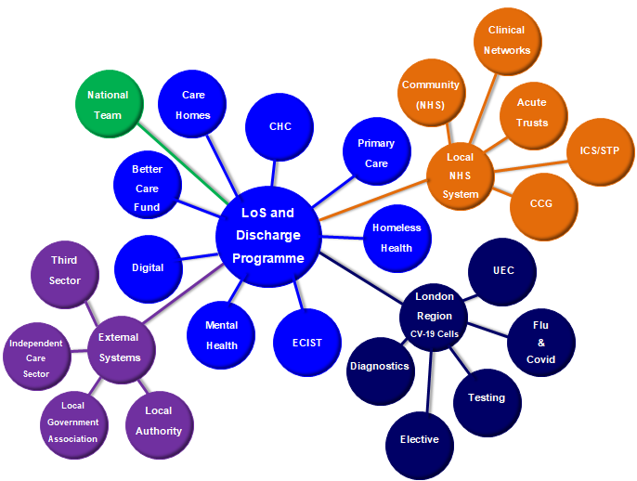
High level Stakeholder Map
Key
Local NHS System
National Team
NHSE/I
London Region CV-19 Recovery Cells
External Systems
HCC Programmes
Health and Care in the Community (HCC)
Programme Scoping Document

Slide 5
Enhanced Health in Care Homes
Overview
EHCH (Enhanced Health in Care Homes) The Enhanced Health in Care Homes framework sets out the national priorities for supporting the health and well-being of care home residents.
The Care Homes programme is also supportingCovid-19 response, Vaccine roll out and winter planning.
Plans
Vaccine Support to Care Homes / Winter Planning
Care Home Dashboard
Deteriorating Resident
Primary Care – Lead GP, Multidisciplinary Home Rounds, Medicine Reviews, Personalised Care Planning
Dementia and Older Peoples Mental Health
End of Life and Palliative Care
Falls Strength and Balance
Hyrdation and Nutrition
Wounds of the lower leg
Digital
Governance
National Discharge and Community Services Cell
NHS E/I Community Services and Ageing Well Programme (National)
London Regional Care Home Oversight Group
Enhanced Health in Care Homes Network
Care Home Resource Working Group
Relative and Resident Working Group
Digital Working Group
Programme Scoping Document

Slide 6
Pandemic Response
Care Homes >1300 care homes regionally– residents and staff disproportionately affected – IPC training, PPE, recognising signs and symptoms were all initial areas of support/focus
Regional Care Homes Oversight Group convened on 7th May 2020 meeting fortnightly
Co-chaired by London ADASS and NHSE/I
Membership including ADASS, Providers, DPHs, CQC, PHE, Healthwatch, ICS’, AHSNs, DHSC
Forum to raise issues and share best practice in a collaborative safe space allowing escalation and shared solutions to emergent challenges
Infection Prevention and Control, well-being (residents and staff), testing, vaccinations, visiting, discharge, end of life care, access to health care support- e.g. GPs, nursing, pharmacy, data, digital
After Action Review in April 2021 showed the impact and value of this forum providing peer support and enabling rapid dissemination of improvements and support through the relationships created

Slide 7
Pandemic Response
COVID resource packs – stakeholder group meeting fortnightly representing wide range of partners which has been extremely powerful and is ongoing. Excellent care in CHs is totally dependent on these partnerships and mutual respect/understanding of the system.
Vaccination resource pack (for Care Homes and for Domiciliary Care)
Staff and Resident vaccination uptake – webinars, capacity and consent, risk assessments, vaccine myth busting, fertility etc.
Pharmacy care homes group - collating and agreeing approach to areas such as SMRs , working with the PCNs and the new DES, implementing the Vit D supplements
Embedding the EHCH principles in the PCN DES, good practice examples such as the ‘DES+’ offer to homes across NEL

Slide 8
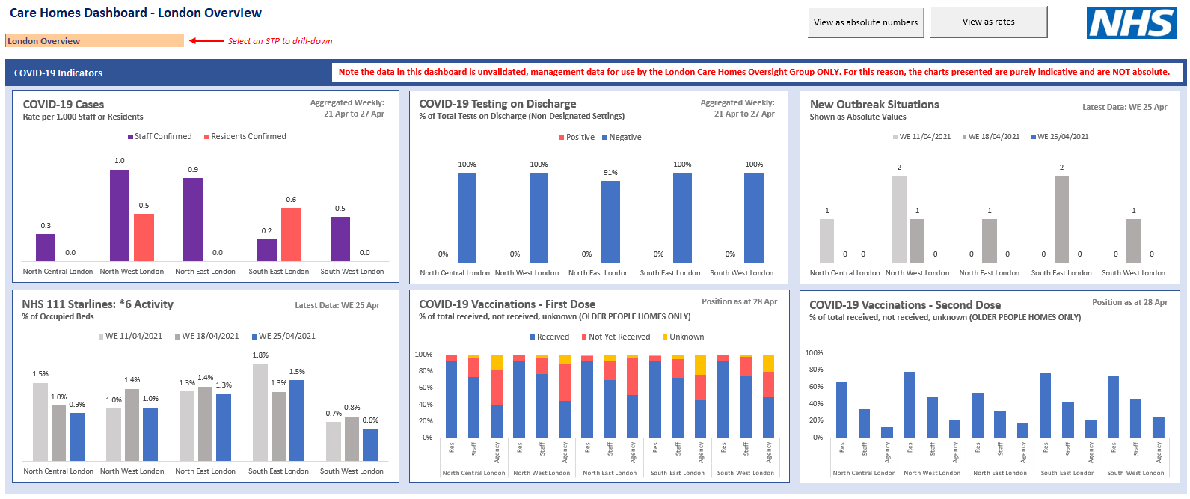

Slide 9
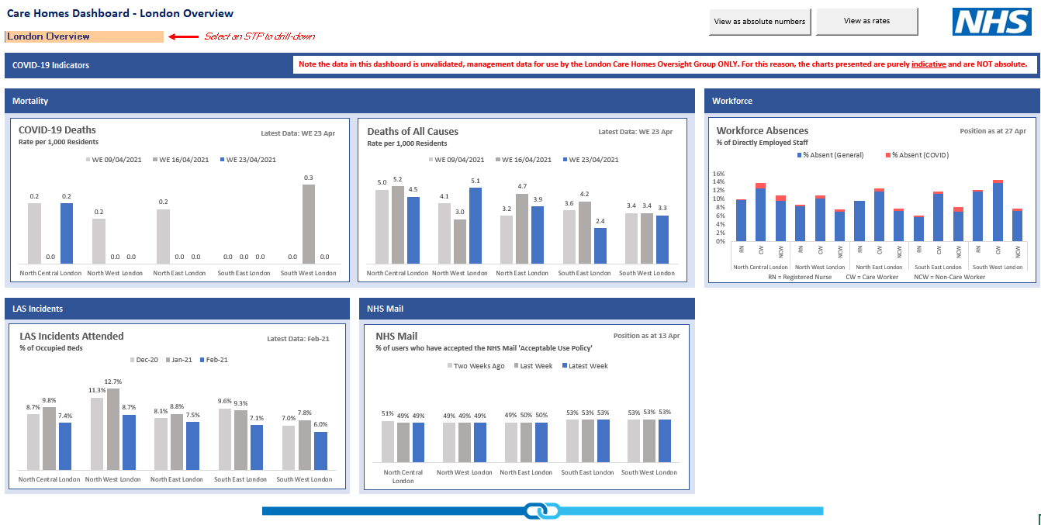

Slide 10
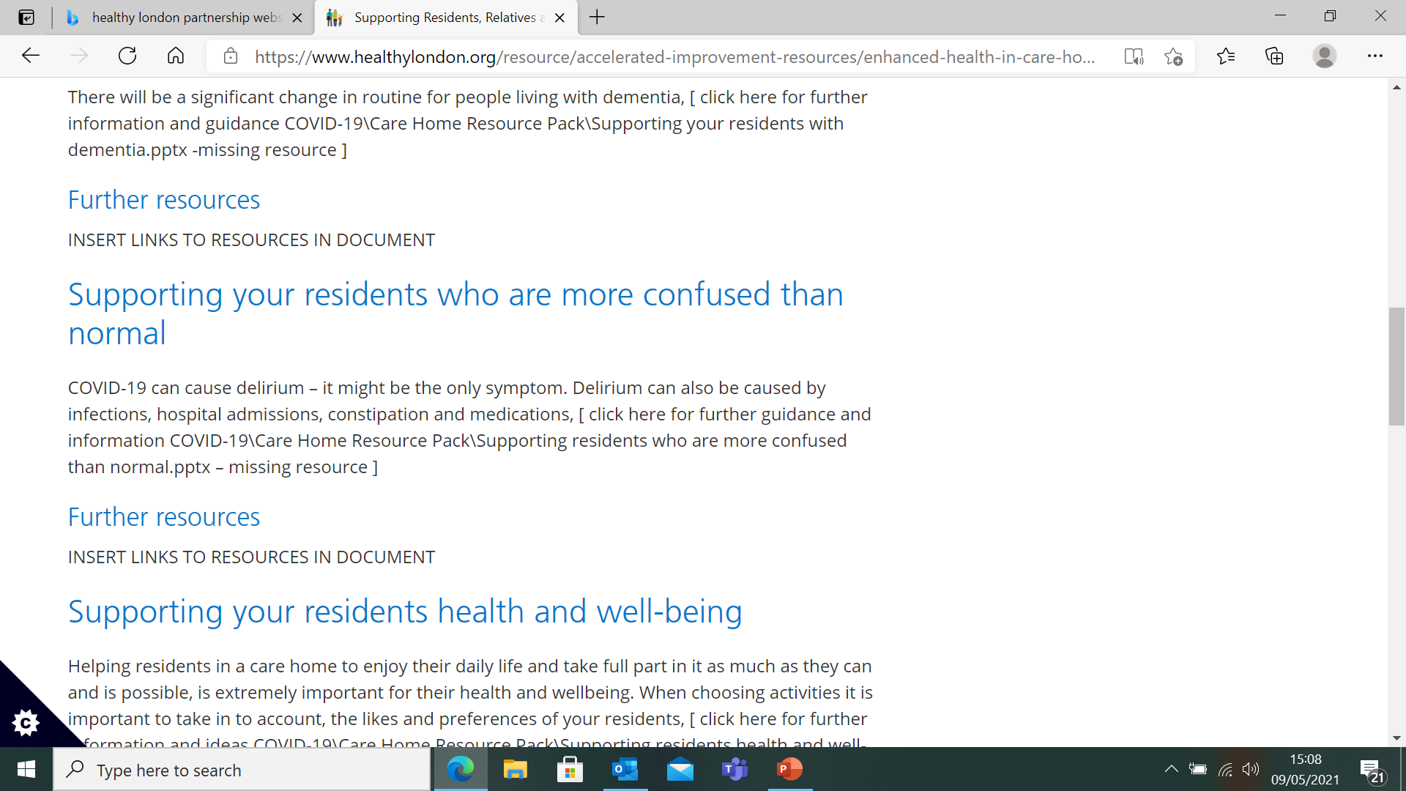
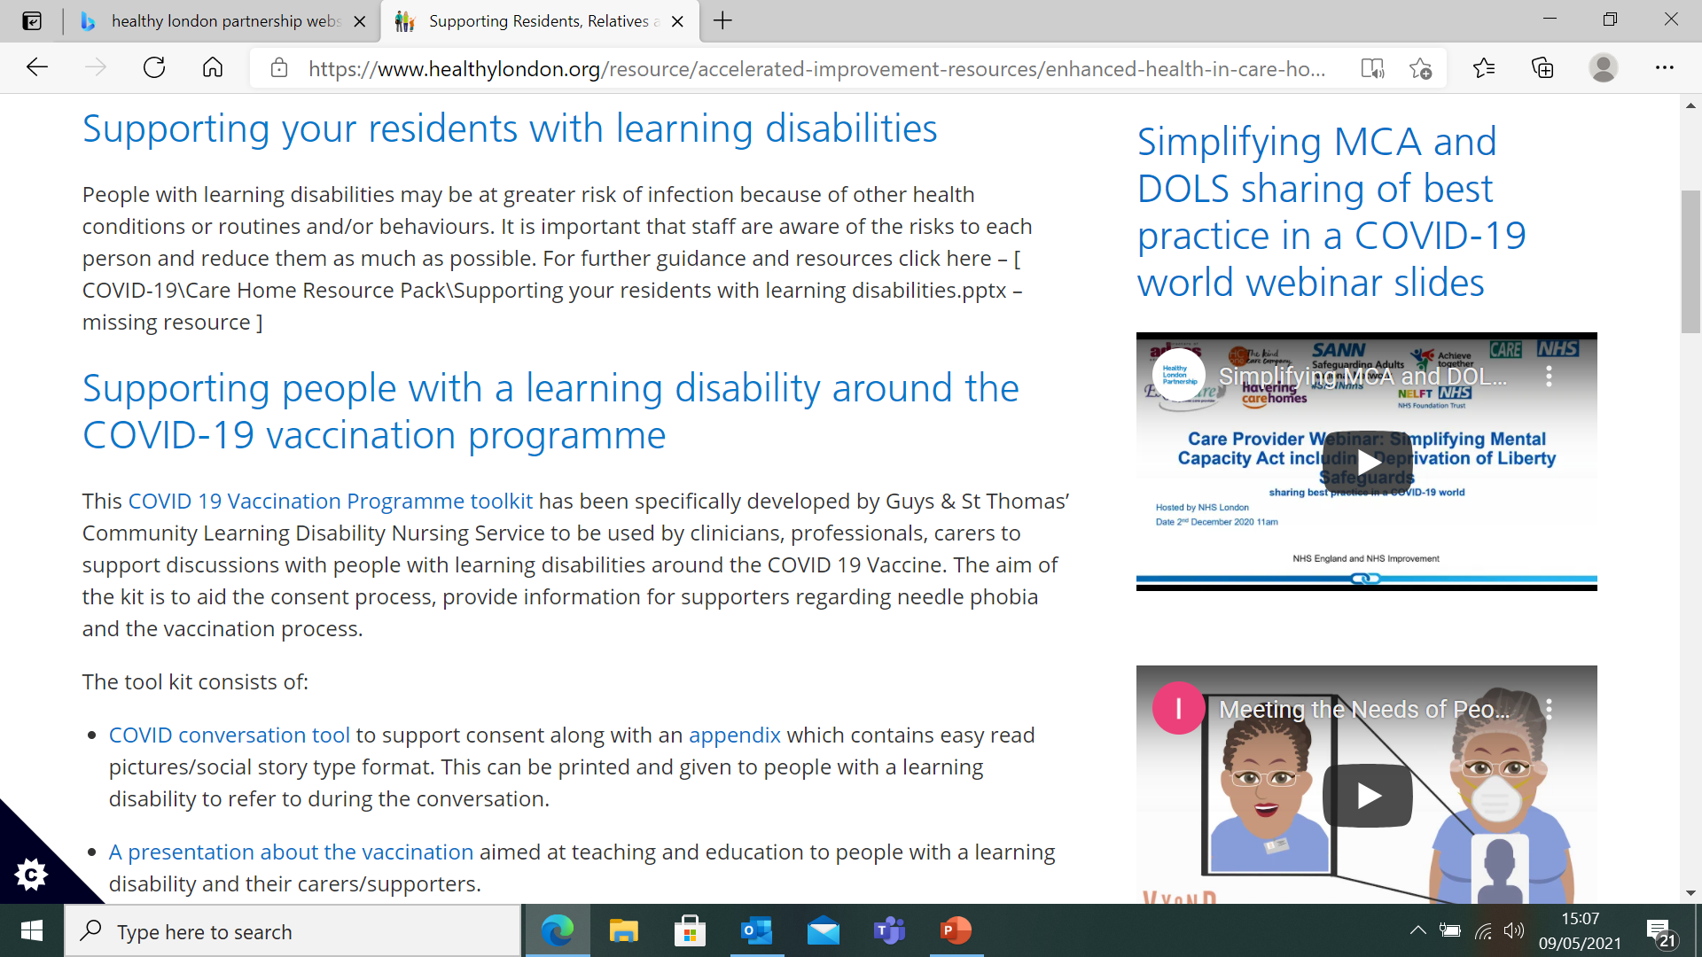
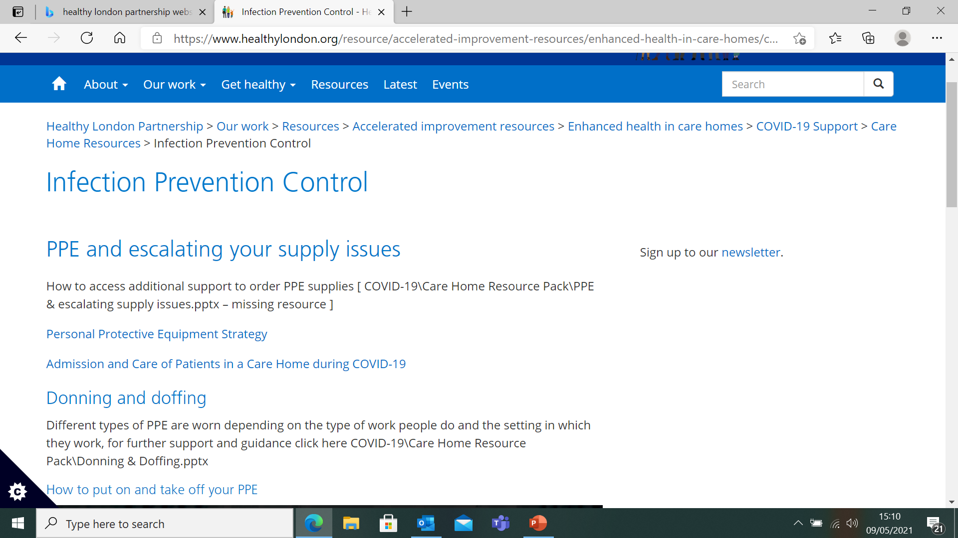
Resources

Slide 11

Resources

Slide 12
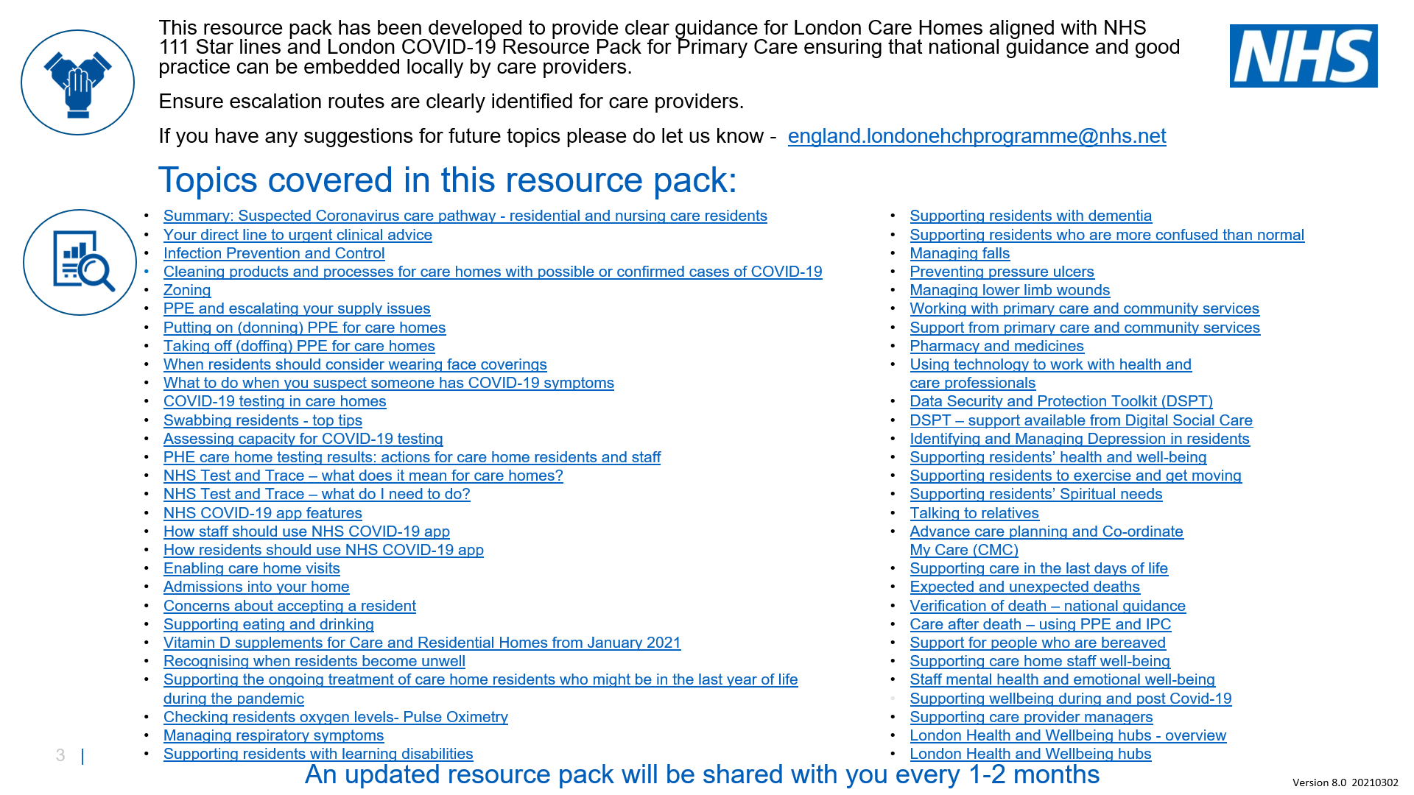

Slide 13
London Care Home COVID-19 Vaccine information pack
Publication date: 14/06/2021
Version 5
Review Date: 12/07/2021
This London guide is designed to complement and not replace local guidance and professional judgement. It will be updated to align with other national and regional guidance once published.
To provide feedback on this pack please contact: england.londonehchprogramme@nhs.net

Slide 14
How to use this pack
This resource pack has been developed to provide clear guidance for London Care Homes about the COVID-19 vaccine, and bring useful resources and information together in one place.
Please note that information and process are continuing to develop, please continue to follow local process and guidance.
Topics covered in this resource pack:
Key messages
Vaccine programme overview
What are vaccines?
How does the Moderna and Pfizer/BioNTech vaccine work?
How does the Oxford/AstraZeneca vaccine work?
Extremely rare blood clots – Oxford/AstraZeneca vaccine
Truths about the vaccine
COVID-19 vaccine animations tackling disinformation
Variants of concern
Fertility Q&As
Pregnancy
Breastfeeding
What are the possible side effects?
Who is receiving the vaccine?
How were the vaccines approved?
Why should people receive a vaccine?
Why should people with a Learning Disability have the Vaccine?
What is the process of getting a vaccine?
What happens after the vaccine?
After Vaccinations
Vaccine information leaflets
Care home managers – preparing for staff vaccines
Care home managers – preparing for staff vaccines – accessing clinical support
Care home staff receiving the vaccine
Preparing for residents to receive the vaccine
Consent
Mental Capacity Act
Capacity Assessment
Supporting residents to make decisions
Summary flow chart – capacity and best interests
Consent forms
What if there are COVID-19 cases or an outbreak at the home?
Managing vaccine anxiety and needle phobia
Techniques to manage anxiety and needle phobia
Summary – supporting residents with dementia, mental health conditions and/or learning disabilities
Capacity Tracker
Additional FAQs
Extremely Rare Blood Clot Q&As
Resources

Slide 15
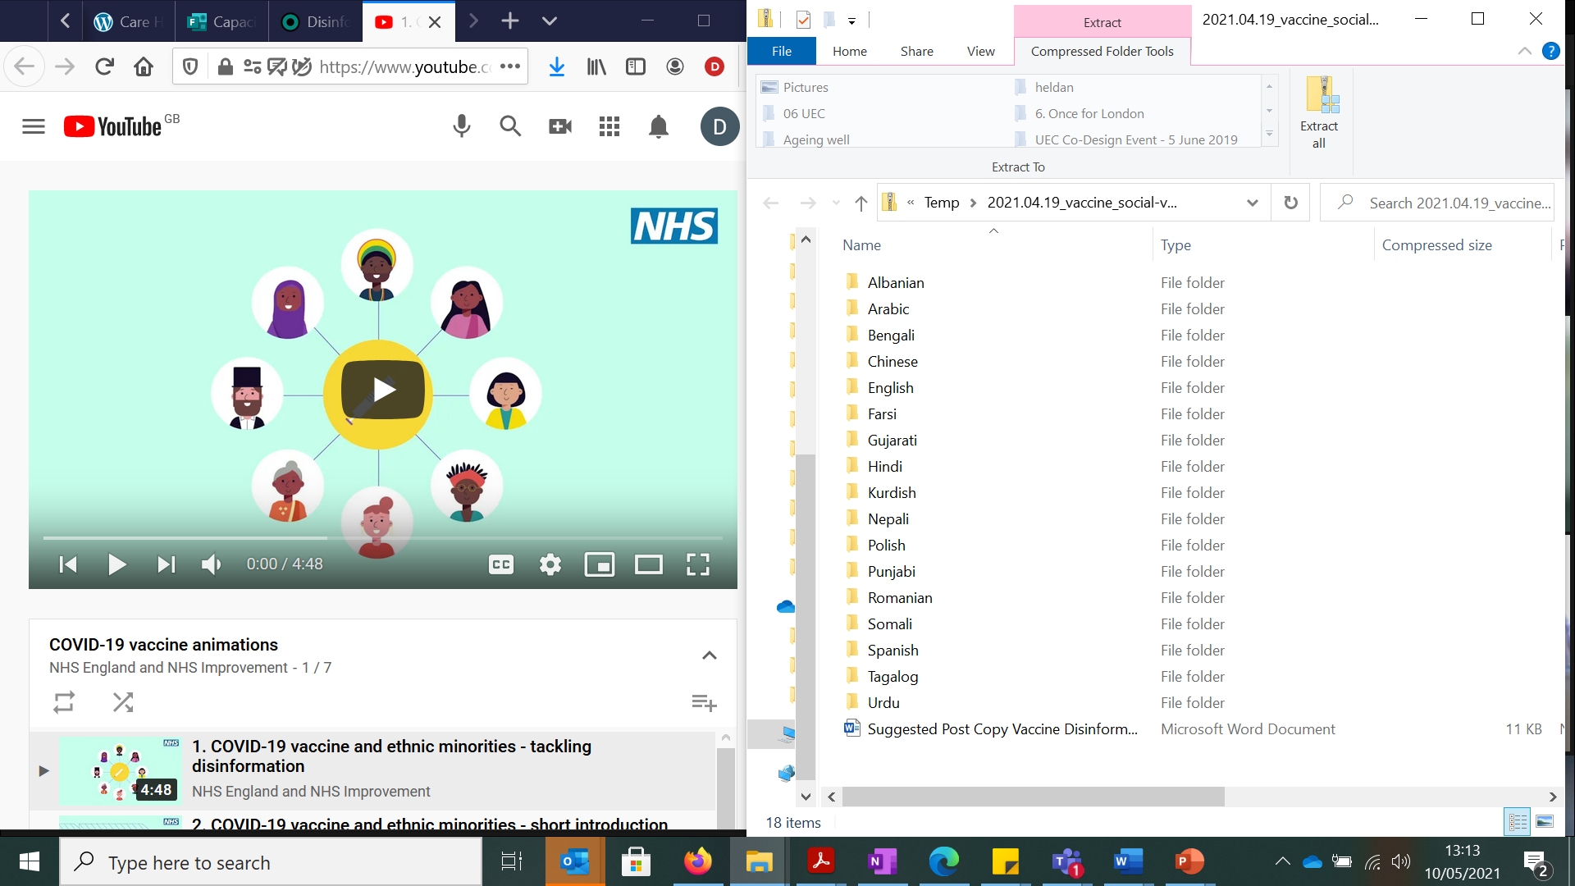
COVID-19 vaccine animations tackling disinformation
NHSE/I has launched a series of animations and suggestedinformation aimed at tackling disinformation about the COVID-19 vaccine and encouraging uptake among ethnic minority groups. The animations are available in 17 different languages. Download them from the Campaign Resource Centre or watch on YouTube.

Slide 16
Care Home Staff
London remains behind national figures for Older peoples CH and Mental Health/Learning Disabailities
BUT…we continue to make progress
From 62.4% 14th March (sprint week)
…..To 71.9% 28th April
……To 81.3 % 28th June

Slide 17
Sprint week – 15th to 21st March 2021

Slide 18
Domiciliary Care - Workforce Demographics
An estimated 5,500 social care establishments were involved in providing or organising adult social care in the London region as at 2019/20, of which 3,355 are non-residential.
237,000 jobs in adult social care in London. 55% are in Domiciliary Care (130,000 jobs), compared to 26% in residential.
42% of jobs are zero hour contracts
The London region accounted for 14% of the 1.65 million adult social care jobs in England.
The adult social care workforce in 2019/20 comprised 81% of workers identifying as female. The average age of a worker was 46years old, and around a quarter of workers (53,000 jobs) were aged over 55 years.
Black, Asian, and Minority Ethnic (BAME) workers made up 66% of the adult social care workforce. This was more diverse than the overall population of the London region (40% BAME). This includes 47% of the workforce identify as Black/ African/ Caribbean/ Black British, compared to 13% of the population in London

Slide 19
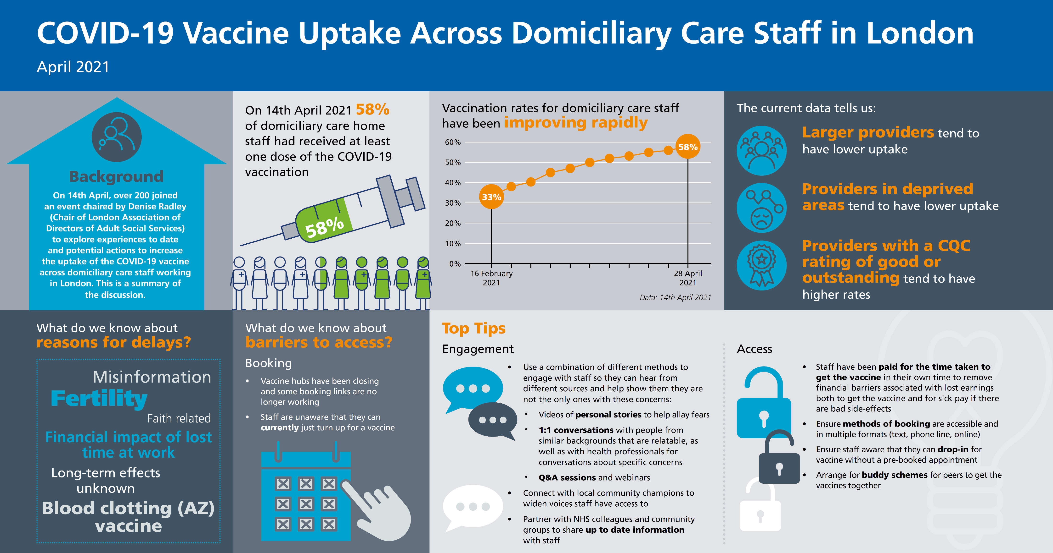
We held a learning event with over 200 attendees

Slide 20
Integrated Digital programmes for Care & Health
Project | Update
Data Security Protection Toolkit (DSPT) | Regional Better Security Better Care support programme developed, supporting ICSs to use their funding to build support teams helping all social care providers to reach ‘Standards Met’ on the DSPT, to demonstrate data security compliance and open up access to further digital tools. Training delivered to ICSs to enable them to take the lead, and reporting developed
NHSMail | April 20 – March 21 - increase in NHSMail coverage in London's care homes, reached roughly 80%, a 300% increase. Coverage in other social care providers has seen a steady increase, and is still considered to be a new area by many of our stakeholders. Team answer daily enquiries, targeted support, hosting webinars and workshops, and providing 1:1 support on fast-track applications. Team now supporting ICSs to help providers maintain levels, and encourage sign-ups before DSPT-NHSMail waiver ends in June 2021.
Proxy Access | Rollout of Proxy Access to medication reordering. Regional support has delivered a 12.8% increase in homes benefiting from this, saving staff time. Project now becoming BAU though regional support for homes to sign up will continue via Barclays Digital Eagles, as we work towards a 25% increase.
Pulse-Oximetry | Team has provided PMO support to roll-out of regional Pulse-Oximetry programme.
Capacity Tracker | Engagement with ICSs, local authorities, care homes, domiciliary care providers, hospices to maintain reporting on Capacity Tracker to provide regional and national oversight of system capacity, business continuity eg PPE supplies, vaccine uptake. Consistently high daily updates from London care homes (~75%) thanks to regular webinars, information sharing and engagement.
Other | Team also works closely with London Digital First programme to support Coordinate My Care, Shared Records Access, Remote Monitoring programmes- pulse oximetry at home, IPADS for all homes, training for staff
Enablers
Data – Care Homes Digital Dashboard – providing real-time digital maturity data on each care home in London, supplemented by new DSPT dashboard for all social care providers
Engagement – Ongoing engagement with LondonADASS and partners across system to develop social care representation and buy-in for all digital work

Slide 21
Urgent Community Response
Overview
2-hour, 2-day response programme (including SEL Accelerator Site Project): To support all systems to deliver the two standards (All systems delivering the 2-hour crisis response at home standard at scale and to deliver reablement care or intermediate care within a maximum of 2 days ), improving patient outcomes and delivering efficiencies for system partners and providers
Community Provider Restoration: Development of the provider mapping restoration tool to understand local restoration processes.
Plans
Support rapid UCR accelerator site delivery
Delivery of UCR Blueprint and ambitions in line with the UCR Clinical Framework
(Re)Mobilise all systems and providers through sector support and learning
Strategic and operational alignment
Improve CSDS and 2hour/2day national and regional oversight
Prototype UCR reporting dashboard and develop evaluation plan
111/999 referral pathways to UCR
Communication with sites to decipher learning from pre/ post/ during Covid
Governance
UCR Regional programme leads
Community Provider Network
Community Health Services Restoration
National UCR Board
National Community Services & Ageing Well Programme
National Discharge and Community Cell
Programme Scoping Document

Slide 22
London Comprises of 5 ICS
Includes 32 Boroughs and 33 2hr Crisis Response Providers
NCL NEL
SWL
NWL
SEL
Presentation title

Slide 23


This or this?
This Photo by Unknown Author is licensed under CC BY-SA

Slide 24
2 Hour Response
The ambition of the standard is to accelerate the treatment of urgent care needs closer to home and prevent avoidable hospital admissions.
NHS Operational Planning Guidance 2021/22
- by March 2022 all systems in England must implement the two-hour crisis response standard.
Minimum requirement, all ICS planners, commissioners and providers must:
  Provide services at scale: full geographic coverage of two-hour crisis response care across systems.
  Provide services from 8am-8pm, 7 days a week at a minimum.
  Accept referrals into crisis response services from all appropriate sources and make crisis response services accessible via 111.
  Submit complete data returns to the Community Services Data Set (CSDS) to demonstrate the achievement of the two-hour standard.

Slide 25
Clock stop
Typical referral routes into crisis response services
Referral routes likely to be increased
Functions of
2hr crisis response services
Clock start
Outcome
Assessment
Urgent and emergency care 111, 999 clinical hubs in ambulance control rooms and patient facing ambulance clinicians
General practice
Social care providers
Care workers
Care homes
Community health services
e.g. District Nursing
VCSE organisations
Self referrals directly or via 111
Urgent and emergency care
111
999 clinical hubs in ambulance control rooms and patient facing ambulance clinicians,
Same Day Emergency Care
Urgent Treatment Centres
Social care providers
Care workers
Care homes
Community health services
specialist teams (e.g. heart failure or respiratory nurses)
VCSE organisations
Primarily a needs based service which may include responding to the following common clinical conditions
Fall
Decompensation of frailty
Reduced function/ deconditioning/ reduced mobility
Palliative/end of life crisis support
Urgent equipment provision
Confusion/ delirium
Urgent catheter care
Urgent support for diabetes
Unpaid carer breakdown
Do not require further support
Single point of access and prioritisation
Service discharge
Immediate crisis resolved and on-going care needed via onward referral
Person experiences
a crisis:
A sudden deterioration in health and wellbeing
and a health or social care need that requires urgent treatment or support within 2hrs in the home setting
Examples of onward care
Community health services
District Nursing
Virtual Wards
Reablement services
Rehabilitation services
Specialist services or condition specific pathways (e.g. frailty or mental health services)
Palliative and end of life care services
Anticipatory care services
General practice/ Primary care networks
Social care providers
Care workers
Care homes
VCSE organisations
Urgent and emergency care
Same Day Emergency Care
Acute hospitals
Care and support delivery
Typical MDT workforce
Registered nurses (inc. district nurses)
Advanced clinical practitioners (inc. AHPs & nurses)
Physiotherapists
Occupational Therapists
Health and care support staff
Social workers
Paramedics
Defining features of a crisis response
Assessment and care should start in under 2hrs
Local single point of access should be used & include access to multi-disciplinary clinical & non-clinical input
Teams should work in an interdisciplinary way
Common interventions
Make the person safe/situation safe
Holistic history review
Clinical observations
Diagnostics
Assessment and provision of equipment
Symptom assessment inc. administration of medicines
Prescription and delivery of appropriate care interventions to support nutrition, personal hygiene, continence, wound care, mobility and rehabilitation to regain or optimise functioning etc.
Key
Year 1: requirement by Mar 22
Year 2: aspiration to increase no. of referrals in 2022 -23

Slide 26
System alignment
Crisis response services will rely on other planned care teams to provide on-going support. These include:
Adult and older adult mental health services: as part of the Long Term Plan, a significant expansion in new integrated models of community mental health services is underway, as well as for urgent mental health crisis services. Alignment and close working is expected to be needed for older adults who are more likely to have multiple co-occurring mental and physical conditions.
Proactive care services such as multi-disciplinary rehabilitation teams, Anticipatory Care and Enhanced Health in Care Homes, which provide proactive health management support to help people to live well for longer.
Community and district nursing services may well provide the core service model to provide crisis response services. These services could be enhanced to become multidisciplinary to respond to all two-hour community crises. However organised locally, district nursing teams will be an important service to provide ongoing planned care after the urgent community response service has ended.
Planned care (with set caseloads) such as hospice at-home services, rehabilitation teams and long-term support provided to people in their homes. This would also include Hospital at Home or Virtual Ward models of care supporting admission avoidance and transfers of care into community settings.
Social care: urgent social care interventions and social care are integral to support people to stay at home or usual place of residence and prevent hospital admission.
Reablement services: crisis response services should work closely with reablement services and support such as social care emergency crisis support for unpaid/family carers.

Slide 27
Design principles
To meet the standard services should: ​
Be coordinated through a local single point of access ensuring a ‘no wrong-door approach’.​
Be centrally co-ordinated enabling professionals to be deployed based on a person’s needs and can involve professionals across a range of teams and organisations depending on how services are configured.
Be interdisciplinary – with staff members from different disciplines taking on the traditional role of another.
Seek to reduce health inequalities in their local population. ​
Establish shared care approaches with Same Day Emergency Care teams and support rapid access to same day diagnostics in acute units.​
Be holistic and personalised to avoid layering services and duplicating assessments and visits.
Comply with Community Services Data Set (CSDS) Technical Guidance.
  Consistently record clock start and clock stops and submit data to CSDS. ​
  Start assessments and care in under two-hours (clock stop) and typically these short-term interventions last under 48hrs.

Slide 28
South East London Urgent Community Response Accelerator site:
Progress
Key achievements
5 of the 6 boroughs has a 7 day, 8-8 service; (6 borough will offer from Q2)
Crisis assessment is provided in all boroughs, latest performance (April 2021) 86% being seen within the standard
Reablement is provided in all boroughs latest performance (April 2021) 83% being seen within the standard
Community Provider Network (CPN) : strong provider involvement and cooperation; mutual aid and high visibility for UCR programme
Good involvement of social care, in all aspects of the programme; growing involvement of primary care.
‘Core offer’ based on agreed outcomes and service elements in place for the UCR pathway - informs ICS commissioning
Integrated health and social care teams (care, packages – significant component of UCR services).

Slide 29
Discharge /Length of stay
Overview
To support the implementation of the National Discharge Policy to the simultaneous aims of avoiding harm and dependence from unnecessarily long hospital stays and managing system resources by supporting discharges home, for any patients that no longer meet the criteria to reside in hospital.
Plans
Data – weekly reporting identifying trends and unwarranted variance in length of stay, discharge numbers, day of the week, weekends, pathways (home, home with support, rehabilitation, care homes)
Discharge funding
Improvement: Alliance 16 improvement programme & 5 Trusts of focus
Rehabilitation pathways
Specialty pathways – Homeless Health, Mental Health, End of Life Care, Hoarding
Partner programme collaboration – ECIST, BCF, ADASS, voluntary sector, CHC
Governance
London Region LOS and Discharge Oversight Group (DOG)
Regional Programme Coordination Group
System Level Oversight
National ODG
National Discharge and Community Services Cell
Programme Scoping Document

Slide 30
Digital Community Health Services Programme
Our purpose:
Our purpose is to ensure community health services, as part of local systems, provide a comprehensive digitally enabled service that aspires to the highest standards of excellence and professionalism, available to all based on clinical need, and delivering the best value for the taxpayers’ money.
Our mission:
This programme will:
value patient and staff experience with a focus on user-centred design and digital inclusion;
drive forward digital transformation within community health services to improve patient care;
address digital debt through targeted investment in community health provider infrastructure; and
develop capacity and capability in regional and local teams to deliver change.
For London enabling community services staff have access to shared care records has been identified as a priority & Frailty Virtual Wards

Slide 31
Anticipatory Care – Starting in October 2021
Implement ‘anticipatory care’ for complex patients in their own home at risk of unwarranted health outcomes right across the country.
Targeting support towards older people with moderate frailty as well as people of all ages living with multiple comorbidities.
The programme will be delivered through Primary Care Networks and multi-disciplinary teams, and use the Electronic Frailty Index and clinical judgement to identify older people living with moderate frailty and their carers who are at risk of adverse health outcomes and provide them with tailored care.
Intended key outcome: supporting people to stay well and at home for as long as possible
Multi-Disciplinary Assessments
Care Manager
Comprehensive personalised care plan
Support in place – health, social care, voluntary sector, mental health etc.
Outcome measures – citizen experience, impact on well-being, care contacts, early identification of need

