Slide 1
QUALITY ACCOUNT
2015/16
Briony Sloper
Deputy Director of Nursing and Quality

Slide 2
What is a Quality Account?
Since the introduction of the Quality Account in 2009 all NHS Trusts are required to publish quality accounts.
A focus on quality improvements: in each organisation: the reports provide an opportunity to set out how the Trust intends to improve its own quality.
Board ownership: this can lead to ambitious board-driven quality improvement priorities, measures and programmes of work.
Engagement with clinicians and patients: the priorities and metrics included in the Quality Account must be relevant and public. Broad engagement in the development of quality reports is needed to meet these requirements.
A wider quality debate: Quality Accounts should provide an opportunity for providers to describe their performance and their improvement goals.

Slide 3
Executive Summary
Substantive appointment
CQC & special measures
Recruitment and retention
Increase in demand
Terror threats and resilience
Staff engagement and investing in our workforce
LAS Academy
Staff survey
Everyone has a role to play – forward momentum

Slide 4
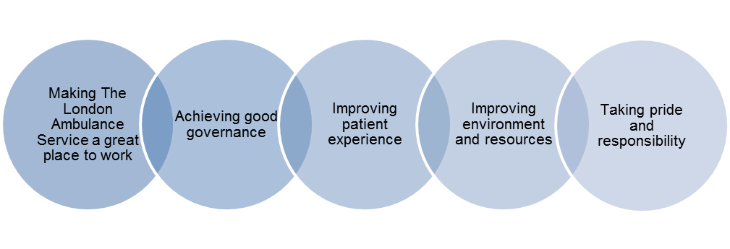
Our Purpose and Values
Clinical Excellence, Care, Commitment

Slide 5
2016/17 Quality priorities
1/ Patient Safety
Sign up to Safety campaign
Continue to learn from incidents
Focus on high risk areas such as maternity, mental health and paediatrics
Duty of Candour
Medicines Management
Storage,
Record keeping
Infection Control
Cleanliness of stations
Bare below the elbow
Blankets

Slide 6
2016/17 Quality priorities
2/ Patient Experience
Mental Health
Dementia
Patients detained under Section 136
Bariatric Care
Dignity
Equipment/Conveyance
End of Life Care
Training
Incident review
Patient/carer experience
Stakeholder engagement

Slide 7
2016/17 Quality priorities
3/ Clinical Effectiveness and Audit
Exercise Unified Response 2016
Continuous Re-contact
Sickle Cell Crisis
Hypovolaemic Shock
Mental Capacity Act
Continued from 2015-16
Paediatric Conveyance Review
Heart Failure

Slide 8
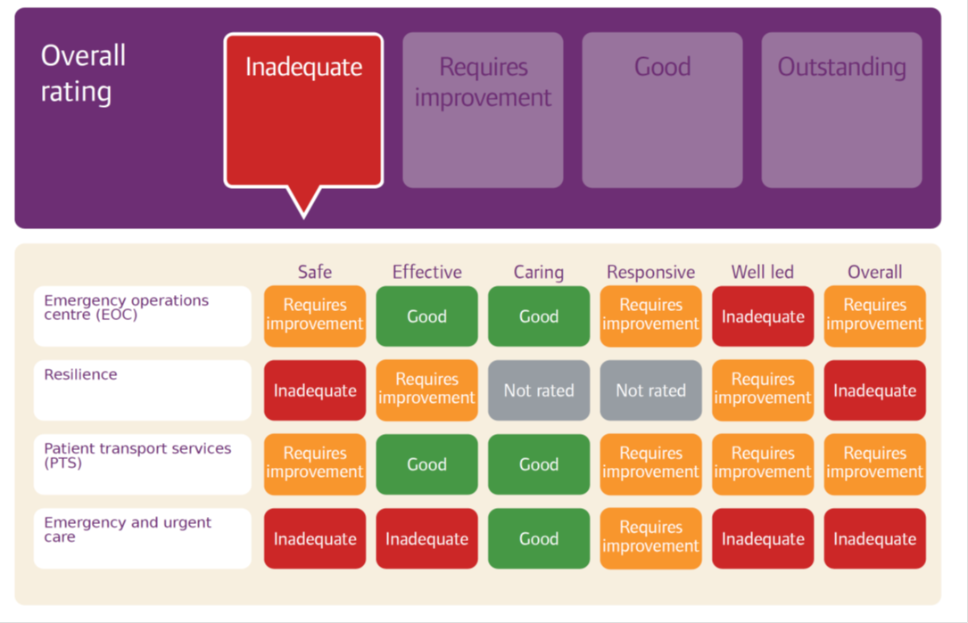
Board Assurance Statements
Audits undertaken
CQUINs – last years and this years
Patient safety incidents - across 2015/16 out of 396 cases reviewed 62 incidents were declared as serious incidents
CQC – inspection results,
scoring grid, improvement plan

Slide 9
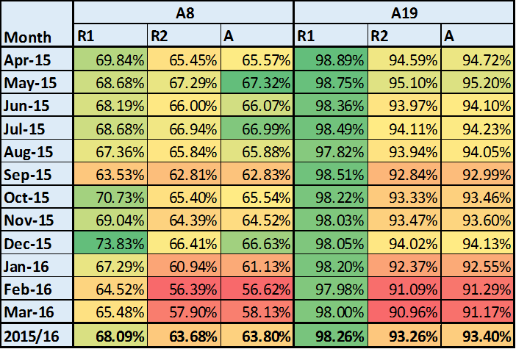
Core Indicators
Response Times
STEMI and Stroke performance – care bundles

Slide 10
Quality Priorities 2015/16 Patient Safety
Sign up to Safety Campaign
In 2015-16 the Trust enrolled on to the Sign up to Safety campaign in order to contribute to the system-wide ambition of making the NHS the safest healthcare system in the world by creating a system devoted to continuous learning and improvement. This meant signing up to 5 specific pledges:
1. Putting safety first. Commit to reduce avoidable harm in the NHS by half and make public our locally developed goals and plans
2. Continually learning. Make our organisation more resilient to risks, by acting on the feedback from patients and staff and by constantly measuring and monitoring how safe our services are
3. Being honest. Be transparent with people about our progress to tackle patient safety issues and support staff to be candid with patients and their families if something goes wrong
4. Collaborating. Take a lead role in supporting local collaborative learning, so that improvements are made across all of the local services that patients use
5. Being supportive. Help people understand why things go wrong and how to put them right. Give staff the time and support to improve and celebrate progress.

Slide 11
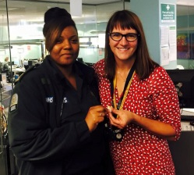
Quality Priorities 2015/16 Patient Safety
Maternity
Celebration of International Day of Midwifery (5.5.2015) and
launch of Maternity Mannikin.
Clinical Safety – Establishment of 6 week Maternity Risk Summit
Establishment of Joint Maternity Training for the
Pre-Hospital Setting led by LAS and local Maternity Units
– 100 Ambulance Staff trained with midwives across London.
Delivery of Maternity “Mouthfuls” training for staff working within the Emergency Operations Centre to reinforce the advice given over the telephones
Responsive changes to the triage system used within the LAS reviewed and submitted to improve care – Cord Prolapse, Water birth, Cardiac Arrest and Skin to Skin care for new-borns.
Stork Awards initiated to celebrate the work of Emergency Medical Dispatchers in management of telephone support to women who give birth prior to the arrival of the ambulance service

Slide 12
Quality Priorities 2015/16 Patient Safety
Frequent Callers
Darzi Fellowship
Review of current processes
Quantifying the problems posed to the service
New reporting system
Understanding the different cohorts of patients who make up this group of patients
Evaluating intervention methodologies to assess effectiveness
Engagement with key stakeholders

Slide 13
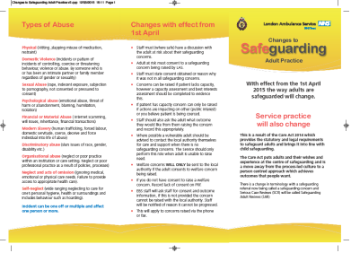

Quality Priorities 2015/16 Patient Experience
Safeguarding processes
Training
Supervision
Partnership working
Implementation of the new Care Act and associated reviews.

Slide 14
Quality Priorities 2015/16 Patient Experience
Mental Health
Dementia care - Focus groups, dementia friends, raised awareness, partner engagement
Training and Education – mental health nurses, risk awareness tool, core performance indicators
Parity of esteem – appropriate care pathways
Care of patients detained under the mental health act (1983) – NETS, 136 audit
Mental health and wellbeing of LAS staff - Blue Light Pledge, Hear Us, MIND training, literature

Slide 15
Quality Priorities 2015/16 Patient Experience
Complaints and PALS
Deep Dive and process review of the complaints backlog, systems and processes and identified:-
•Process and system for managing statements from crews
•Process and system for managing Clinical opinions form the medical directorate
•Process and system for managing throughput in the Executive office
•Process and system for managing complaints from Health Care Professionals
A comprehensive action plan was developed which has been integrated into the Quality Improvement Plan

Slide 16
Quality Priorities 2015/16 Workforce
Recruitment
In total we have brought 717 additional frontline staff in 2015/16
increased the number of Paramedics in training with our 4 main Universities from 150 to 590 training places
Retention
Non pay benefits, appraisals, leadership training (clinical team leaders)
Engagement
Annual plan of events – road shows, executive visibility, new intranet, VIP awards, CEO video messages, Facebook
Training and Development
Core Skills Refresher, e-learning, record keeping
.

Slide 17
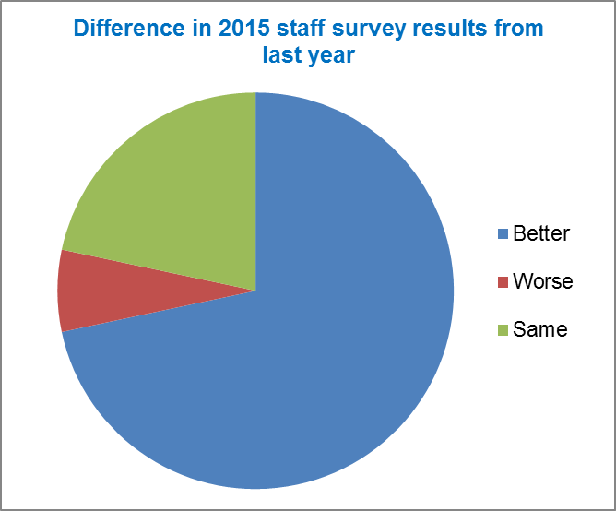
Staff Survey
Significantly better in 2015 in 43
Around the same in 13 of them
Significantly worse in 4
•Acting upon concerns raised by patients and service users
•Managers taking a positive interest in the health and well-being of their staff
•Staff looking forward to going to work
•Happiness with the standard of care provided by the organisation

Slide 18
Staff Survey

Slide 19
Complaints and Patient Advice & Liaison
Activity
The volume of complaints dropped this year, totalling 1050 against 1403 in 2015/16
Themes
Delay and staff conduct.
Many complaints involve multiple issues
Increased number relating to alternative pathways
Performance
Deep Dive results and impact on 35 days response targets
Improvements made arising from patient feedback
Elderly fallers protocol
Children who have swallowed a foreign object
Diabetes and ketone levels
Non weight bearing injuries
Deep lacerations
Ombudsman cases

Slide 20
PATIENT ENGAGEMENT
Patient Representative Reference Group
Mental Health Focus Groups
Dementia Focus Groups
Friends and Family Test (FFT)
Taxi Usage (patient survey)
Feedback from events
The range of events we attend is extensive including Basic Life Support and cardiac awareness training, Careers events, Job Fairs, Junior Citizenship, Knife Crime awareness, First Aid (Brownies, Cubs groups), road safety initiatives, Mental health events, deaf awareness training, Older peoples groups, Learning disability groups, Patient and Public Involvement events.

Slide 21

Patient and Non-Emergency Transport
Non-Emergency Transport service (NETs) commenced in June 2015. to increase the availability of frontline crews to attend life threatening calls made to the service and ensure lower acuity patients receive transport within an agreed timeframe providing for a better patient experience.
Incidents, complaints and feedback
Call Quality and monitoring
Safeguarding
Patient Experience
General governance activity
Other information

Slide 22
QUESTIONS?

