Slide 1
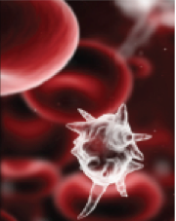
Sepsis
Tim Edwards
Consultant Paramedic – London Ambulance Service NHS Trust

Slide 2
What is sepsis ?
Overwhelming systemic response to infection
Can rapidly lead to organ failure and death
May trigger abnormal clotting and bleeding
Most likely to develop from infection, trauma, surgery, burns, cancer and AIDS.
80% of patients who die from major injuries are actually killed by sepsis.
Notes:
Why do we rapidly assess and treat chest pain but seem far more relaxed about suspected sepsis

Slide 3
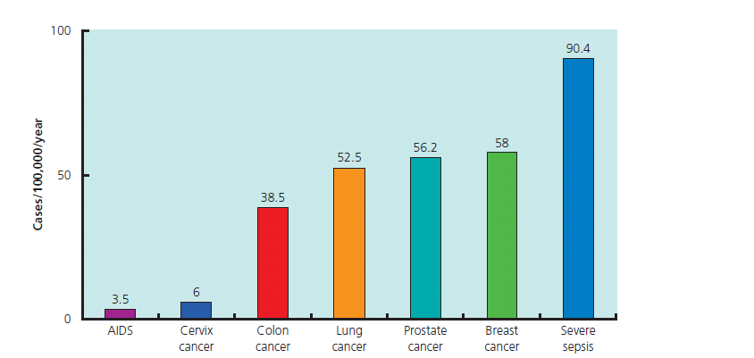
Severe Sepsis Prevelance
Incidence of severe sepsis in Europe, (Davies A 2001)

Slide 4
Extent of the problem
37,000 lives claimed annually in the UK from Sepsis
Mortality 35% in Severe Sepsis
Mortality 50% in Septic Shock
Costs an estimated 2.3 billion per year to the NHS
Notes:
Sepsis is one of our biggest killers! sepsis claims 37,000 lives every year in the UK and costs the NHS £2.5 billion a year. Mortality ranges from 35% in severe Sepsis to 50 % in Septic shock. In comparison, breast cancer claims less than 8,000 lives a year. For survivors long term physiological and physical disabilities. Rapid intervention is essential to save lives.
For survivors, life can be difficult- through obvious physical injury such as the loss of digits or limbs, or through ‘hidden’ problems like post-traumatic stress disorder, sleep disturbances, anxiety or chronic pain. Common Long Term Problems. Post Sepsis Syndrome (PSS) is the term used to describe the group of long term problems that some patients who have experienced severe sepsis can suffer during their rehabilitation period. The effect of any critical illness and spending time being treated in a Critical Care Unit is already recognised by health care professionals as causing certain long term problems for up to two years afterwards. However, sepsis can cause additional problems which may not become apparent for several weeks, for example, recurring infections during the rehabilitation period. It is important to remember that not everyone experiences problems after being critically ill and the length and severity of the sepsis and the fitness of the individual prior to their illness has a marked impact on how quickly they recover. The length of time spent in hospital can also affect rehabilitation. These problems can be divided into physical or psychological and emotional.
Physical:
•Lethargy / excessive tiredness
•Poor mobility / muscle weakness
•Breathlessness / chest pains
•Swollen limbs (excessive fluid in the tissues)
•Joint pains
•Insomnia (due to pain / breathlessness)
•Hair loss
•Dry / flaking skin and nails
•Taste changes
•Poor appetite
•Changes in vision
•Changes in sensation in limbs
Psychological and emotional:
•Anxiety / fear of sepsis recurring
•Depression
•Flashbacks
•Nightmares
•Insomnia (due to stress or anxiety)
•PTSD (Post Traumatic Stress Disorder)
Long Term Recurring Infections
A very small percentage of sepsis survivors suffer recurring infections during their rehabilitation period. Occasionally, this may last for several years. These infections can present as a milder version of the original sepsis experienced by the patient or as infections starting in different areas of their body. They often need treatment with antibiotics and can be very wearing both physically and mentally
References
http://.sepsistrust.org
Daniels R (2014) Survive Sepsis (3rd ed) UK Sepsis Trust

Slide 5
Systemic Inflammatory response syndrome (SIRS)
≥2 of the following
Temperature >38.3c or <36c
Heart rate >90/minute
Respiratory Rate >20/minute
BM >7.7 (in non diabetic patient)
Acutely altered mental state
Notes:
The box above is the currently accepted criteria for SIRS. If the patient has two or more of the criteria then SIRS is present.
Systemic Inflammatory response syndrome (SIRS) is our systems ability to respond and attempt to overcome an injury. During this protective period, inflammation starts, blood vessels dilate and the capillaries leak fluids. The area becomes warm and red due to this vasodilation. Increased blood flow results in more white blood cells getting to the area to fight the potential infection and more platelets and fibrin are delivered to stop the bleeding. The capillary leakage is necessary because the damage is to the tissues and cells and these substances can do little to help from inside the blood vessel. Generalised inflammation manifests as SIRS. Our immune system is acting rapidly and signals for the bone marrow to make more white blood cells (wbc) in case of infection and causes vasodilation. As our cells and tissues are working harder we experience an increase in O2 and glucose demands. Therefore a patient with SIRS may have a raised wbc count, a high temperature tachycardia, tachypnoea and a raised blood glucose. The system can not keep this high level response up forever and if the SIRS cause continues some of the adaptive responses begin to fail. The bone marrow can not produce WBC’s as quickly as they are being used up if infection is present and our wbc count may fall. The vasodilation causes blood to be diverted to the skin and peripheries and we can loose heat temperature falls. This can cause reduced blood flow to major organs and the brain may not get enough glucose and O2 causing confusion, agitation or drowsiness.
Temperature: Some patients can be hyper/hypothermic. An initial raise in temp is from the release of prostaglandin E2. As the sepsis develops vasodilation leads to increased peripheral blood volume and a warm and pink appearance, the vasodilation also contributes to the hypotension and tachycardia but can also lead to increased heat loss from the peripheries this can eventually lead to a drop in core body temperature.
Tachycardia: Initially tachycardia coupled with increased stroke volume tries to meet the O2 demand. In profound sepsis Relative hypovolemia reduces stroke volume therefore increase heart rate further.
Tachypnoea: Respiratory rates above 20 in adults is seldom normal and is a sensitive sign of an acutely unwell patient therefore important to measure correctly. If measured over 15 seconds an error of one is made four times greater when scaled up.
BM: Raised BM is found as part of the stress response in septic patients due to the release of substances to mobilise glucose. The flight or fight response results in initial low levels of insulin, high levels of cortisol and high levels of glucagon which lead to the raised BM.
References
http://.sepsistrust.org
Daniels R (2014) Survive Sepsis (3rd ed) UK Sepsis Trust

Slide 6
Sepsis
SIRS + Infection = Sepsis
Notes:
SIRS
Sepsis
ARDS
MODS
DIC

Slide 7
Types of sepsis
Simple sepsis - response to an infection
Severe sepsis - the above plus one or more signs of organ dysfunction
Septic shock = hypotension not responding to adequate fluid challenge
Notes:
The next slides discuss Simple v Severe Sepsis.
Septic shock is defined by the sepsis trust as the most severe end of the spectrum. If an individual BP drops below 90mmhg or more than 40mmhg from their base line this is termed Sepsis induced hypotension, if this hypotension is unable to be remedied by IV fluid resuscitation this is classed as Septic shock. Septic shock carries a 50% mortality rate. It is unlikely that the diagnosis of Septic shock will be identifiable in the pre hospital setting as a patient with septic shock would be a time critical transfer with a pre alert of sepsis and the fluid administration administered on route.
References
http://.sepsistrust.org
Daniels R (2014) Survive Sepsis (3rd ed) UK Sepsis Trust

Slide 8
The Sepsis six

Slide 9
LAS Sepsis Audit 2015
Retrospective audit 200 patient records
87% necessary observations to identify sepsis
n=70 (35%) with evidence of ≥ severe sepsis
14% high flow O2
18% IV fluids
40% had pre-alert

Slide 10
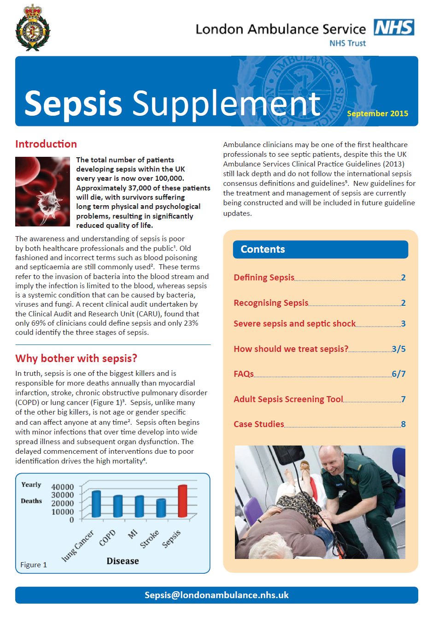

Slide 11
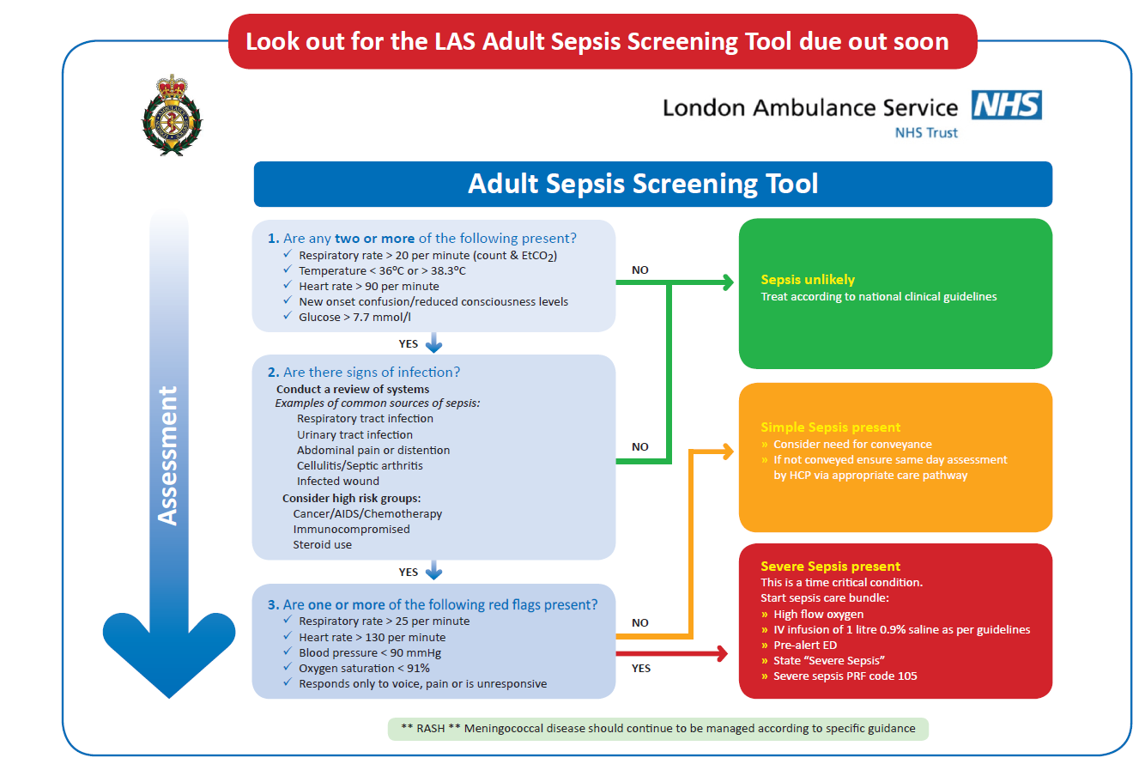

Slide 12
Questions ?

