Slide 1




STAR partnership
Pan-London housing and homelessness service for Londoners over 25

Slide 2
What we do
free housing, welfare benefit and debt advice
face to face advice surgeries and street outreach
specialist, confidential housing advice and advocacy for LGBT people
practical help to keep your tenancy
support to access health and community services
support to find properties in the private rented sector
support to access employment and training

Slide 3
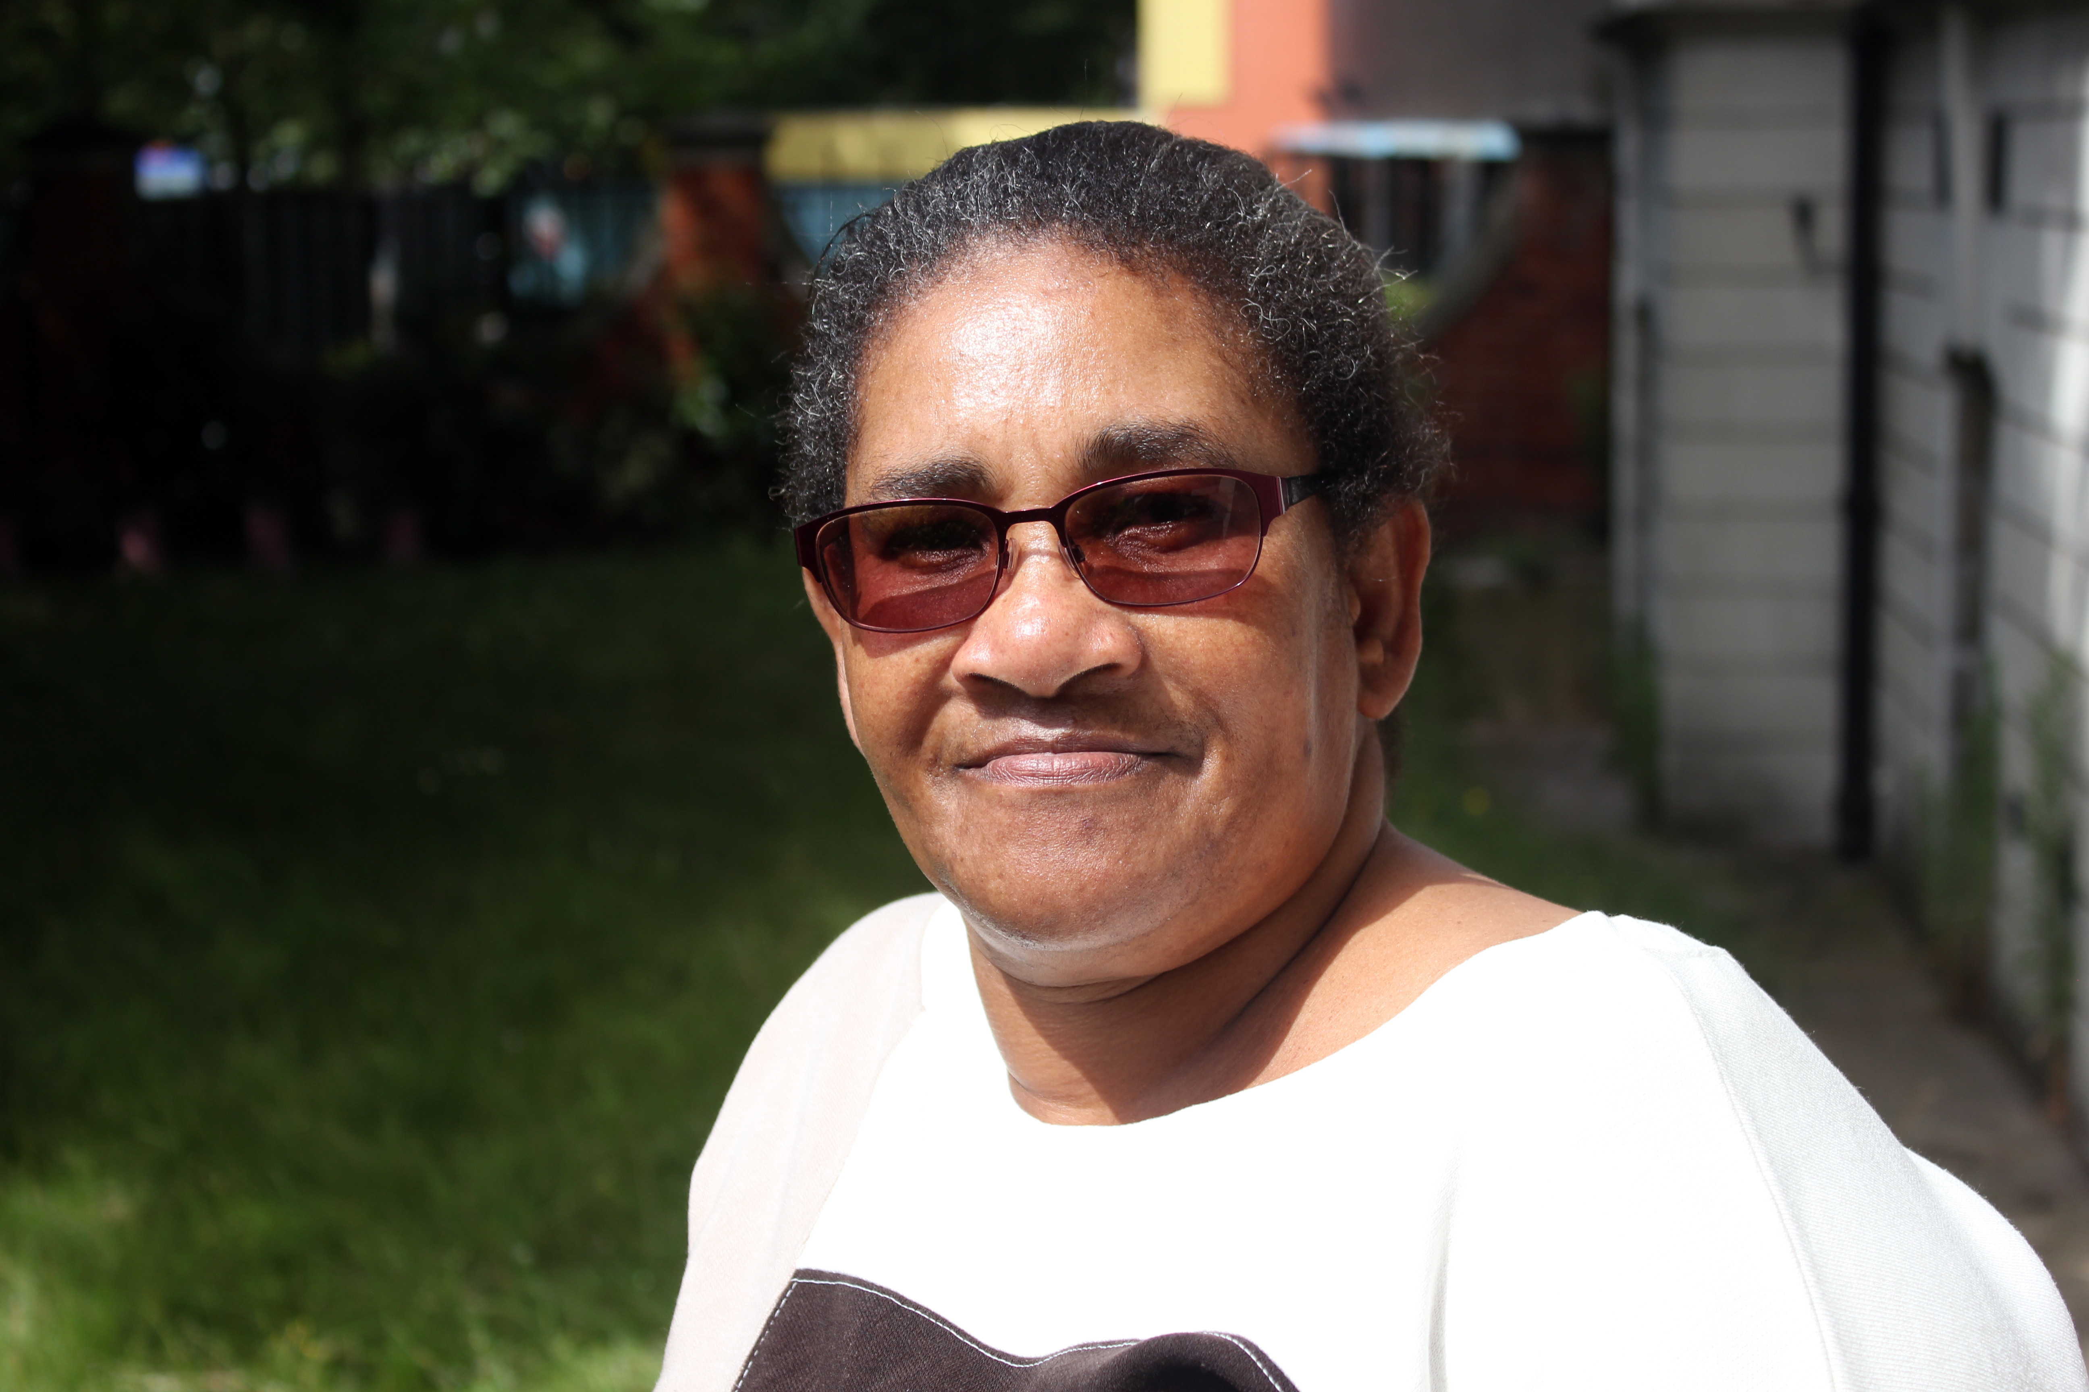
How to access the service
Call us on 0344 515 1540 for advice and to find out more about how we can help you.
For direct access to confidential housing advice and advocacy for LGBT people, call Stonewall Housing on 0207 359 576.

Slide 4
Who to contact
Ben Tovey
London Hub Manager
Ben_tovey@shelter.org.uk
Amy Wilkes
Service Manager
amy_wilkes@shelter.org.uk

