Slide 1
INTRODUCTION
TO THE ROLE OF NHS TDA
April 2015

Slide 2
Ambition
There has been much change to the health and care system in the two years since the establishment of the NHS TDA, but the goal of NHS trusts and all NHS providers remains the same: to provide high quality, sustainable services to patients.
As a result, the role of the NHS TDA remains unchanged: to oversee and hold to account NHS trusts across all aspects of their business, while providing them with support to improve services and ultimately achieve a sustainable organisational form.
Hence the objectives of NHS Trusts and the TDA are the same, and The Trust’s success is the TDA’s success.
All the core elements of the relationship between NHS Trusts and NHS TDA are captured in a later slide

Slide 3
Principles underpinning our work with trusts (1 of 2)
The principles underpinning our work with trusts have remained unchanged since we published our first Accountability Framework:
Every interaction we undertake has an impact on the quality of care patients receive – our focus on quality improvement remains central to the work of the NHS TDA;
One model, one approach – the NHS TDA is a national organisation and the approach set out in the Accountability Framework will be applied consistently to NHS trusts across England and across all sectors of care;
Clear local accountability for delivery – the accountability for all aspects of NHS trust business remains with the board of the trust, held to account and supported by the NHS TDA;
•

Slide 4
Principles underpinning our work with trusts (2 of 2)
Openness and transparency – being open and candid publicly about the quality of care remains central to the NHS TDA’s approach;
Making better care as easy to achieve as possible – working with partners to create the right environment for change remains a central challenge both locally and nationally;
Working supportively and respectfully – the NHS TDA recognises the very significant challenges faced by NHS trust boards and therefore aims to work supportively and respectfully at all times;
An integrated approach to business – the NHS TDA remains committed to aligning all the different aspects of its business with NHS trusts through a single set of processes, as set out in this Accountability Framework

Slide 5
Relationship with NHS trusts
The NHS TDA operates through:
The oversight process. This includes the way in which the NHS TDA measures and scores the quality and sustainability of services and how the NHS TDA holds trusts to account for delivering the required standards. It also covers expectations of trusts in terms of senior appointments, the handling of whistleblowing cases and information governance;
The development offer from the NHS TDA to NHS trusts. Whilst there is rightly a strong focus on delivering for patients today, the NHS TDA is bolstering the ways in which it supports NHS trusts to deliver in the longer-term. This includes change and improvement management and professional leadership;
The approvals processes around foundation trust applications, transactions and capital development.

Slide 6
How we work with trusts
The Accountability Framework – Refreshed March 2015.
(Sets out how we oversee trusts, support and develop trusts and how we intervene if delivery is off track).
Planning Guidance –
Refreshed December 2014
(Sets out what we expect trusts to deliver to ensure they are providing high quality, sustainable services for patients and their local communities).

Slide 7
Matrix working within the NHS TDA
Chief Executive
Delivery & Development Directors
Finance Director
Medical Director
Nursing Director
Director of Strategy
Core account teams
Additional NTDA support
Additional external support

Slide 8
DEVELOPMENT AND SUPPORT
The unique advantage of the NHS TDA is its dual focus on both delivery and development – not only working alongside organisations to support them to adopt best practice over the medium to long term, but also working with them to overcome day-to-day issues they face.
Our aim is to provide three core levels of support to NHS organisations and their leaders:
A professional leadership and development programme for chairs and their boards, medical directors, nurse directors, finance directors, communications and strategy directors and COOs;
A range of medium-term support programmes, to be delivered over 12-18 months to support cohorts of NHS trusts, to address key underlying issues, for example, improving flow, modernising the emergency care pathway and service integration; and
A partnership programme, running over 3-5 years, to create partnerships between a small number of NHS trusts and successful improvement organisations to support trusts to fundamentally improve their management systems and processes to become sustainably more efficient and effective in the long term.

Slide 10
Working in Partnership across the system
Alignment of oversight models: Monitor Risk Assessment Framework & TDA Accountability Framework
Alignment of planning guidance.
Alignment of assessment and authorisation processes.
Joint work on choice & competition cases and transactions.
Joint sector engagement & development offers.
Alignment of planning guidance.
Triangulation of local health economy plans.
Resolution of local health economy issues.
Quality Surveillance Groups.
Local system resilience.
Alignment of quality oversight models: CQC Intelligent Monitoring & TDA Accountability Framework
Incorporation of CIH inspection into FT application process.
Local intelligence sharing.

Slide 11
Partnership Working
Working in Partnership across the system
Triangulation of workforce planning and surveillance data.
Collaboration on strategic & operational workforce issues.
Collaboration on quality improvement initiatives.
Consultation of production of standards and guidance.
Tailored support from NICE field team for individual trusts.
Intelligence sharing on Education & Training, Fitness to Practice and Revalidation.
Potential joint development initiatives on clinical leadership.
Intelligence sharing on Education & Training, Fitness to Practice and Revalidation.
Information sharing around complaints and investigations.
Patient and public involvement.

Slide 12
WRITTEN QUESTIONS?

Slide 13
Additional Information
Non-Executive Directors
Executive Directors

Slide 14
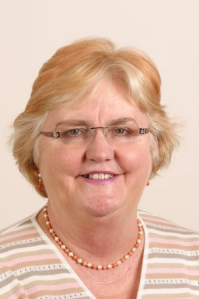
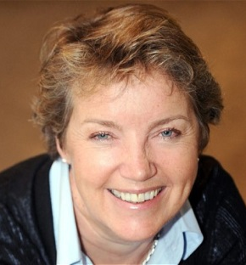
Non-Executive Directors
Sir Peter Carr CBE
Chairman
Dame Christine Beasley
Chair of Appointments Committee
Sarah Harkness
Chair of Audit Committee
Caroline Thomson
Non-Executive Director
Crispin Simon
Non-Executive Director

Slide 15
Executive Directors

