Slide 1
Unconscious Bias – A Taster
Mohamed Kebbay, Diversity Advisor
Race for Opportunity and Opportunity Now
Notes:
Welcome and brief introductions
Brief insight into Unconscious Bias – further work will be needed to highlight what your biases are...
http://www.youtube.com/watch?v=uESZRjP6D_Y (optional)

Slide 2
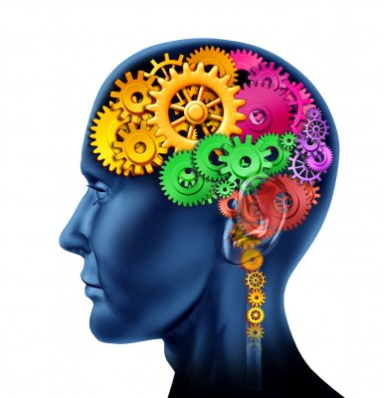
Overview
What is Unconscious Bias?
How do I recognise It?
How do I manage it?
What are the consequences?
What can we do?
Q&A / Discussion
Notes:
Outline overview – what we are going to cover in the next 45 - 60 minutes

Slide 3
What is UB?
Unconscious/Hidden bias is a neurological concept
Unconscious biases are our unintentional people preferences, formed by our socialisation and experiences, including exposure to the media.
Can help with quick-think / survival situations but can also (if unchecked) lead to disproportionate and discriminatory behaviour.
Notes:
Our unconscious brain processes and sifts vast amounts of information looking for patterns (200,000 times more information than the conscious mind). Scientists estimate that we are exposed to as many as 11 million pieces of information at any one time, but our brains can only functionally deal with about 40.
So how do we filter out the rest? How is it that we can walk down a busy street in London with a virtual ocean of stimuli and still look for a specific person or thing? How can we have a conversation with a friend in the middle of thousands of people at a music festival? We do it by developing a perceptual lens that filters out certain things and lets others in, depending upon certain perceptions, interpretations, preferences and biases that we have adapted throughout our life.
Anyone here like Designer bags? Anyone help me name a few brands. Louis Vutton, Prada, Gucci, Christian Dior

Slide 4
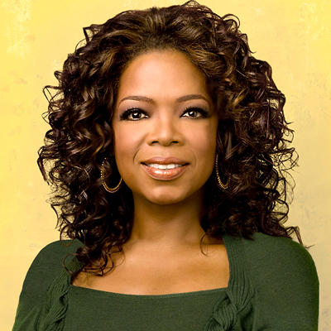
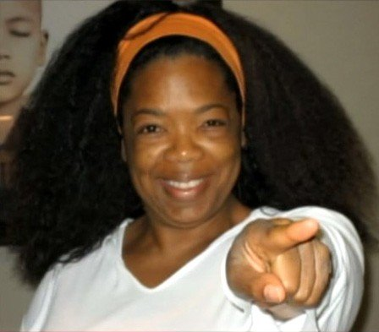
Notes:
Oprah Gail Winfrey is best known for her multi-award-winning talk show "The Oprah Winfrey Show" which was the highest-rated program of its kind in history and was nationally syndicated from 1986 to 2011. She has been ranked the richest African-American of the 20th century, the greatest black philanthropist in American history and was for a time the world's only black billionaire.
OW went into a store and I say to the woman ‘‘Excuse me, could I see the bag right above your head?” and she says to me “No. It’s too expensive.”’ Miss Winfrey asked a second time to see the bag, which was locked in a cabinet to deter shoplifters.
But oblivious to her fame and fortune, the shop assistant allegedly replied: ‘No, no, you don’t want to see that one, you want to see this one because that one will cost too much. You will not be able to afford that.’
It may have been beyond the salaries of ordinary mortals, but £24,460 is small change to a celebrity worth about £1.8billion.

Slide 5
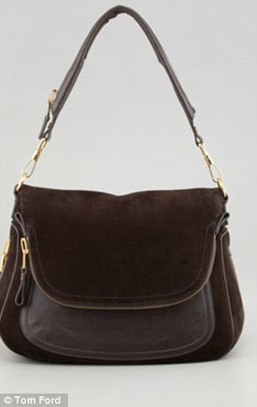
Notes:
Controversy: The bag in question was a Jennifer bag in crocodile skin. Tom Ford designed the handbag for the actress, pictured with it left, and now makes it in a number of different finishes, right.

Slide 6
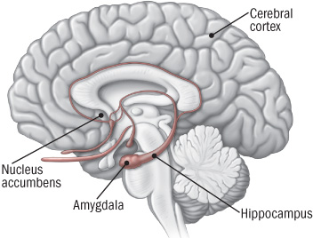
What is UB?
Notes:
Brain imaging scans have demonstrated that when people are shown images of faces that differ to themselves, it activates an irrational prejudgment in the brain's alert system for danger; the amygdale. This happens in less than a tenth of a second. Our associations and biases are likely to be activated every time we encounter a group member. We socially and intuitively categorise people in similar ways which may not be logical, modern or accurate.
Researchers at MIT and the University of Chicago have discovered that even names can unconsciously impact people’s decision-making. These researchers distributed 5,000 CV’s to 1,250 employers who were advertising employment opportunities. The CVs had a key distinction in them: some were mailed out with names that were determined to be “typically white,” others with names that were “typically black.” Every company was sent four CVs: one of each race that was considered an “average” résumé and one of each race that was considered “highly skilled.”
CVs with “typically white” names received 50 percent more callbacks than those with “typically black” names. There was another striking difference. While the highly skilled “typically white” named candidates received more callbacks than the average ones, there was virtually no difference between the numbers of callbacks received by highly skilled versus average “typically black” named candidates. Even more strikingly, average “typically white” named candidates received more callbacks than highly skilled “typically black” named candidates! http://www.cookross.com/docs/UnconsciousBias.pdf

Slide 7
Male
Female
C. A. Moss-Racusin et al., PNAS, 2012, 109(41), 16474-16479
Notes:
127 staff given application for lab manager position- same application randomly assigned a gender.
Staff member gender made no difference
Scientists who value their objectivity and fairness are more likely to fall prey to biases.
Staff member field, age and tenure made no difference
Staff “liked” the female candidates more, but this didn’t translate to competence.

Slide 8
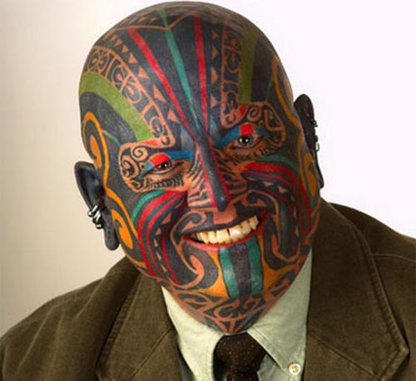
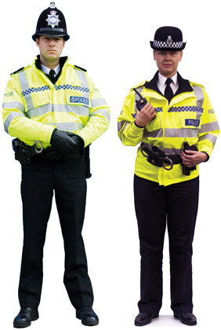
Notes:
Talking about skin colour – what about this man? Could he work for us?
Which officer is more senior? Who would do a better job? What if you were sexually harassed? What if someone was violent? Community bias
Allports scale?
Disparaging terms (negative language/name calling, jokes)
Avoidance (isolation, neglect)
Discrimination (policies and processes)
Physical attack
Execution (expulsion)

Slide 9
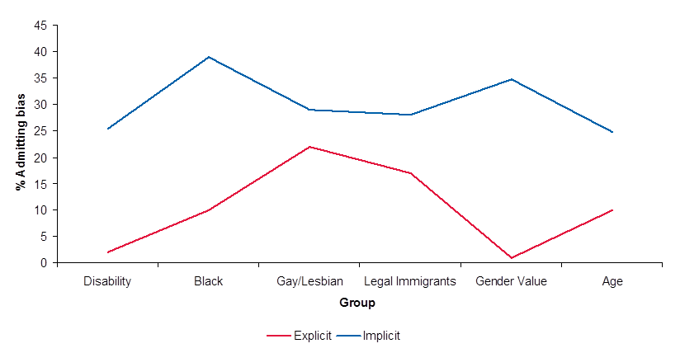
Explicit vs. Implicit Bias
(Abrams & Houston 2006) Jones, P 2005 Implicitly 3000
Notes:
Five Types of Bias:
Explicit vs. Implicit – what we say and what we think ~ inconsistent
Affinity – they’re like me ~ favoured
Confirmation – we only observe information/behaviour that confirms our first thoughts (bias) ~ self-fulfilling prophecy
Comparison – Differences are accentuated ~ comparing to oneself

Slide 10
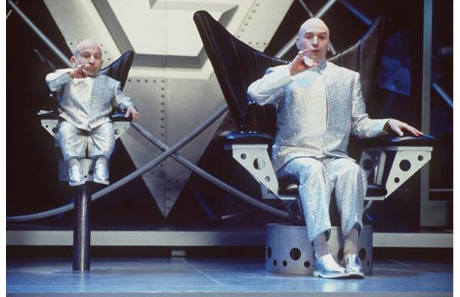
Affinity Bias
Notes:
Affinity – they’re like me ~ favoured
We are all preferentially biased to people who we perceive to be like us, people we have a bond with, people who have similar traits to ourselves. Unconscious patterns can play out in ways that are so subtle they are hard to spot. So lets imagine a scenario. Imagine, for example, that you are conducting an interview with two people, we’ll call them Rebecca and John.
Example: John reminds you of yourself when you were younger, or of someone you know and like. You have that sense of familiarity or “chemistry.” You instantly like him, and though you are not aware of why, your mind generates justifications. (“He seems down to earth, a good team player etc”)
You ask him the first interview question and he stumbles and fluffs it up. You give him the benefit of the doubt. After all, it’s an interview, you think. He’s nervous. Because you feel an affinity toward him, you pick up on his nervousness. You want to put him at ease. You say, “John, I know it’s an interview, but there’s nothing to be nervous about. Take a breath and let me ask the question again.” John is eloquent this time and he’s off and running to a great interview. The whole interaction took four seconds, yet it made a world of difference.
Then you sit down with Rebecca. There is nothing negative about her, just no real connection. It is a very “business-like” interaction. You ask her the first question and she’s a little nervous too, but this time you don’t pick up on it. This interview moves forward, but not quite as well as John’s. The next day a co-worker asks you how the interviews went, and you respond: “John was great…open, easy to talk to. I think he’ll be great with clients.” And your reply about Rebecca? “She’s okay, I guess.”
Your perceptions about the interviews constitute your reality. You probably don’t even remember the four-second interaction that changed John’s entire interview. In fact, if somebody asks you, you would swear you conducted the interviews exactly the same way with the same questions. Your own role in influencing the outcomes was completely invisible to you, driven by your background of comfort with John.

Slide 11
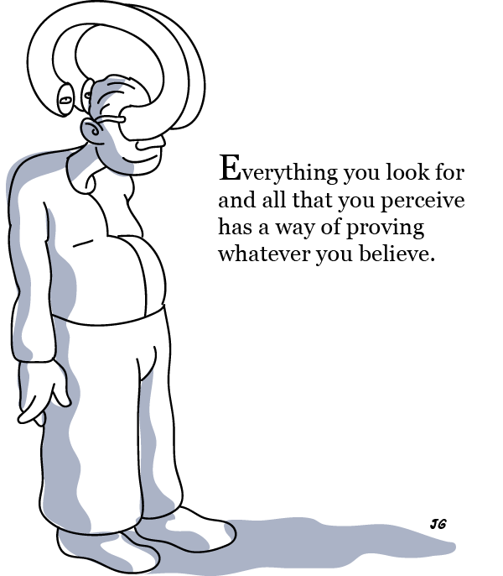
Confirmational Bias
Notes:
World View?
We tend to make decisions in a way that is designed to confirm beliefs that we already have. This phenomenon is called “confirmational behaviour” and occurs unconsciously in both positive and negative ways. Our thoughts and decisions are constantly influenced by widely held stereotypes. Lets exaggerate a scenario to show how it may work. Imagine, for example, that you have an ingrained unconscious belief that “young black men are lazy” (as untrue and damaging stereotype as this might be).
How do you manage a young black man who reports to you?
Are you more or less likely to invest in developing him? Are you more or less likely to put him on high level assignments?
Are you more or less likely to introduce him to significant players in the organisation? When he makes a mistake, are you more or less likely to accept his explanation?
The answers are apparent. As a result of your stereotype and consequent actions which may not be conscious, the employee would become frustrated, he may lose motivation. He might leave, but, then again, having experienced the same kind of treatment in other places, he might believe that this is “just the way it is” and stay while “going through the motions” on his job. In other words, he would behave in a way that appears “lazy” to you, further confirming your dangerous stereotype and prejudice.

Slide 12
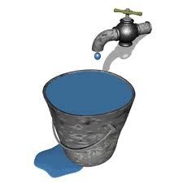
So, how do I recognise it?
Micro-biases or behaviours (more or less eye contact, compliments, lunches)
Assumptive deselection
Favourable offerings of work
Exclusionary Banter
Gossip?
Notes:
Flipcharts on the wall
What are the positive stereotypes about these groups – write on the paper...
Japanese woman
Amputee (leg – if asked...)
Gay man
Buddhist
Scaffolder
What if you are one of these but you do not possess these attributes? Is the bias still positive?
Dripping tap analogy

Slide 13
What are the consequences?
Unfair recruitment and progression (CV sift)
Unbalanced assigning of work and opportunities
Dissatisfied and underrepresented workforce
Preferential training, mentoring, sponsorship
One-sided performance reviews and policies
Undiverse marketing campaigns and products
Neglected customers
Notes:
(http://www.youtube.com/watch?v=nFbvBJULVnc – CNN – subconscious racial bias in children)
Opportunity Now research, shows how biases play out in a powerful and negative way in the workplace:
Amongst the top ten barriers to progression cited by women, several specifically relate to the behaviours and biases they experience from colleagues, managers and leaders that exclude them from being able to fully realise their potential. Particularly around the :
Stereotyping and preconceptions of women’s aspirations for promotion
Lack of mentoring
Women are not given the same opportunities as men to work in high risk/high reward areas
Women are excluded from informal networks of communication and influence
In addition Catalyst coined the term Think-Manager-Think-Male perspective which refers to how perceptions of leadership
are stereotypically masculine—as either predominantly associated with men (higher percentages of men than women in leadership
positions) or with task-oriented traits (perceptions of men as “doers” and action oriented). Researchers have found that stereotypes often leave women in a double bind where their behaviours and characteristics are either defined as too feminine or too masculine. Catalyst has also found that women who try to conform to traditional—that is, masculine—leadership behaviours are damned if they do and doomed if they don’t.
What’s in a Name? RfO Blog - http://raceforopportunity.bitc.org.uk/blogwhatsinaname

Slide 14
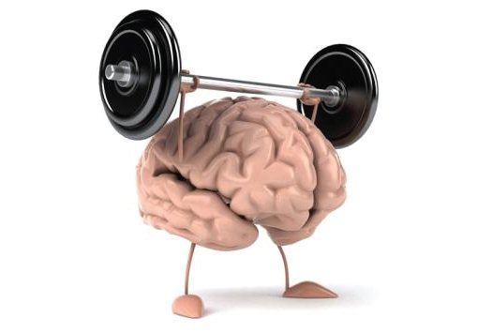
How do I manage it?
Awareness is key – we are biased... Amber Zones!
Question yourself – why do I think this?
Question others – what do they think?
Educate yourself / colleagues
Do Something Different
Notes:
Amber Zones
When we are tired, hungry, dehydrated
When under emotional pressure and stress
When experiencing cognitive over-load
Time of change (all of the above)
Do Something Different and Opening Minds E-Learning
After the first e-learning programme, a group of staff was asked to sign up to a voluntary, twice-weekly email prompting them to think differently about others. Of those that received the email, 83% felt they were more open minded about their peers, compared with 55% of those who had completed the training but didn't receive the prompts

Slide 15
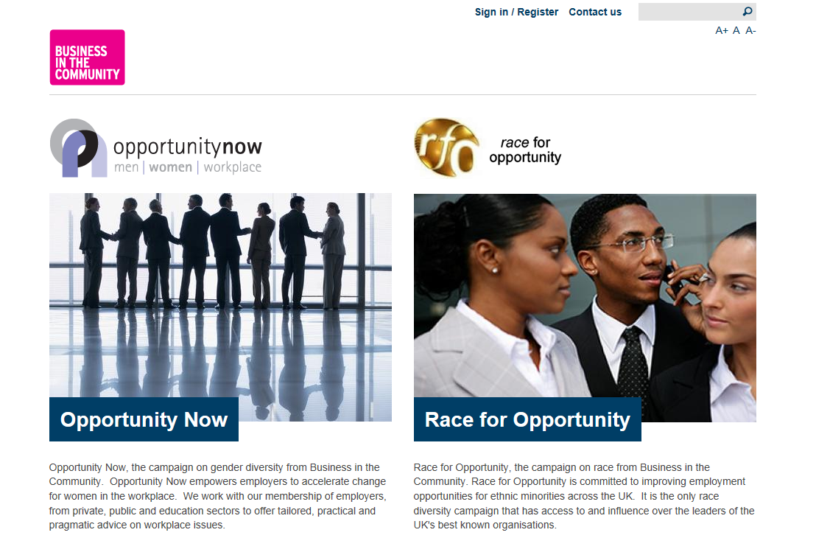
Further Information
Web www.bitcdiversity.org.uk
BITC Diversity Channel
@OpportunityNow1
@RaceforOpps
Contact Mohamed.kebbay@bitc.org.uk

