Slide 1
Weekly Tri-Partite Performance Report
21st December– 27th December 2015

Slide 2
Winter resilience
A8 performance – daily comparison 2014/15 to 2015/16.
Updated for actual hours and A8% data (light blue) and latest forecast (dark blue).
The A8% forecast is based on forecast hours and opening activity volumes. While activity has been lower than expectations for the last few days it still remains unclear if this will continue. It is prudent to maintain a pessimistic position.
Performance remains in excess of forecast.

Slide 3
Winter resilience – Hours (week ending 27th December)
Hours continue to perform largely in line with expectation.
Expected hours across the Xmas period were marginally higher than reported last week.
The Overtime has continued to be stronger across the period up to 30th December. Volumes for this period, and across into the first week in January continue to improve, although the increase on New years Eve and New Years Day remains modest.
Work continues to encourage take up of overtime on these days and to optimise the spread across the 24 hour cycle. Cover on the night of 31st from 7pm through to 7am on the 01st is lower than desired. Work continues to increase cover across these specific times.
Staffing for the NY Event in central London is almost to plan.
HUB and EOC staffing levels are above plan
Cover is seen as good from 7am on the 01st which will assist in addressing stacked calls.
PAS exceeded plan over Xmas. This is not expected to be repeated at New Year.
NOTE:
Last weeks version of this page is included as the final slide in the pack for comparative purposes.
These figures exclude overtime in place for the Event in Central London.

Slide 4
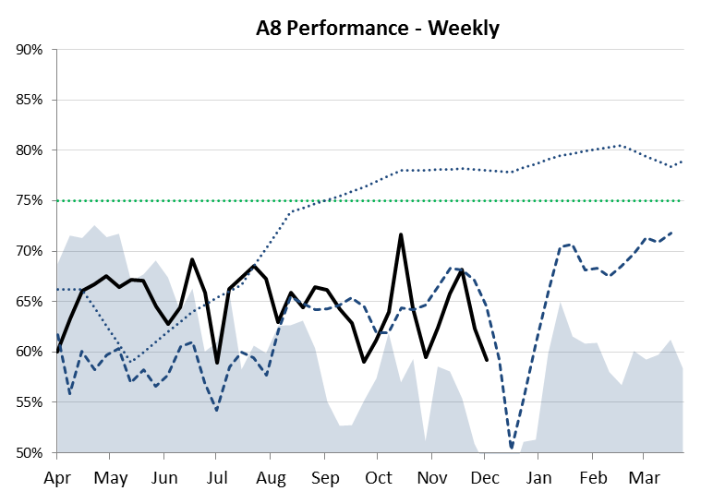
Performance Summary
Introduction
Overview
This pack sets out current weekly performance data for London Ambulance Service. As well as showing current performance for YTD, the pack also shows the previous years performance, future projected performance, and current performance targets.
In addition to the overarching performance data the pack also shows the elements which support Performance namely Demand, Capacity, Efficiency and Forecasting Rule. Each of these elements is compared against target and is broken down to constituent parts namely:
Demand = Calls, Incidents, Cat A & Cat C
Capacity = Substantive, Overtime, PAS/VAS
Efficiency = JCT & MAR
As well as the headline numbers for each element the pack also looks at the various performance improvement projects supporting each element namely:
Demand = NETS, taxis
Capacity = Sickness, OOS, A to A (recruitment)
Efficiency = Full JCT
The following key is used throughout this document unless otherwise stated
14/15 actual data
15/16 actual data
Business case trajectory
Revised trajectory (Oct 15)
National target

Slide 5
Contents
Page No
Heading
6 A8 Performance
7 Other Performance
8 Demand
9 Demand Projects
10 Capacity
11 Capacity Projects
12 Efficiency
13 CCG position
14 Hospital Conveyance
15-20 Response Curves times
21 Performance overview
22-23 Data sheets

Slide 6
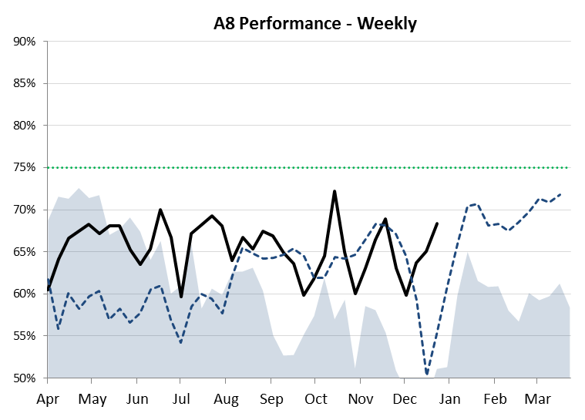
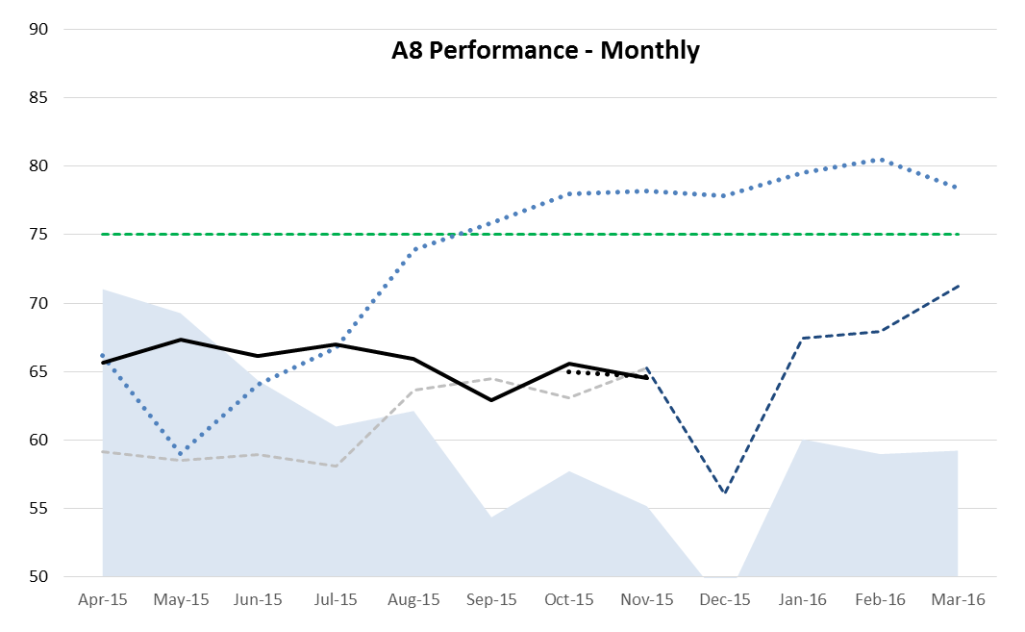
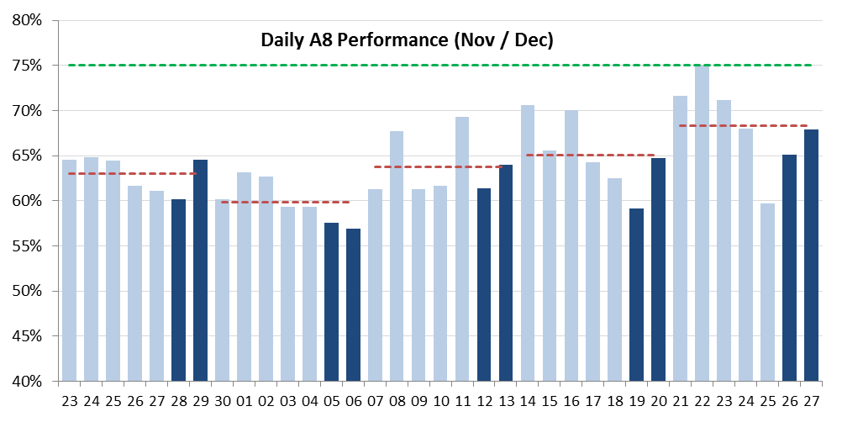
A8 Performance
Category A performance returned 68.33% last week. This was considerably above the Performance overview forecasted position of 58% and over 17% higher than same week last financial year.
Influencing factors - Whilst being the 18th busiest week ever for the LAS on Category A demand, our expected total demand levels were below predicted forecasts. Therefore even with a reduced frontline staffing position we were able to return performance above the revised trajectory.
We expect this week to be challenging owing to New Years eve. But we are expecting the next 4wks to be on track or above trajectory. However if our demand increases significantly we will then track against the revised lower performance.

Slide 7
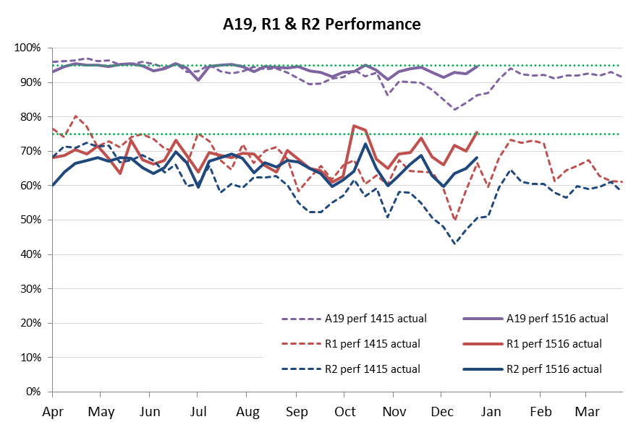
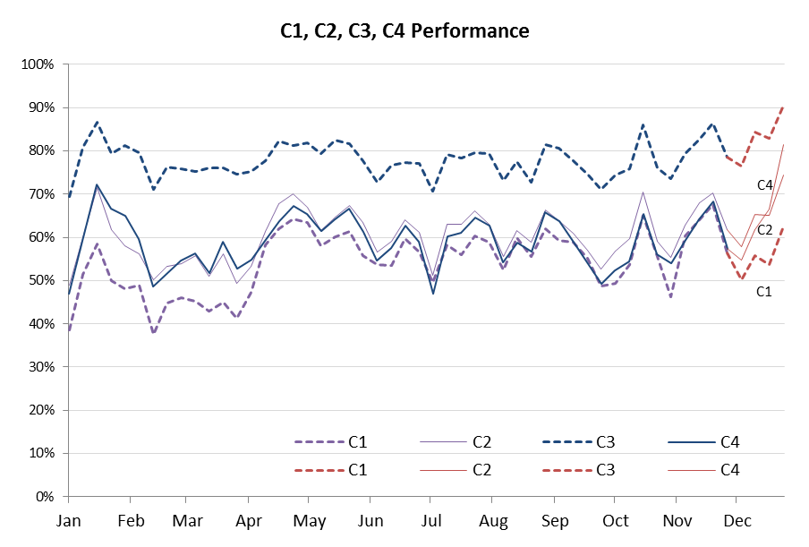
Other Performance
The Cat A metrics (Red 1, Red 2 & A8 / A19 Minutes) have improved last week by 2 – 5%. They all continue to track well above last years actuals. They are also in line with the revised trajectory for the month.
The Cat C weekly (C1-C4) performance also saw a marked improvement, with increases ranging from 8-15%. The year to date position for all Cat C targets continues to show significant improvement.
We are mindful of winter pressures and New Years day impacting on performance as demand increases.

Slide 8
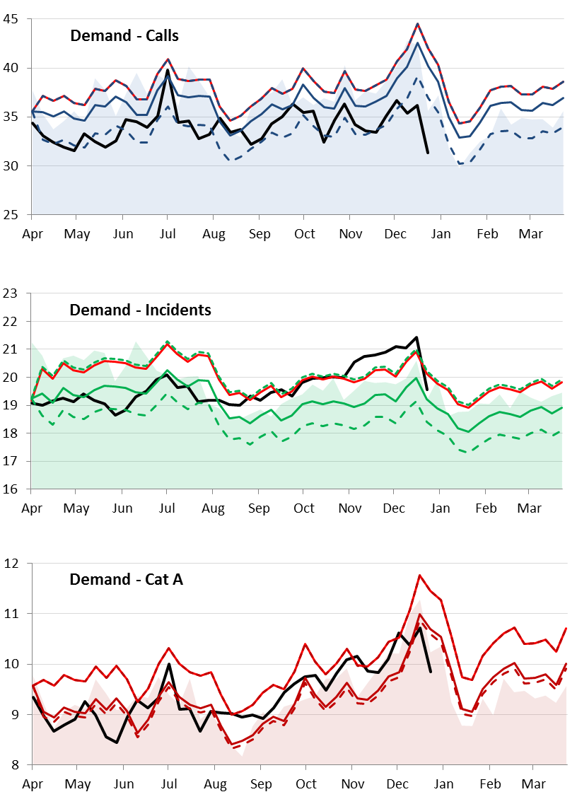
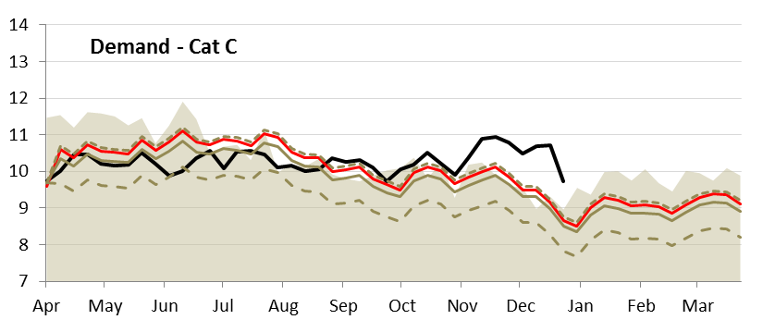
DEMAND
Calls fell last week at 31,364 (down 4,827calls). While this is below the lower trajectory we are still expecting this position to climb over this week as we approach New Year.
Overall incident volumes also fell sharply last week (down 1,855 incidents), now just below the higher contracted levels.
This pattern was also reflected in both the Cat A incidents and C incidents last week, both down 867 and 988 incidents respectively. Cat C even with the drop continues to track well above the higher trajectory. Cat A is now below all trajectories. This was still the 18th busiest ever week for the LAS.
 | Key | Calls | Inc. | Cat A | Basis
High | Short Dash | 4.6% | 5% | 7% | contract
Medium | Solid Line | 0% | 0% | 0% | 14/15 actual
Low | Long Dash | - 8% | -4% | -1% | Q1 actual

Slide 9
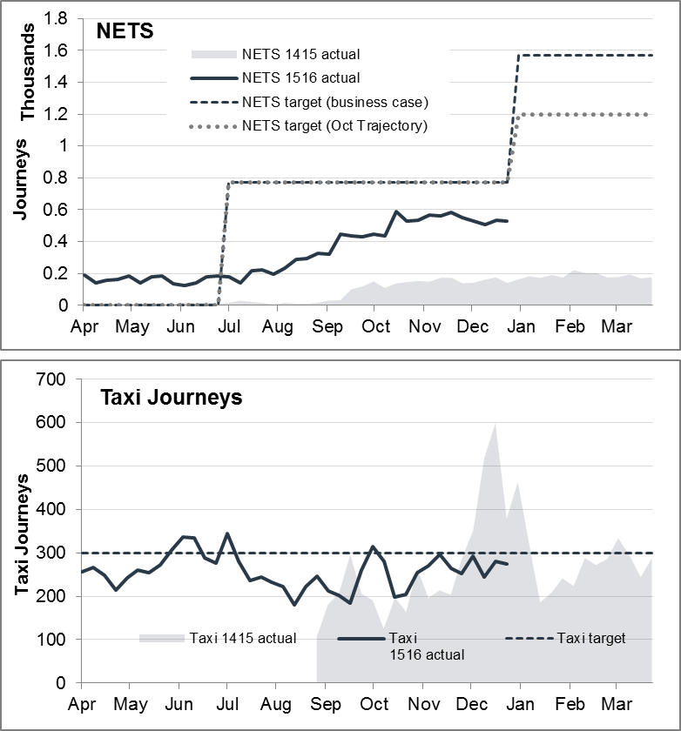
Demand Projects
Both modes of Alternative Transport reported a marginal decline in the number of journeys completed last week, Taxi journeys down from 293 to 275. Nets down from 536 to 528..
ED conveyance by NET transportation increased from an already high level to 86% (average 82% for the 12 week period), compared to a trust average of circa 65-66%. Only 3.6% of incidents being conveyed to other departments e.g. UCC, WIC, ACUTE etc. Further review and analysis of calls is required to understand the cause of the high conveyance rate to ED’s.
Daily calls on the management of the NETS activity continue.
The LAS is still looking at the following areas:
A full review of the auto transfer determinants.
Stronger emphasis on the communication and publicity required to increase the profile of Cold 2 transport options
Increasing the staffing within the control room on the health care professional desk, these staff are due to start in the new year

Slide 10
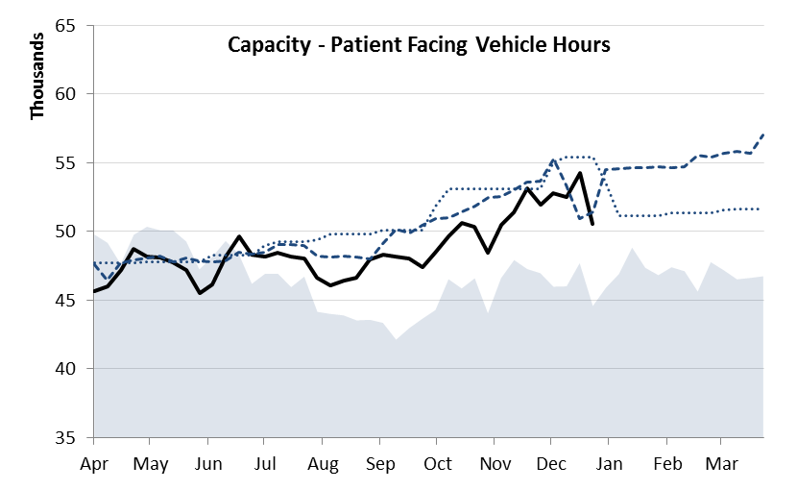
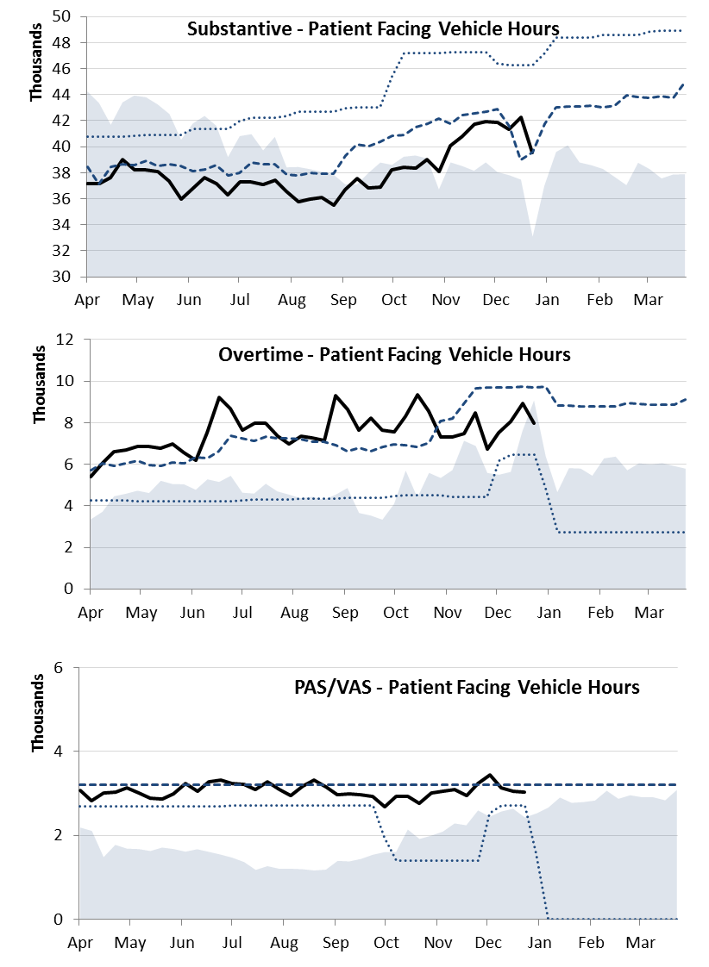
Capacity
Overall Capacity (PFVH) fell significantly last week to 50,557hrs (lowest weekly level in 7 weeks), now just below planned trajectory. Substantive hours fell last week, down 2,691hrs and is now just on trajectory. This is in line with forecasted position for Christmas week.
Overtime hours, while below the revised trajectory, fell last week realising an decrease of 969hrs on the previous week.
PAS/VAS dropped last week, down 27hrs, at 3,031hrs VH per week.

Slide 11
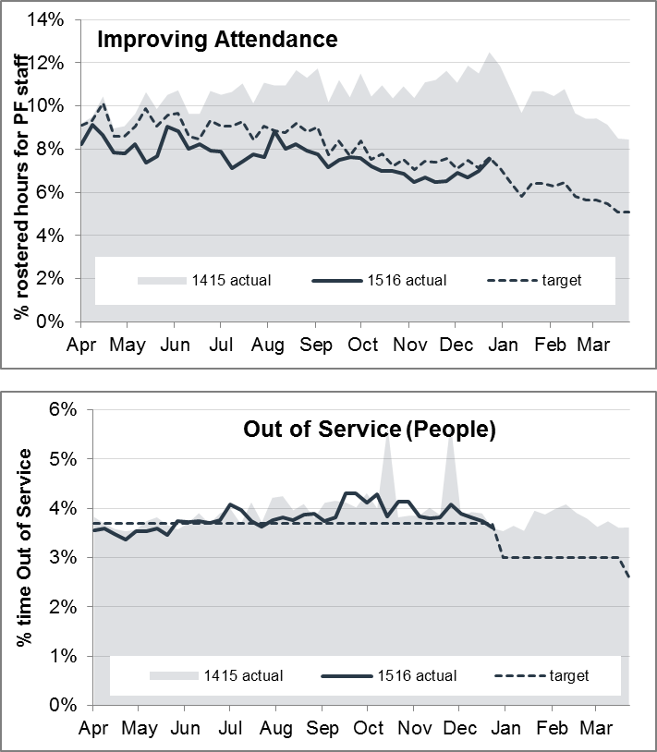
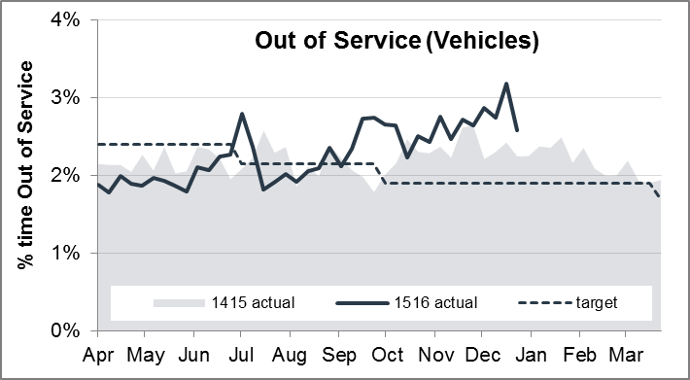
Capacity Projects
The sickness rate continues to exhibit the marginal increase experienced in the previous week, however is still performing favourably against the target. This is not unusual given seasonal pressures.
A marked improvement for Both Out of Service projects has continued.
Anecdotally, the OOS (people) workstream may be benefiting from having all Clinical Team Leaders on clinical shifts during the holiday period which reduces the proportion of staff who become Singles, and the OOS (vehicles) may be seeing a reduction with the allocated fleet to crews programme completed pan-London and therefore management of the fleet may be stabilising.

Slide 12
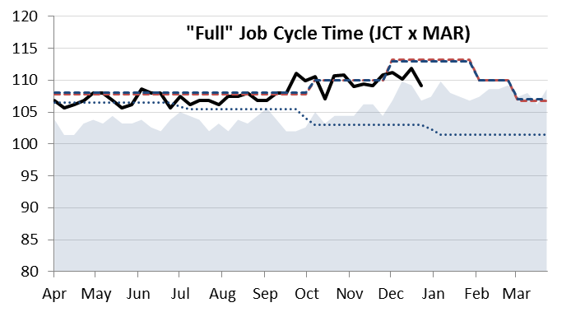
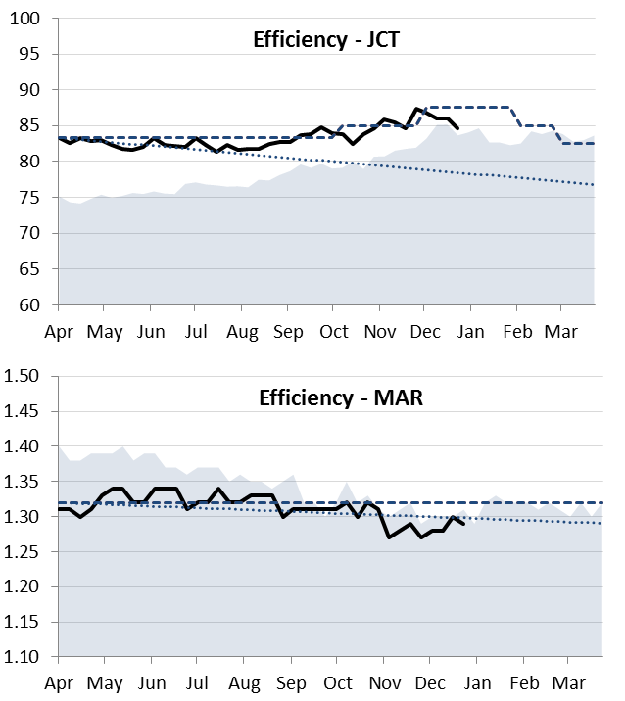
Efficiency
Overall Job Cycle (FULL) fell last week to 109.2 minutes last week, and is still tracking below the revised trajectory.
Overall Job Cycle improved last week, to 85 minutes, continuing below trajectory.
MAR saw a decrease last week to just over 1.29 vehicles per incident. This combined with the overall JCT improvement, caused the Full JCT measurement to fall.

Slide 13
CCG A8 Performance
 | * Please note current month, quarter and YTD includes data up to |  |  |  | 27/12/2015
 |  |  | Q1 |  |  | Q2 |  |  | Q3 |  |  |  |  |  |  |  |  | Cumulative CCG A8 Performance
 | CCG cluster | CCG name | Apr-15 | May-15 | Jun-15 | Jul-15 | Aug-15 | Sep-15 | Oct-15 | Nov-15 | Dec-15 | YTD |  | 2015/16 QTR 1 | 2015/16 QTR 2 | 2015/16 QTR 3 |  | Apr-15 | May-15 | Jun-15 | Jul-15 | Aug-15 | Sep-15 | Oct-15 | Nov-15 | Dec-15
 | East Central | NHS City and Hackney CCG | 67.63% | 69.00% | 69.97% | 66.82% | 68.37% | 63.19% | 65.97% | 65.56% | 64.91% | 66.79% |  | 68.88% | 66.13% | 65.50% |  | 67.63% | 68.31% | 68.88% | 68.32% | 68.33% | 67.47% | 67.24% | 67.02% | 66.79%
 |  | NHS Newham CCG | 68.88% | 71.91% | 71.02% | 68.14% | 65.36% | 61.92% | 68.18% | 67.93% | 67.46% | 67.86% |  | 70.62% | 65.15% | 67.87% |  | 68.88% | 70.42% | 70.62% | 69.99% | 69.05% | 67.86% | 67.91% | 67.91% | 67.86%
 |  | NHS Tower Hamlets CCG | 70.74% | 73.44% | 71.26% | 67.24% | 70.85% | 64.49% | 71.48% | 71.46% | 69.25% | 70.02% |  | 71.81% | 67.51% | 70.79% |  | 70.74% | 72.08% | 71.81% | 70.62% | 70.66% | 69.63% | 69.91% | 70.11% | 70.02%
 |  | NHS Waltham Forest CCG | 58.49% | 60.72% | 61.83% | 59.52% | 59.64% | 60.12% | 61.15% | 57.95% | 59.78% | 59.89% |  | 60.35% | 59.75% | 59.58% |  | 58.49% | 59.61% | 60.35% | 60.14% | 60.04% | 60.05% | 60.21% | 59.90% | 59.89%
 | East Central | Total | 66.73% | 69.10% | 68.79% | 65.72% | 66.10% | 62.50% | 66.95% | 65.90% | 65.47% | 66.36% |  | 68.21% | 64.80% | 66.12% |  | 66.73% | 67.92% | 68.21% | 67.56% | 67.27% | 66.48% | 66.55% | 66.47% | 66.36%
 | North Central | NHS Barnet CCG | 58.23% | 59.20% | 54.21% | 58.12% | 52.23% | 51.08% | 57.95% | 57.42% | 56.39% | 56.10% |  | 57.22% | 53.83% | 57.27% |  | 58.23% | 58.73% | 57.22% | 57.46% | 56.36% | 55.46% | 55.85% | 56.07% | 56.10%
 |  | NHS Camden CCG | 74.41% | 74.36% | 73.67% | 74.40% | 75.33% | 72.62% | 72.19% | 71.94% | 71.98% | 73.40% |  | 74.14% | 74.15% | 72.04% |  | 74.41% | 74.39% | 74.14% | 74.21% | 74.44% | 74.14% | 73.83% | 73.58% | 73.40%
 |  | NHS Enfield CCG | 61.64% | 62.22% | 63.01% | 59.92% | 60.12% | 58.97% | 63.01% | 56.15% | 55.99% | 60.08% |  | 62.29% | 59.68% | 58.33% |  | 61.64% | 61.93% | 62.29% | 61.70% | 61.40% | 61.01% | 61.31% | 60.61% | 60.08%
 |  | NHS Haringey CCG | 58.09% | 62.07% | 59.31% | 59.03% | 58.39% | 57.61% | 57.60% | 58.17% | 53.10% | 58.15% |  | 59.81% | 58.36% | 56.35% |  | 58.09% | 60.06% | 59.81% | 59.61% | 59.38% | 59.09% | 58.86% | 58.77% | 58.15%
 |  | NHS Islington CCG | 67.81% | 68.85% | 70.79% | 68.26% | 65.43% | 66.23% | 67.30% | 67.37% | 62.28% | 67.13% |  | 69.18% | 66.67% | 65.75% |  | 67.81% | 68.36% | 69.18% | 68.93% | 68.22% | 67.88% | 67.79% | 67.73% | 67.13%
 | North Central | Total | 63.61% | 64.88% | 63.75% | 63.64% | 61.93% | 60.79% | 63.45% | 61.77% | 59.69% | 62.60% |  | 64.09% | 62.14% | 61.68% |  | 63.61% | 64.26% | 64.09% | 63.97% | 63.56% | 63.10% | 63.15% | 62.97% | 62.60%
 | North East | NHS Barking and Dagenham CCG | 65.08% | 70.35% | 68.45% | 67.24% | 62.72% | 57.18% | 65.61% | 61.35% | 60.72% | 64.26% |  | 68.01% | 62.48% | 62.51% |  | 65.08% | 67.79% | 68.01% | 67.81% | 66.75% | 65.19% | 65.26% | 64.73% | 64.26%
 |  | NHS Havering CCG | 68.74% | 74.71% | 71.20% | 71.65% | 69.21% | 64.79% | 68.72% | 66.69% | 63.11% | 68.64% |  | 71.51% | 68.55% | 66.23% |  | 68.74% | 71.67% | 71.51% | 71.55% | 71.06% | 69.97% | 69.78% | 69.35% | 68.64%
 |  | NHS Redbridge CCG | 61.31% | 62.68% | 63.54% | 63.88% | 60.62% | 58.59% | 66.20% | 62.54% | 64.41% | 62.66% |  | 62.51% | 61.05% | 64.36% |  | 61.31% | 62.00% | 62.51% | 62.85% | 62.41% | 61.78% | 62.43% | 62.44% | 62.66%
 | North East | Total | 64.88% | 68.84% | 67.53% | 67.51% | 64.16% | 60.32% | 66.91% | 63.61% | 62.81% | 65.15% |  | 67.09% | 64.03% | 64.45% |  | 64.88% | 66.87% | 67.09% | 67.20% | 66.58% | 65.53% | 65.74% | 65.45% | 65.15%
 | North West | NHS Brent CCG | 60.55% | 66.25% | 63.00% | 63.09% | 60.82% | 59.33% | 60.99% | 62.14% | 63.62% | 62.16% |  | 63.26% | 61.10% | 62.19% |  | 60.55% | 63.40% | 63.26% | 63.22% | 62.71% | 62.14% | 61.96% | 61.98% | 62.16%
 |  | NHS Harrow CCG | 63.31% | 65.53% | 63.08% | 65.03% | 61.25% | 59.29% | 67.69% | 62.69% | 62.65% | 63.40% |  | 63.97% | 61.81% | 64.41% |  | 63.31% | 64.42% | 63.97% | 64.24% | 63.62% | 62.86% | 63.62% | 63.49% | 63.40%
 |  | NHS Hillingdon CCG | 68.31% | 69.60% | 65.70% | 70.28% | 68.70% | 65.93% | 67.27% | 66.09% | 70.19% | 67.98% |  | 67.88% | 68.29% | 67.79% |  | 68.31% | 68.96% | 67.88% | 68.47% | 68.52% | 68.09% | 67.96% | 67.71% | 67.98%
 | North West | Total | 64.16% | 67.38% | 64.04% | 66.12% | 63.82% | 61.75% | 64.84% | 63.74% | 65.88% | 64.62% |  | 65.20% | 63.89% | 64.79% |  | 64.16% | 65.77% | 65.20% | 65.43% | 65.10% | 64.53% | 64.58% | 64.47% | 64.62%
 | South East | NHS Bexley CCG | 64.76% | 69.92% | 66.96% | 67.26% | 64.03% | 64.92% | 65.66% | 62.05% | 62.99% | 65.33% |  | 67.20% | 65.42% | 63.56% |  | 64.76% | 67.31% | 67.20% | 67.22% | 66.59% | 66.29% | 66.19% | 65.62% | 65.33%
 |  | NHS Bromley CCG | 60.18% | 64.98% | 63.40% | 66.64% | 64.88% | 61.87% | 61.81% | 61.05% | 59.65% | 62.67% |  | 62.86% | 64.39% | 60.86% |  | 60.18% | 62.58% | 62.86% | 63.80% | 64.02% | 63.64% | 63.36% | 63.05% | 62.67%
 |  | NHS Greenwich CCG | 72.07% | 70.03% | 71.02% | 72.66% | 68.94% | 64.79% | 67.89% | 66.59% | 65.57% | 68.80% |  | 71.03% | 68.84% | 66.71% |  | 72.07% | 71.03% | 71.03% | 71.46% | 70.94% | 69.90% | 69.60% | 69.20% | 68.80%
 |  | NHS Lambeth CCG | 69.93% | 69.94% | 71.06% | 71.83% | 71.47% | 69.43% | 68.37% | 68.82% | 70.30% | 70.12% |  | 70.32% | 70.94% | 69.10% |  | 69.93% | 69.93% | 70.32% | 70.71% | 70.87% | 70.64% | 70.29% | 70.10% | 70.12%
 |  | NHS Lewisham CCG | 64.20% | 63.07% | 61.70% | 66.28% | 65.17% | 62.52% | 64.19% | 63.32% | 64.07% | 63.83% |  | 62.98% | 64.68% | 63.86% |  | 64.20% | 63.63% | 62.98% | 63.82% | 64.08% | 63.82% | 63.88% | 63.81% | 63.83%
 |  | NHS Southwark CCG | 71.80% | 74.45% | 71.35% | 70.61% | 73.65% | 68.08% | 68.61% | 68.45% | 69.59% | 70.72% |  | 72.53% | 70.83% | 68.87% |  | 71.80% | 73.17% | 72.53% | 72.03% | 72.37% | 71.66% | 71.21% | 70.85% | 70.72%
 | South East | Total | 67.32% | 68.91% | 67.90% | 69.44% | 68.53% | 65.46% | 66.23% | 65.32% | 65.61% | 67.17% |  | 68.05% | 67.82% | 65.72% |  | 67.32% | 68.13% | 68.05% | 68.40% | 68.43% | 67.93% | 67.67% | 67.36% | 67.17%
 | South West | NHS Croydon CCG | 61.50% | 60.51% | 57.72% | 62.12% | 58.43% | 58.06% | 61.18% | 59.21% | 59.09% | 59.76% |  | 59.90% | 59.56% | 59.82% |  | 61.50% | 60.99% | 59.90% | 60.48% | 60.07% | 59.73% | 59.95% | 59.85% | 59.76%
 |  | NHS Kingston CCG | 70.83% | 74.00% | 70.10% | 77.48% | 73.99% | 68.39% | 69.58% | 73.61% | 73.86% | 72.44% |  | 71.64% | 73.38% | 72.32% |  | 70.83% | 72.40% | 71.64% | 73.13% | 73.28% | 72.49% | 72.05% | 72.26% | 72.44%
 |  | NHS Merton CCG | 73.53% | 73.84% | 73.75% | 77.93% | 75.97% | 69.52% | 71.97% | 72.99% | 76.91% | 74.01% |  | 73.71% | 74.45% | 73.87% |  | 73.53% | 73.69% | 73.71% | 74.78% | 75.03% | 74.09% | 73.75% | 73.64% | 74.01%
 |  | NHS Richmond CCG | 65.80% | 66.45% | 63.65% | 67.76% | 67.96% | 63.85% | 65.97% | 62.48% | 62.74% | 65.17% |  | 65.31% | 66.47% | 63.87% |  | 65.80% | 66.14% | 65.31% | 65.93% | 66.35% | 65.90% | 65.92% | 65.47% | 65.17%
 |  | NHS Sutton CCG | 69.14% | 69.07% | 69.36% | 68.06% | 70.18% | 65.51% | 63.94% | 69.33% | 67.92% | 67.96% |  | 69.19% | 67.81% | 67.03% |  | 69.14% | 69.10% | 69.19% | 68.92% | 69.17% | 68.50% | 67.75% | 67.97% | 67.96%
 |  | NHS Wandsworth CCG | 69.22% | 71.61% | 64.52% | 70.90% | 69.91% | 68.94% | 66.06% | 67.66% | 66.95% | 68.36% |  | 68.35% | 69.90% | 66.88% |  | 69.22% | 70.41% | 68.35% | 69.00% | 69.18% | 69.13% | 68.66% | 68.53% | 68.36%
 | South West | Total | 67.23% | 67.78% | 64.90% | 69.10% | 67.42% | 64.62% | 65.48% | 66.10% | 66.22% | 66.51% |  | 66.62% | 67.02% | 65.93% |  | 67.23% | 67.51% | 66.62% | 67.25% | 67.29% | 66.82% | 66.61% | 66.54% | 66.51%
 | West | NHS Central London (Westminster) CCG | 72.28% | 72.88% | 73.80% | 72.25% | 74.60% | 70.69% | 72.15% | 73.15% | 69.65% | 72.42% |  | 73.03% | 72.57% | 71.67% |  | 72.28% | 72.59% | 73.03% | 72.82% | 73.19% | 72.79% | 72.70% | 72.75% | 72.42%
 |  | NHS Ealing CCG | 57.03% | 58.60% | 60.24% | 62.81% | 58.11% | 53.45% | 58.94% | 56.22% | 60.00% | 58.37% |  | 58.65% | 58.08% | 58.38% |  | 57.03% | 57.82% | 58.65% | 59.70% | 59.39% | 58.36% | 58.45% | 58.16% | 58.37%
 |  | NHS Hammersmith and Fulham CCG | 65.90% | 68.65% | 64.50% | 69.26% | 70.75% | 65.28% | 70.30% | 71.81% | 70.48% | 68.65% |  | 66.39% | 68.42% | 70.87% |  | 65.90% | 67.27% | 66.39% | 67.15% | 67.90% | 67.45% | 67.90% | 68.43% | 68.65%
 |  | NHS Hounslow CCG | 61.81% | 59.45% | 58.96% | 62.64% | 62.85% | 60.06% | 61.85% | 59.25% | 59.79% | 60.71% |  | 60.02% | 61.83% | 60.31% |  | 61.81% | 60.59% | 60.02% | 60.69% | 61.12% | 60.94% | 61.09% | 60.83% | 60.71%
 |  | NHS West London (Kensington and Chelsea, Queen's Park and Paddington) CCG | 68.06% | 68.89% | 70.72% | 70.61% | 74.98% | 67.64% | 69.02% | 69.83% | 69.78% | 70.05% |  | 69.19% | 71.30% | 69.52% |  | 68.06% | 68.48% | 69.19% | 69.56% | 70.86% | 70.31% | 70.12% | 70.08% | 70.05%
 | West | Total | 64.63% | 65.30% | 65.63% | 67.34% | 68.05% | 62.85% | 65.87% | 65.16% | 65.21% | 65.58% |  | 65.20% | 66.11% | 65.42% |  | 64.63% | 64.97% | 65.20% | 65.75% | 66.24% | 65.67% | 65.70% | 65.63% | 65.58%
 | Grand Total |  | 65.62% | 67.34% | 66.11% | 67.01% | 65.94% | 62.88% | 65.59% | 64.55% | 64.34% | 65.48% |  | 66.36% | 65.29% | 64.84% |  | 65.62% | 66.49% | 66.36% | 66.53% | 66.41% | 65.82% | 65.78% | 65.62% | 65.48%
 | Cat A % within 8 mins or less
 | >=75%
 | 70%-75%
 | <70%

Slide 14
Hospital Conveyance
Hospital Conveyances - Non Blue Calls| Arrival at Hospital to Patient Handover| 21 Dec 15 - 27 Dec 15
##### | 27/12/2015
Over 15 min Rank | Hospital Site | Total Conveyances | Total Handover | Over 15min | 15min and under | % Over 15min | Ratio of Over 15min | Average Overrun Per Breach (Mins)
1 | North Middlesex | 512 | 446 | 350 | 96 | 78% | 3.65 | 13.2
2 | Queens, Romford | 583 | 504 | 335 | 169 | 66% | 1.98 | 9.6
3 | Kings College | 476 | 457 | 333 | 124 | 73% | 2.69 | 7.5
4 | St Georges, Tooting | 462 | 436 | 294 | 142 | 67% | 2.07 | 6.7
5 | Princess Royal, Farnborough | 390 | 378 | 287 | 91 | 76% | 3.15 | 9.1
6 | Croydon University Hospital (Mayday) | 444 | 424 | 280 | 144 | 66% | 1.94 | 7.1
7 | Northwick Park | 489 | 480 | 251 | 229 | 52% | 1.10 | 8.2
8 | Royal Free | 308 | 285 | 218 | 67 | 76% | 3.25 | 10.3
9 | Queen Elizabeth II, Woolwich | 517 | 507 | 206 | 301 | 41% | 0.68 | 5.5
10 | Hillingdon | 324 | 311 | 204 | 107 | 66% | 1.91 | 9.1
11 | St Marys, W2 | 348 | 321 | 203 | 118 | 63% | 1.72 | 6.8
12 | St Thomas' | 406 | 388 | 188 | 200 | 48% | 0.94 | 5.4
13 | Lewisham | 304 | 294 | 177 | 117 | 60% | 1.51 | 5.1
14 | Barnet | 340 | 332 | 168 | 164 | 51% | 1.02 | 25.1
15 | University College | 311 | 292 | 167 | 125 | 57% | 1.34 | 5.7
16 | Newham | 323 | 232 | 163 | 69 | 70% | 2.36 | 5.9
17 | St Helier | 306 | 302 | 162 | 140 | 54% | 1.16 | 6.9
18 | Whipps Cross | 336 | 252 | 148 | 104 | 59% | 1.42 | 8.6
19 | Whittington | 265 | 251 | 147 | 104 | 59% | 1.41 | 5.2
20 | Kingston | 308 | 304 | 141 | 163 | 46% | 0.87 | 4.5
21 | Ealing | 262 | 248 | 137 | 111 | 55% | 1.23 | 9.5
22 | Royal London (Whitechapel) | 344 | 263 | 111 | 152 | 42% | 0.73 | 7.9
23 | West Middlesex | 298 | 290 | 107 | 183 | 37% | 0.58 | 5.7
24 | Charing Cross | 233 | 222 | 105 | 117 | 47% | 0.90 | 5.6
25 | Chelsea & Westminster | 240 | 234 | 92 | 142 | 39% | 0.65 | 4.8
26 | King Georges, Ilford | 192 | 163 | 88 | 75 | 54% | 1.17 | 5.5
27 | Homerton | 207 | 164 | 44 | 120 | 27% | 0.37 | 3.8
58% of all recorded handovers were greater than 15 mins.
71% of the top 4 hospital’s handovers were longer than 15 minutes.
The hospitals occupying the top 3 remain the same as last week with a changeover within the ranking.
Barnet had the longest average overrun per breach at 25.1 mins followed by N. Middlesex (13.2 mins) and Royal Free(10.3 mins). Homerton remain the lowest with 3.8 mins.
Because of PAS/VAS or handover issues the Handover count will always be lower than the total conveyances.
PAS/VAS are currently trialling a new web page based solution which if successful, will roll out Pan London.

Slide 15
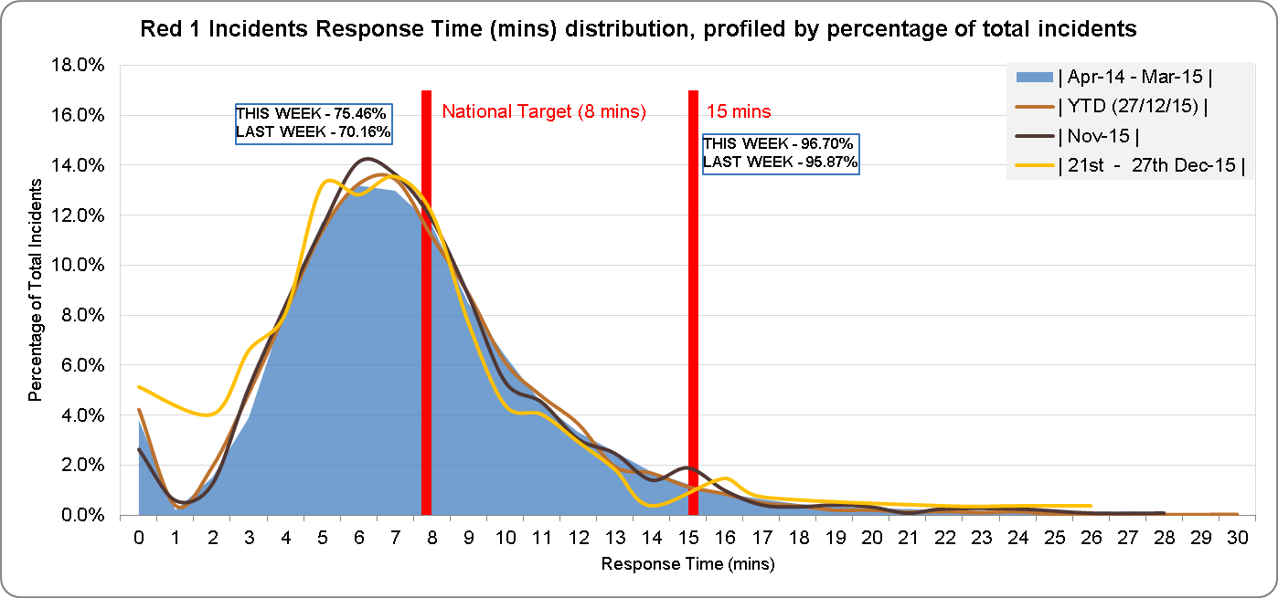
Red 1 Responses
Performance year to date is now better than 2014/15.
November and last week are also above last years stated position.

Slide 16
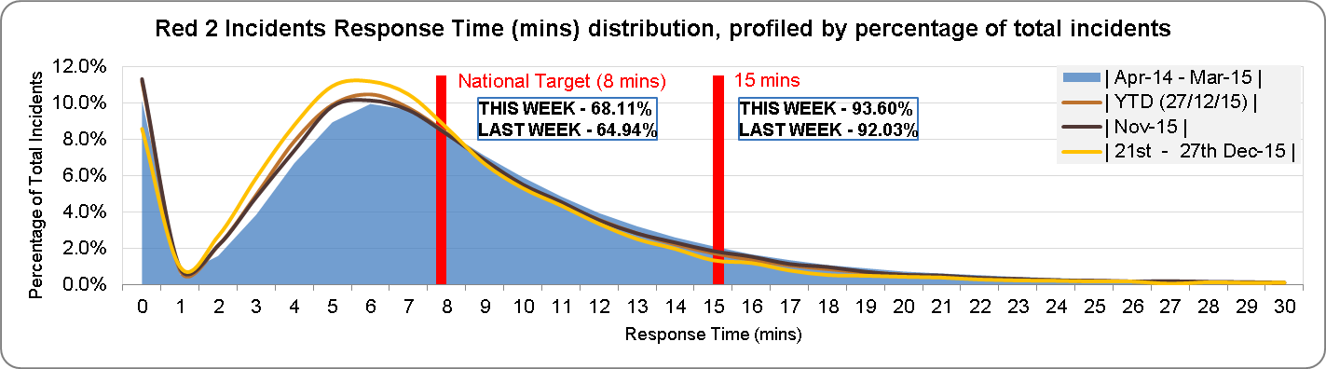
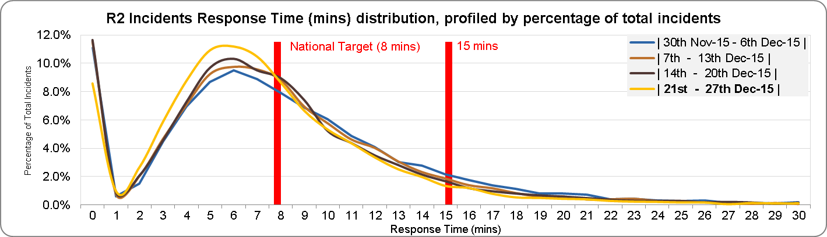
Red 2 Responses
Performance year to date continues to be better than with 2014/15.
November and last week are better than last years reported position.

Slide 17
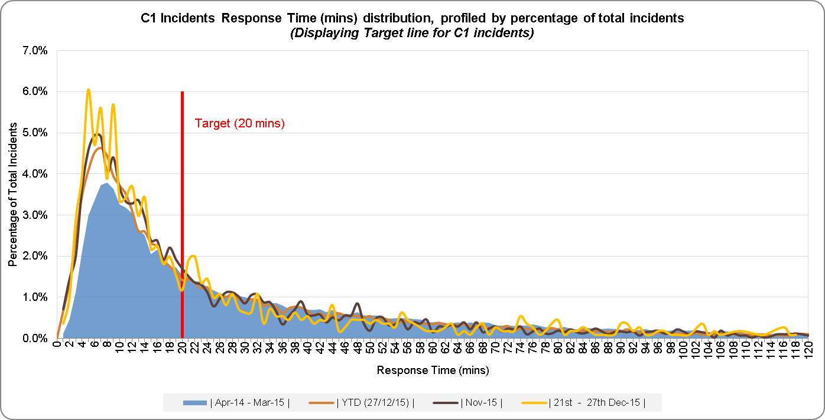
C1 Responses
Performance year to date is still better than 2014/15.
November is much improved on last years and the current YTD position
The week ending 27^{h} Dec shows a improved response position compared to last year.

Slide 18
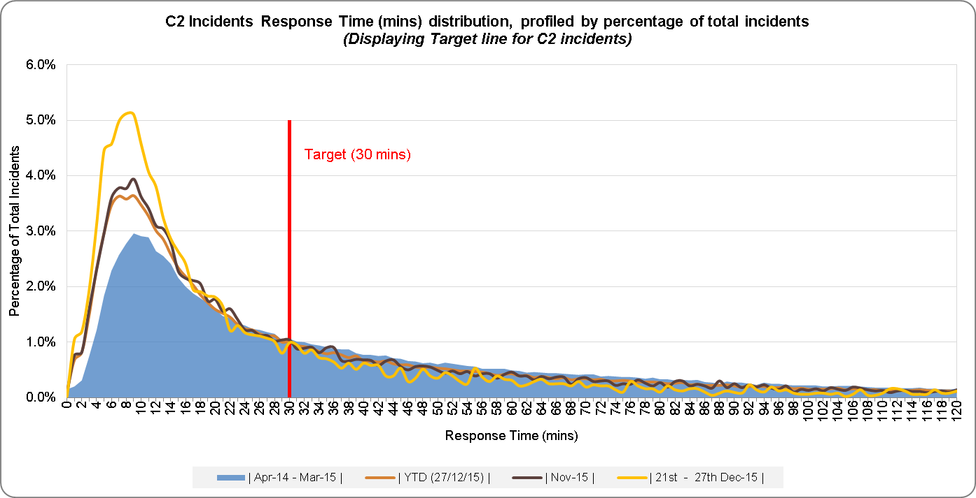
C2 Responses
The response profile for the YTD, last full month and last week continue to be much better than 2014/15 performance. Last week at 74.07%

Slide 19
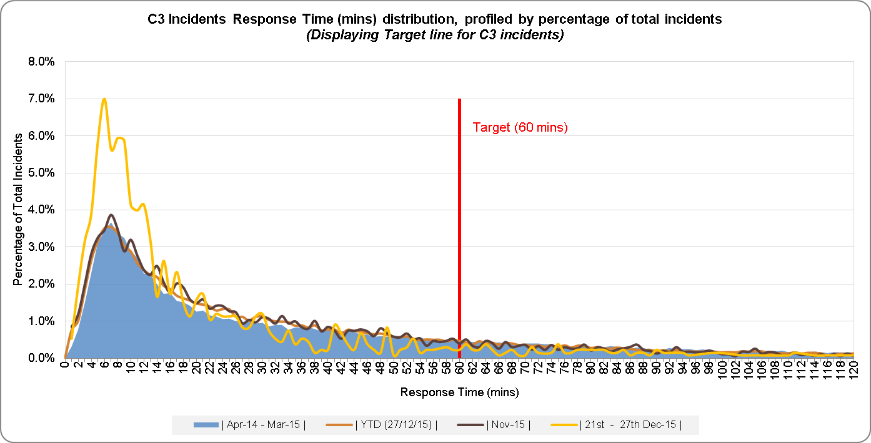
C3 Responses
The response profile for the YTD, last full month, last week continue to be better than 2014/15. Last week very high at 90.59%

Slide 20
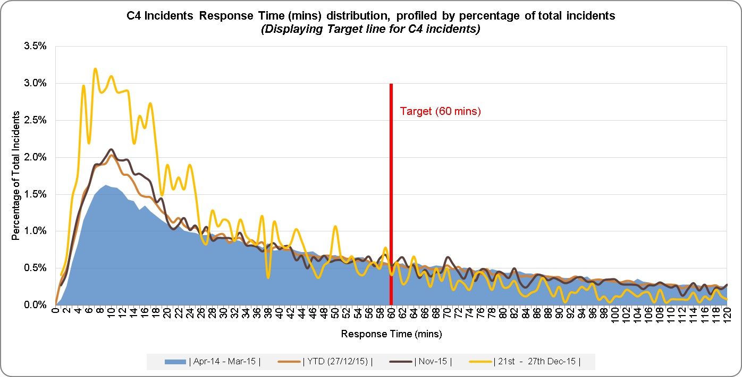
C4 Responses
The response profile for the YTD, last full month and last week are considerably better than 2014/15. Last week saw more incidents reached inside the target window compared to November. Last week returned 81.41%, 26% up on last year.

Slide 21
Performance Overview
Cat A actual was below forecast by 175 and total demand by 433.
A19 was above target with 96.14%
Red1% was above target with 88.31%
Projected Cat A 8 Min forecast for week ending 3rd January is 70%
Hear & Treat figures below the 2 day forecast by 27.3%.
5 second call answering above target with 99.62%

Slide 22
Daily data

Slide 23
Weekly data

Slide 24
Winter resilience – Hours (week ending 20th December)
Expected hours across the Xmas period are higher on every day bar one.
The mix of hours has seen some movement but overall predicted volumes are being generated.
The 26th December represents the one day where hours are below. Additional incentives are in place to attract more overtime on the 25th and 26th.
Up to the 23rd December performance has been stronger than expected from these hours due to lower than expected activity. It is unclear if activity will remain low.

